Slide 1
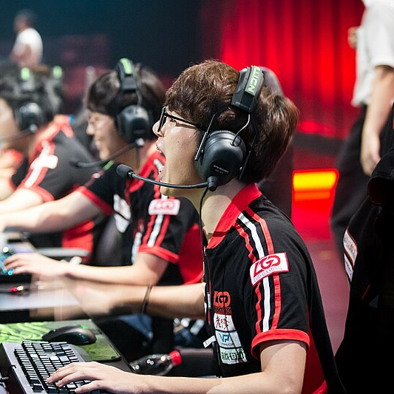
Investigating the Effect of Pressure on Heart Rate Variability (HRV) in Esports
Matthew R. Welsh
Emma Mosley, Sylvain Laborde, Melissa C. Day, Benjamin T. Sharpe & Phil D. J. Birch

Slide 2
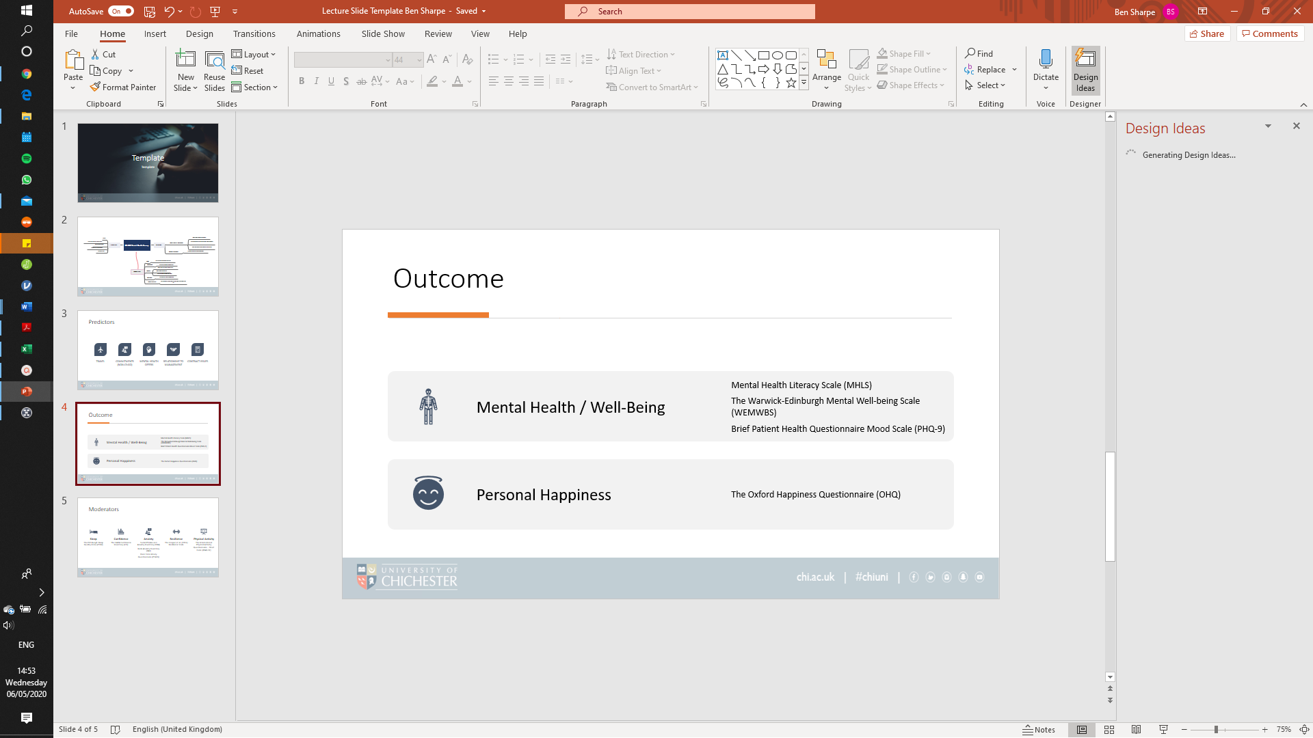
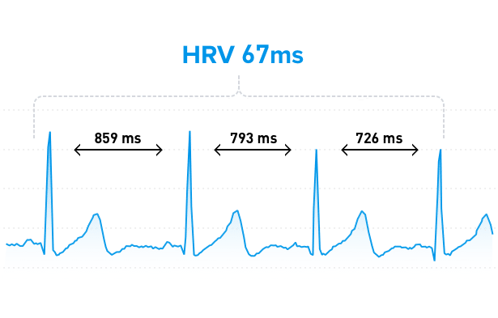
What is Heart Rate Variability (HRV)?
  HRV represents the changes in time between successive heartbeats and is also known as the inter-beat interval.
  (Berntson et al., 1997; Camm et al., 1996; Akselrod et al., 1981)

Slide 3
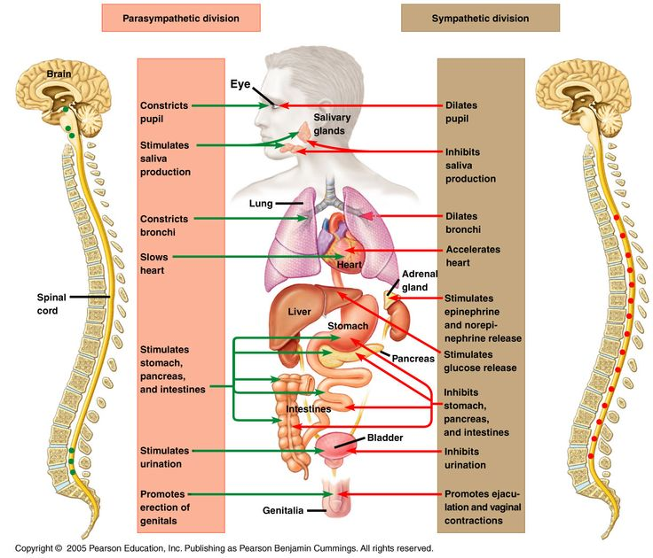
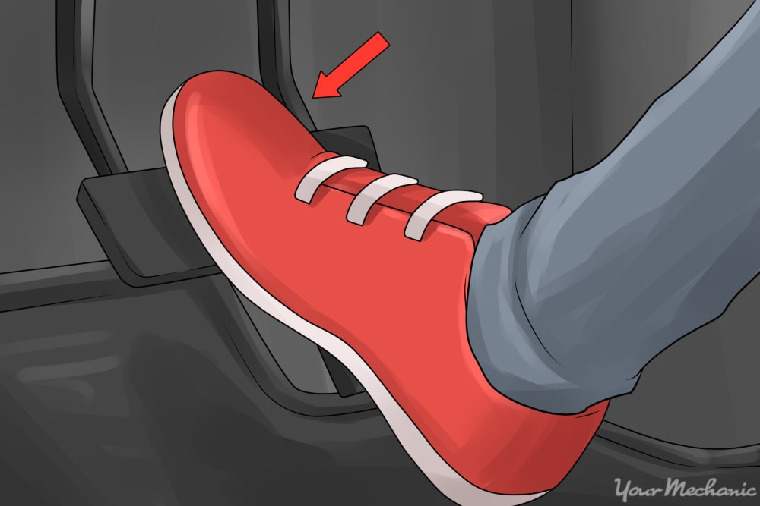
Vagally mediated HRV
Parasympathetic
Sympathetic
  vmHRV: RMSSD, HF(ms²)

Slide 4

Why is vmHRV useful?
  vmHRV reflects self-regulation:
  The psychophysiological processes that enable goal directed behaviour and maintains health.
  (Laborde et al., 2018; Thayer et al., 2009)
Aim: Determine if pressure causes a vmHRV response in FPS esports.

Slide 5

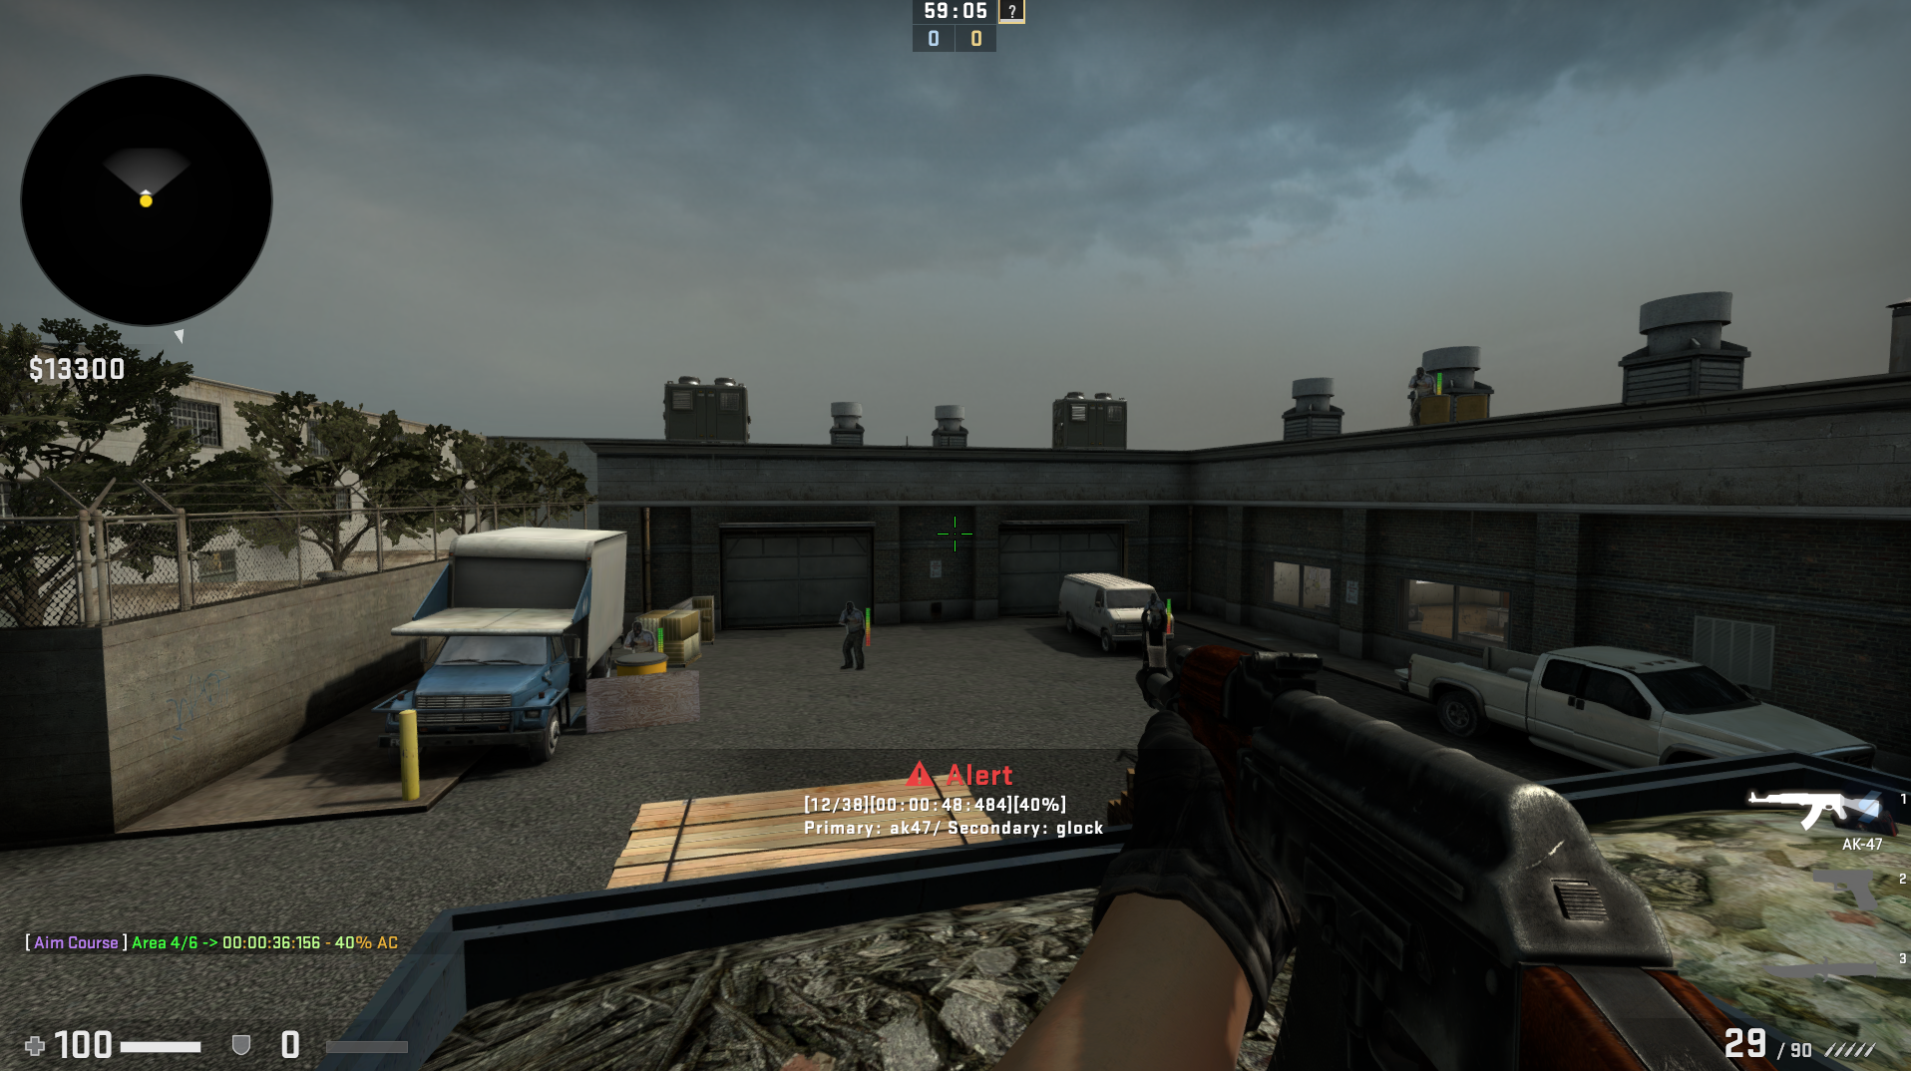




  Method
  Participants
  28 Males
  21.04yrs±1.84yrs
  University FPS esport players
  Playtime 46.63hrs±28.58hrs (week)

Slide 6
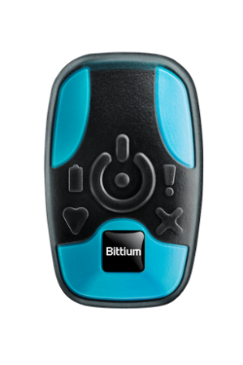
  Method
Condition A | Pre-screening & Test data | 5 min Baseline | Familiarisation | Trial 1 | 30s rest | Trial 2 | 30s rest | Trial 3 | 30s rest | Trial 4 | 30s rest | Trial 5 | Psycho-metrics | 5 min Recovery
Washout | 30-minute neutral documentary
Condition B |  | 5 min Baseline |  | Trial 1 | 30s rest | Trial 2 | 30s rest | Trial 3 | 30s rest | Trial 4 | 30s rest | Trial 5 | Psycho-metrics | 5 min Recovery

Slide 7
  Method
Vagal Tank Theory
(Laborde et al., 2018)
Reactivity
Recovery
Rest
Event
Post Event
Condition A | Pre-screening & Test data | 5 min Baseline | Familiarisation | Trial 1 | 30s rest | Trial 2 | 30s rest | Trial 3 | 30s rest | Trial 4 | 30s rest | Trial 5 | Psycho-metrics | 5 min Recovery
Washout | 30-minute neutral documentary
Condition B |  | 5 min baseline |  | Trial 1 | 30s rest | Trial 2 | 30s rest | Trial 3 | 30s rest | Trial 4 | 30s rest | Trial 5 | Psycho-metrics | 5 min Recovery

Slide 8



  Pressure manipulation (Sharpe et al., 2024)
1
2
3
4
(Leis et al., 2022; Leis & Lautenbach, 2020; Poulus et al., 2022; Smith et al., 2019; Smith et al., 2022)

Slide 9
  Preliminary results
  Perceived measures
Self-Assessment Manikin
(Bradley & Lang, 1994)
Valence, Arousal, Dominance
Immediate Anxiety Measurement Scale
(Thomas et al., 2002)
Cognitive, Somatic, Self-Confidence
(p < .001, d = 0.886)
(p = .006, d = 0.662)

Slide 10
  Preliminary results
  Perceived measures
  Objective measures
(p < .001, d = 0.886)
(p = .006, d = 0.662)

Slide 11
  Preliminary results - vmHRV
*
*
*
(*P < .05)
Task switching
(Matuz et al., 2021)
Respiration outside 9-24cpm
Notes:
Coping through task switching – activation of ANS to promote relaxation during times of demand (Matuz et al., 2021) – emma chapter
Link to mental fatigue but not physiological?

Slide 12


  Future directions
Research
(Sharpe et al., 2024)
Applied Practice
(Laborde et al., 2021)

Slide 13
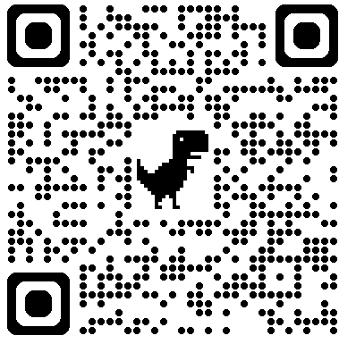



Thank you for listening
Want to know more?
Contact me
Email: M.Welsh@chi.ac.uk
X: @MattRWelsh_
Thanks to:
Emma Mosley (Bournemouth University), Sylvain Laborde (German Sport University Cologne), Mel Day (UoC), Ben Sharpe (UoC) & Phil Birch (UoC)
Application of methodological guidelines
Scan for linked research!

