Slide 1
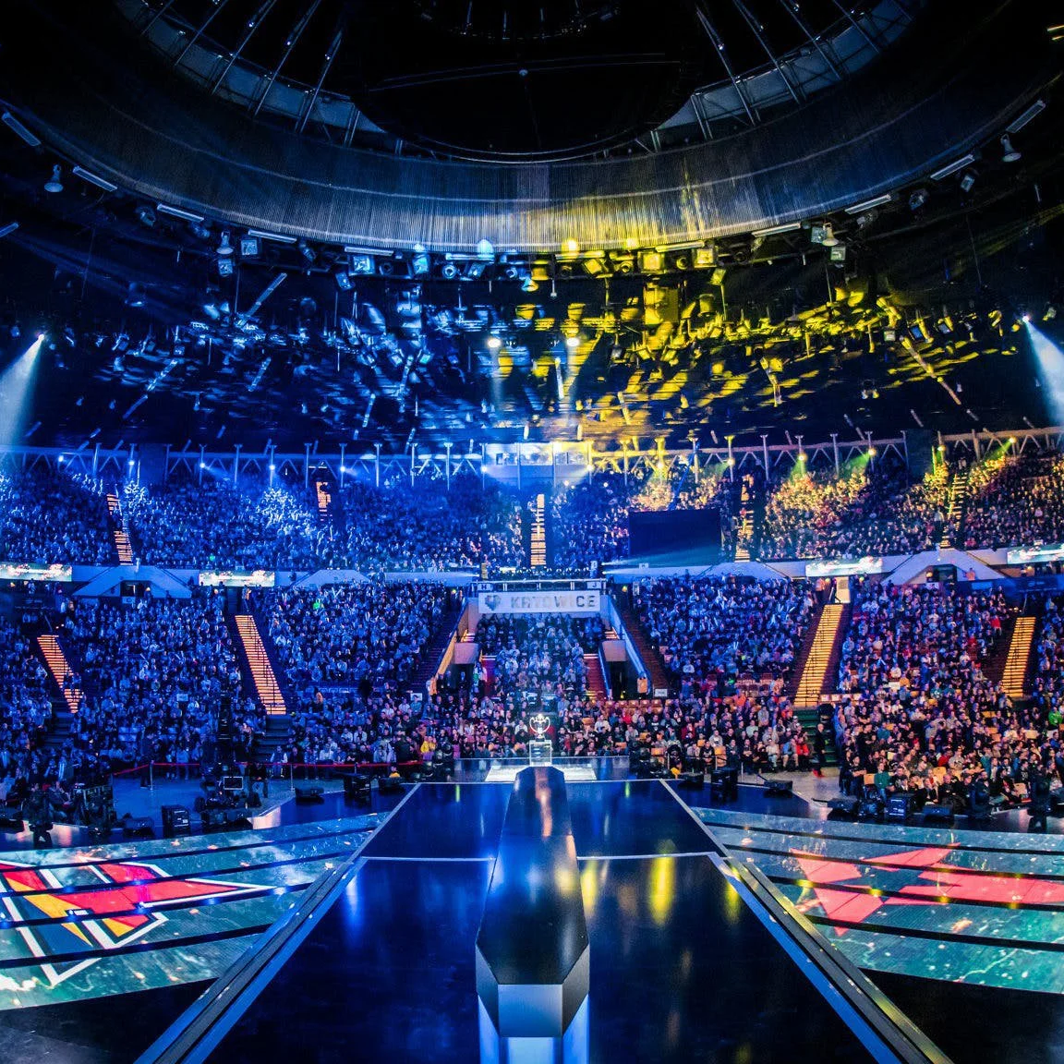
The Use of Heart Rate Variability in Esports: A Systematic Review
Matthew R. Welsh
Emma Mosley, Sylvain Laborde, Melissa C. Day, Benjamin T. Sharpe, Rachel A. Burkill & Phil D. J. Birch

Slide 2
What is esports?
Esports - The competitive playing of specific video games that provides professional or personal development to the player.
(Pedraza-Ramirez et al., 2020)

Slide 3
The systematic review
Existing HRV research in SEP is often lacking theoretical underpinning leading to inconsistent measurement of HRV.
(Mosley & Laborde, 2022)
Seeming disparity in the application of HRV in esports.
Aim: To systematically review how HRV has been utilised within esports research.

Slide 4
Inclusion & Exclusion
Inclusion:
Empirical study
HRV in any esports context
Assess participants at any level in esports
English language
Exclusion:
Non peer review
Pre-existing clinical illness (other than IGD)
Opinion pieces or reviews
Additional info:
No restriction on publication date was made

Slide 5
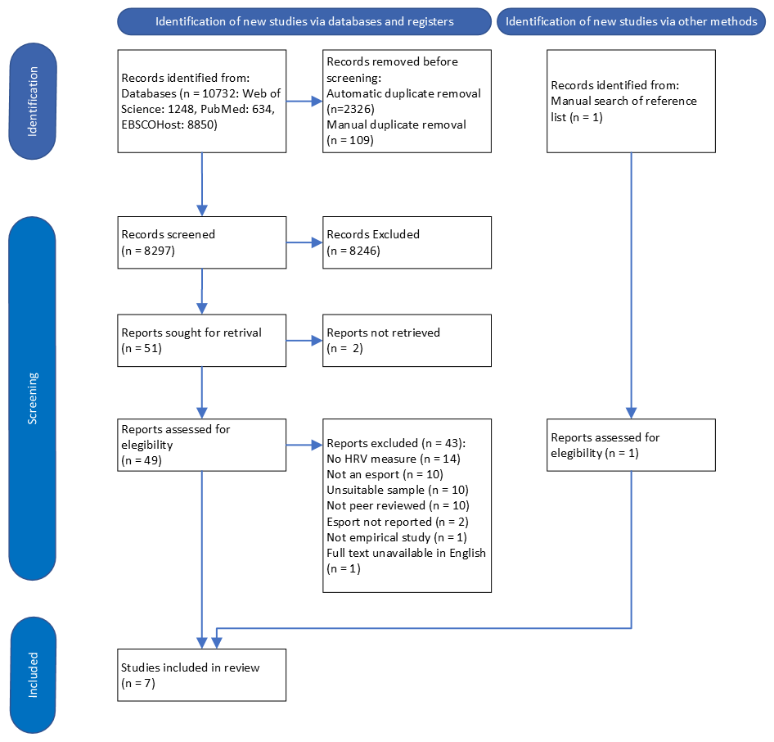
Identification
10732 records identified
8297 screened
Screening
50 full texts assessed
Included
7 included

Slide 6
Results

Slide 7
Results
236 Male participants
1 Female participant

Slide 8
Application of research
Theory
Theoretical underpinning:
Methodological recommendations
Laborde et al. (2017): 3*
Malik (1996): 2
0

Slide 9
HRV measurement
Initial 5 min
Middle 5 min
Final 5 min
5 min - 15-25 mins pre
Whole game
Immediately post 5 min
5 min rest
Initial 5 min
10 min – 60 & 30 mins pre
10 min post
Pre-game (4)
In-game (6)
Post-game (3)
Whole game minute values
5 min resting
5 min periods of high/low attention
5 min post
30s, 60s, 90s, 120s at point of ‘kill’ or ‘killed’

Slide 10
Stress* (Self-regulation)
Players have a physiological reaction to esports.
(Andre et al., 2020; Bennet et al., 2022)
Professionals have significantly higher HRV during the end phase of gameplay*.
(Ding et al., 2018)
Higher vmHRV (RMSSD & pNN50) was observed in winning teams than in losing teams' post-game.
(Machado et al., 2022)

Slide 11
Internet Gaming Disorder
Individuals with IGD may have lower LnHF during gameplay in periods of high attention and the final 5 minutes*.
(Hong et al., 2018; Lee et al., 2021)
Reduced HF(ms2)
Internet Gaming Disorder
Executive control?
(Thayer et al., 2009)

Slide 12
Common limitations
Theoretical underpinning
No included study showed clear consideration of any recognised HRV theory in their aims or methodology
Limited application of methodological guidelines
Laborde et al. (2017) – 3*
Malik (1996) – 2
Measurement units
Many studies did not report units and in some cases, it was not possible to determine.

Slide 13
Chaos in the brickyard
(Forscher, 1963)

Slide 14
Future research
Theoretical underpinning
Theoretical underpinning
Theoretical underpinning
Application of methodological guidelines
Varied participants

Slide 15
Thank you for listening
Want to know more?
Contact me
Email: M.Welsh@chi.ac.uk
X: @MattRWelsh_
Thanks to:
Emma Mosley (BU), Sylvain Laborde (GSUC), Mel Day (UoC), Ben Sharpe (UoC), Rachel Burkill & Phil Birch (UoC)
Application of methodological guidelines
The Effect of Pressure on vmHRV in Esports,
Friday 1:30-2:30pm, Hall Brüssel, Symposium 58
Scan for full text

