Slide 1
Pressure impacts esports performance
Dr Phil Birch
University of Chichester, UK.
Sharpe, B, Obine, E,
Pocock, C, & Moore, L
By Dr Phil Birch
Find me on X: @PhilBirch02

Slide 2
Pressure in esports
Audience
Criticism
Media interviews
Leaderboards
Making mistakes
Pressure is often referred to as stressors.
Many forms of pressure in esports.
E.g., Leis et al. (2022).
Poulus et al. (2022).
Smith et al. (2019).
Aim: Advance our understanding of the impact of pressure in elite Counter-Strike (CS) competitors using quantitative methods.
Find me on X: @PhilBirch02

Slide 3
Integrative framework of Stress, Attention, and Visuomotor Performance (Vine et al., 2016)
Attentional control
Psychophysiological state
Outcomes
Balance goal and stimulus systems
↓ Search rate (fewer fixations of longer duration)
↑ Performance
CHALLENGE
Resources
Motivated performance situations
Demands
↑ Influence of stimulus system
↑ Search rate
(more fixations of shorter duration)
↓ Performance
THREAT
Find me on X: @PhilBirch02

Slide 4
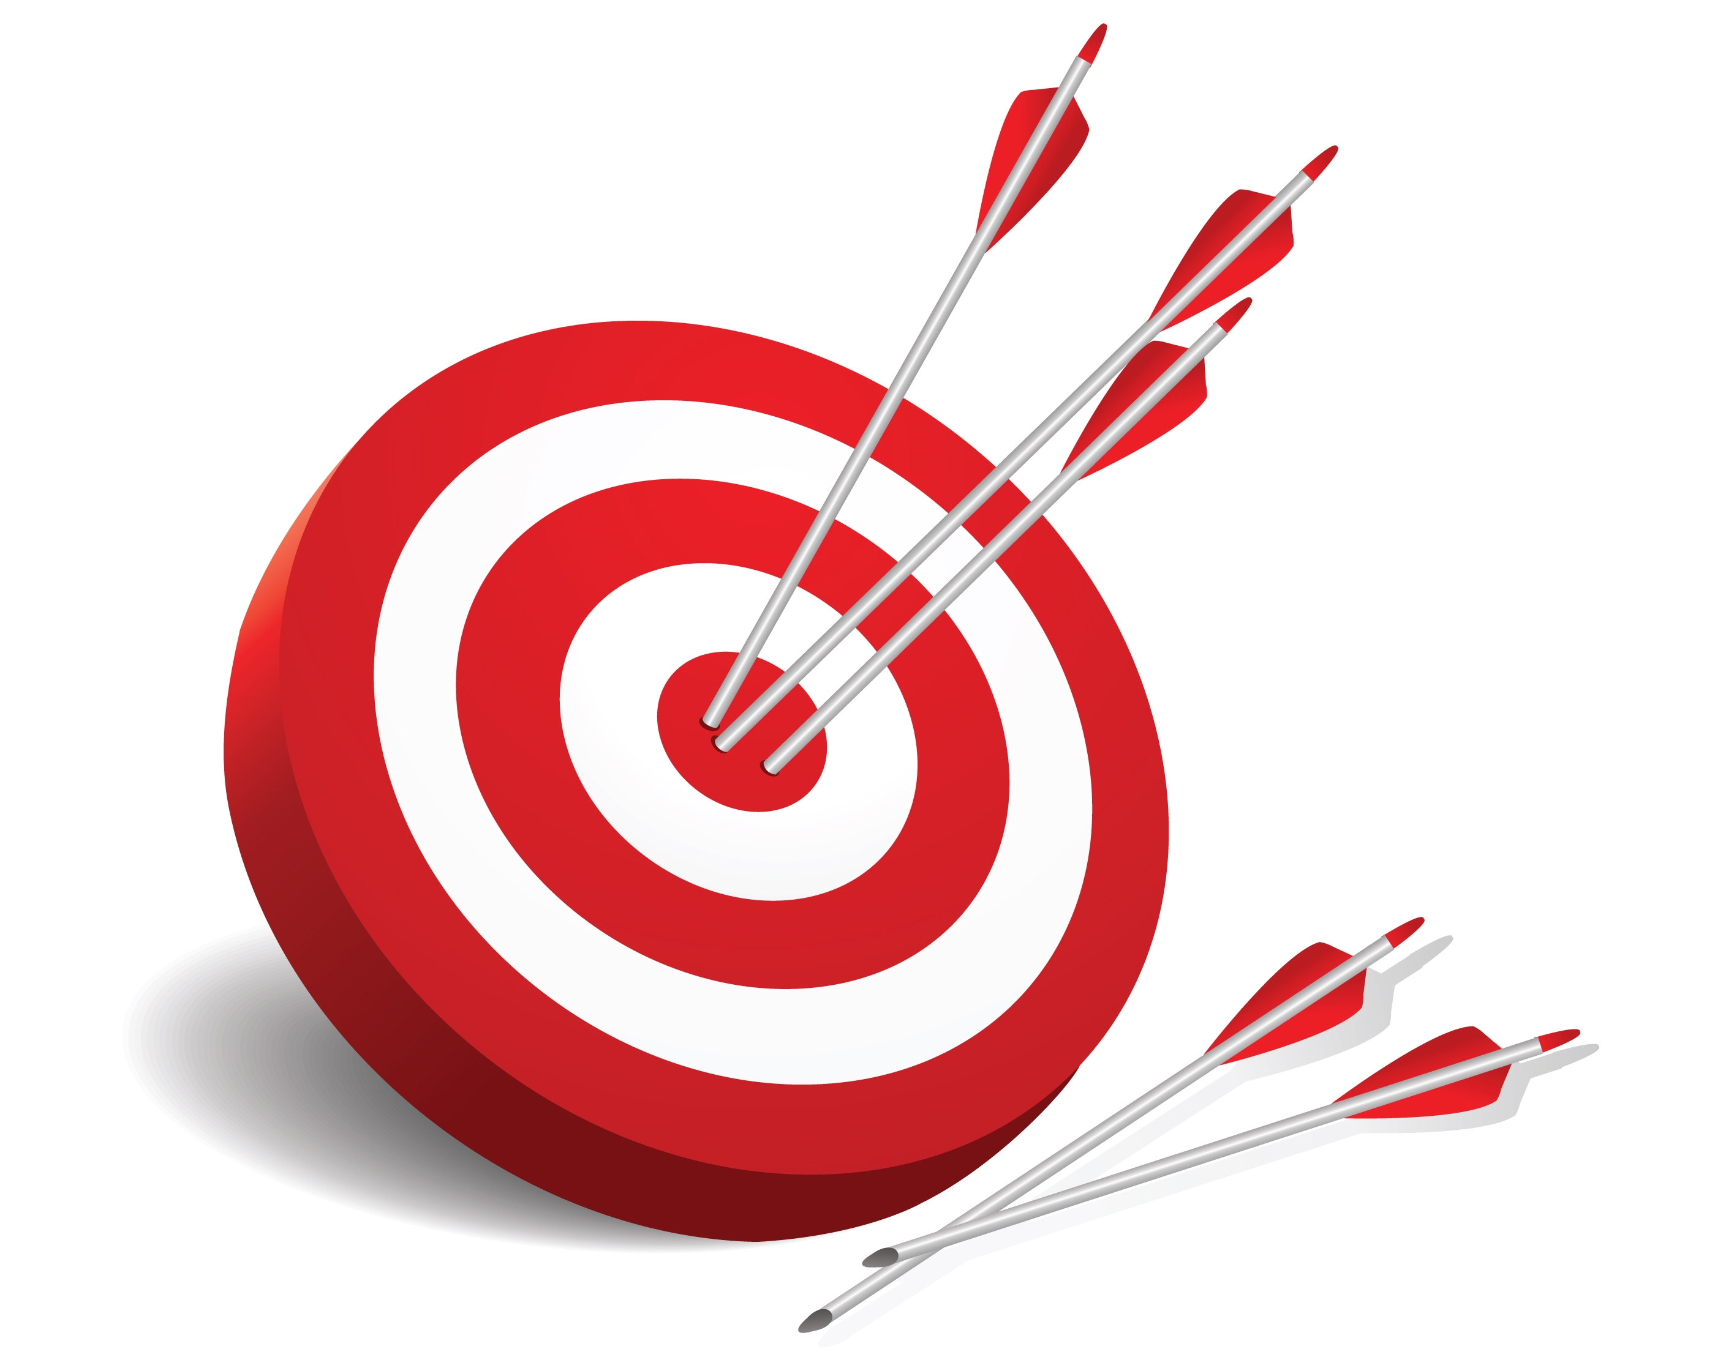
Hypotheses (study 2 only)
1) Display less optimal gaze behaviour
(i.e., higher search rate).
Gaze behaviour (search rate)
2) Perform more poorly
(i.e., longer trial times,
less accurate shooting)…
Action performance
…in the high-pressure condition when compared to the low-pressure condition.
Find me on X: @PhilBirch02

Slide 5
Method
Participants
28 national pros (fully salaried) CS players (25 male, 3 female).
≥ five national tournaments in the past two years (M = 19.18, SD = 10.92).
Design
Two experimental counterbalanced conditions.
4 trials in each.
Pressure manipulations
High pressure
Task importance
Leaderboard
Potential interview
“You need to make less mistakes next time”
Live audience
(Leis et al., 2022; Poulus et al., 2021; Smith et al., 2019, 2022).
Low pressure (control)
No specific instructions or stressors provided.
Find me on X: @PhilBirch02

Slide 6
Find me on Twitter: @PhilBirch02

Slide 7
Search rate findings
t(27) = -4.57,
p < 0.001,
d = .66
Medium (Cohen, 1988)
Instrument
Head-mounted 50 Hz, four sensor, Tobii Pro Glasses 2 mobile eye tracker.
Calculation
Total number of fixations divided by the total duration of fixations.
(e.g., Moore et al., 2019).
206.75
1.07
193.54
0.45
Find me on Twitter: @PhilBirch02

Slide 8
Performance findings
t(27) = -10.09, p = 0.007,
d = .75
Medium (Cohen, 1988)
t(27) = 12.08,
p < 0.001,
d = .92
Large (Cohen, 1988)
51.12
40.96
88.30
80.04
Find me on X: @PhilBirch02

Slide 9
Discussion
Limitations
Manipulated state anxiety…
…Yet, future research could measure states before each trial (Thomas & Clifford, 2017).
Ecological validity of task.
Research & applied implications
Integrative Model feedback loops.
Evidence informed interventions.
(e.g., Reappraisal/mindset intervention; Sharpe et al.’s 2024).
Other psychophysiological measures.
(e.g., HRV; Welsh et al., 2023).
Find me on X: @PhilBirch02

Slide 10
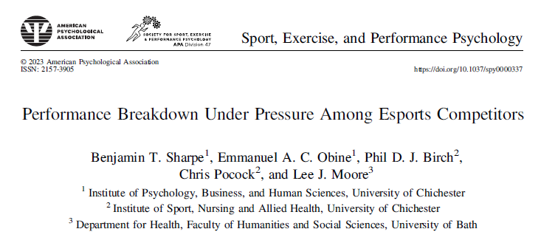
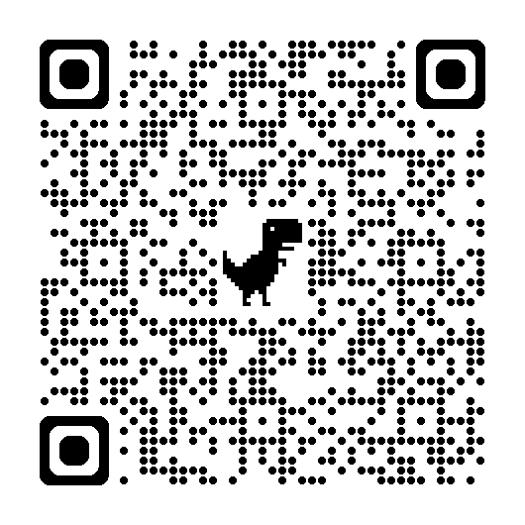
Many thanks for your attention. Please check out our publication.
Find me on X: @PhilBirch02

