Slide 1
Mental (ill) Health and Performance
Dr Phil Birch & Dr Benjamin Sharpe

Slide 2
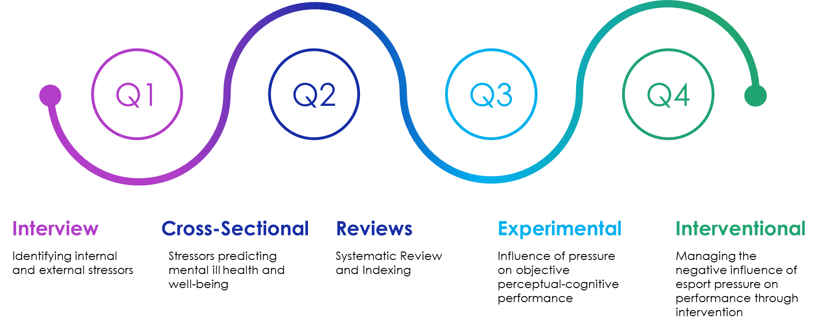
Research roadmap
[Delete this box and add your logo]
@Philbirch02 / @benjamintsharpe
P.Birch@chi.ac.uk / B.Sharpe@chi.ac.uk

Slide 3
What is the impact of stress on esports players?
Smith et al. (2019)
Internal
•Team Issues
E.g., communication issues.
•Individual Issues
E.g., life balance.
External
•Scrutiny and criticism
E.g., social media.
•Event issues
E.g., live audience.
Leis et al. (2022)
Team issues
Performance expectations
Internal evaluation
Environmental constraints
Audience and social media
Dissociation and avoidance coping
"If you start playing scared you don’t wanna die, you don’t want to make a mistake. . . just playing really passively and not really going for anything and not playing how you would usually play." (Smith et al., 2019)
[Delete this box and add your logo]
@Philbirch02 / @benjamintsharpe
P.Birch@chi.ac.uk / B.Sharpe@chi.ac.uk
Smith et al. (2019). https://doi.org/10.4018/IJGCMS.2019040102
Leis et al. (2022). https://www.ijesports.org/article/76/html

Slide 4
What are the correlates of stress and mental (ill) health?
Smith et al.
(2022)
n = 313
Uni-based
FPS players
Personal concerns
Game-specific uncertainty
DS, GHQ-12, PHQ-9
In-game pressure
Birch et al. (in prep)
n = 51
pro CS players
Personal stressors
DS (r = .34*), PHQ-9 (r = .46**)
Note. *p < .05. **p < .01.
[Delete this box and add your logo]
@Philbirch02 / @benjamintsharpe
P.Birch@chi.ac.uk / B.Sharpe@chi.ac.uk
Smith et al. (2022). https://doi.org/10.3390/healthcare10040626

Slide 5
What is the prevalence of mental (ill) health in esports?
Distress screener
GHQ-12
82.4%
54.9%
[Delete this box and add your logo]
@Philbirch02 / @benjamintsharpe
P.Birch@chi.ac.uk / B.Sharpe@chi.ac.uk
Birch et al. (In Prep). Prevalence of Mental (ill) Health in Esports.

Slide 6
What is the prevalence of mental (ill) health in esports?
PHQ-9
25.5%
[Delete this box and add your logo]
@Philbirch02 / @benjamintsharpe
P.Birch@chi.ac.uk / B.Sharpe@chi.ac.uk
Birch et al. (In Prep). Prevalence of Mental (ill) Health in Esports.

Slide 7
What is the impact on health?
Monteiro-Pereira et al. (2023) – 6 elite FIFA players, 2 coaches, and 2 members of the esports department.
Physical health
Negatively impacted by poor equipment/facilities and sitting time.
Mental health
Positively impacted by gaming (e.g., multitasking ability).
Negatively impacted by competition performance results.
Strategies to improve health
Optimise training/scheduling.
Improve lifestyle (e.g., increase physical activity).
Enhance health support provision.
[Delete this box and add your logo]
@Philbirch02 / @benjamintsharpe
P.Birch@chi.ac.uk / B.Sharpe@chi.ac.uk
Monteiro-Pereira et al. (2023). https://doi.org/10.21203/rs.3.rs-2784247/v1

Slide 8
What is the value of heart rate variability in esports?
Welsh et al. (2023) – Systematic review of HRV in esports.
Stress* (self-regulation)
Physiological reaction of players
(Andre et al., 2020;
Bennet et al., 2022).
There is high inter-participant variability – facing different in game stressors
(Bennet et al., 2022).
Internet gaming disorder (IGD)
Individuals with IGD may have lower LnHF during gaming (Hong et al. 2018).
Reduction in HF may be linked to IGD (Thayer et al., 2009).
Harness more theory and methodological guidelines
[Delete this box and add your logo]
@Philbirch02 / @benjamintsharpe
P.Birch@chi.ac.uk / B.Sharpe@chi.ac.uk
Welsh et al. (2023). https://doi.org/10.1016/j.psychsport.2023.102495

Slide 9
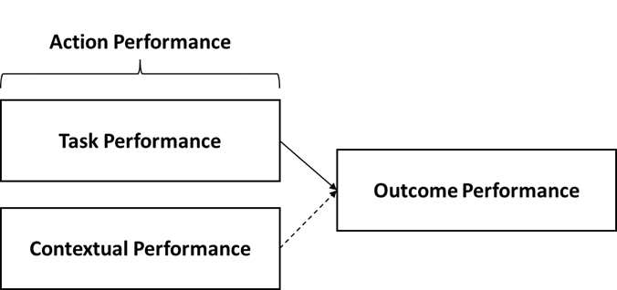
How can we index esport performance?
[Delete this box and add your logo]
@Philbirch02 / @benjamintsharpe
P.Birch@chi.ac.uk / B.Sharpe@chi.ac.uk
Sharpe et al. (2023) Indexing Esport Performance. https://doi.org/10.1123/jege.2022-0017

Slide 10
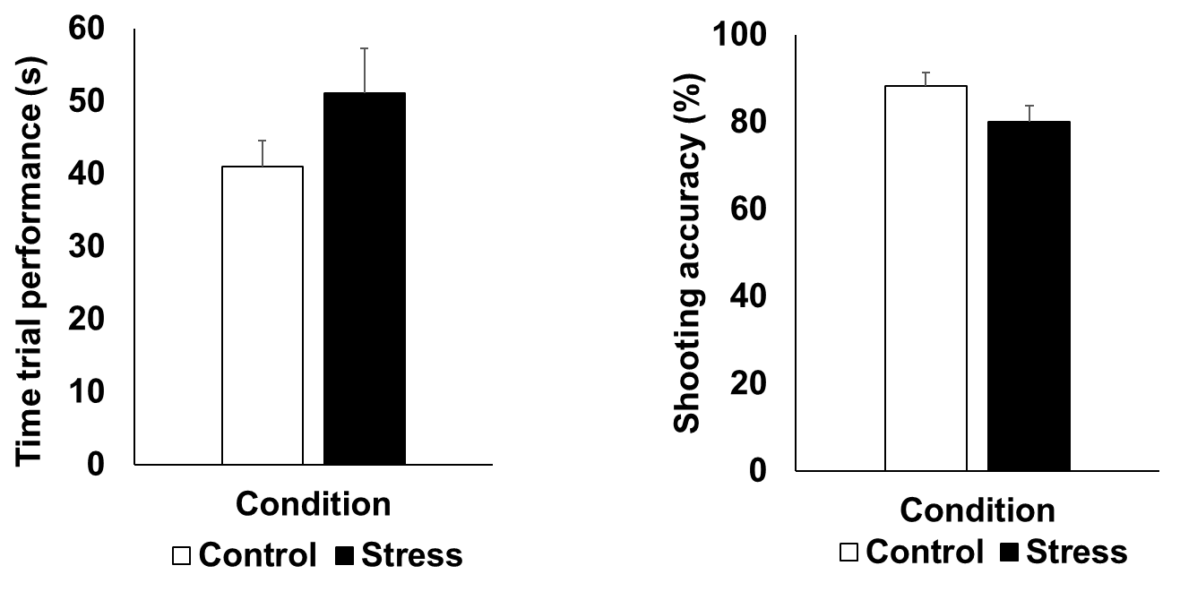
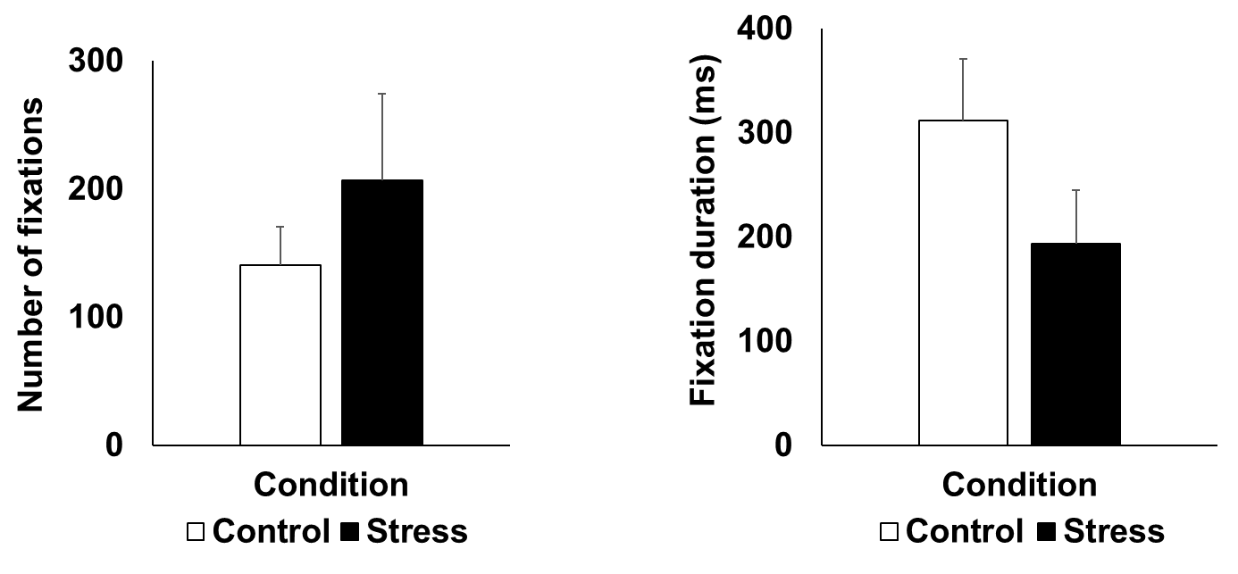
How is performance impacted by pressure?
Action Performance
Gaze Behaviour (Visual Search)
[Delete this box and add your logo]
@Philbirch02 / @benjamintsharpe
P.Birch@chi.ac.uk / B.Sharpe@chi.ac.uk
Sharpe et al. (Under Review) Performance Breakdown Under Pressure.

Slide 11
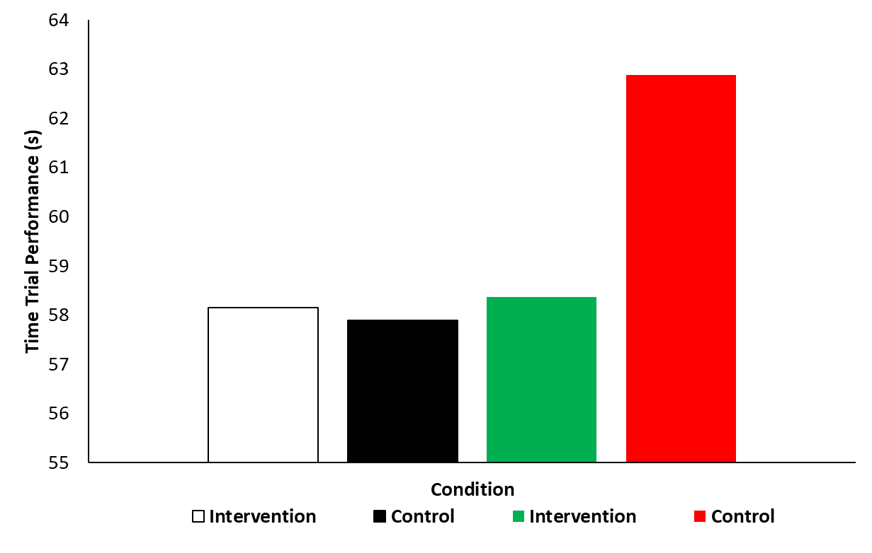
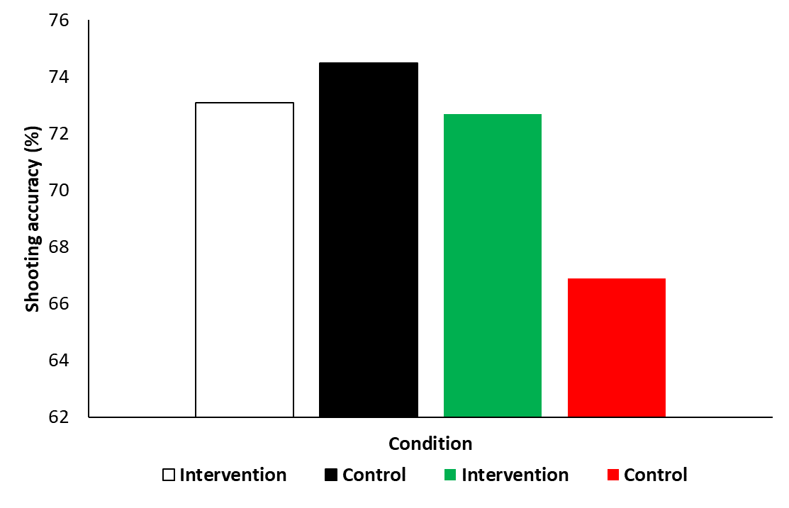
Can we intervene to manage pressure?
High Pressure
Low Pressure
High Pressure
Low Pressure
[Delete this box and add your logo]
@Philbirch02 / @benjamintsharpe
P.Birch@chi.ac.uk / B.Sharpe@chi.ac.uk
Sharpe et al. (In Prep) Reappraisal and Mindset on Pressurised Performance.

Slide 12
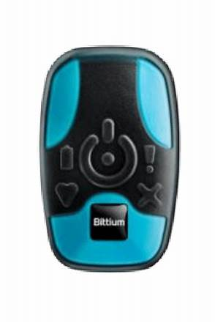
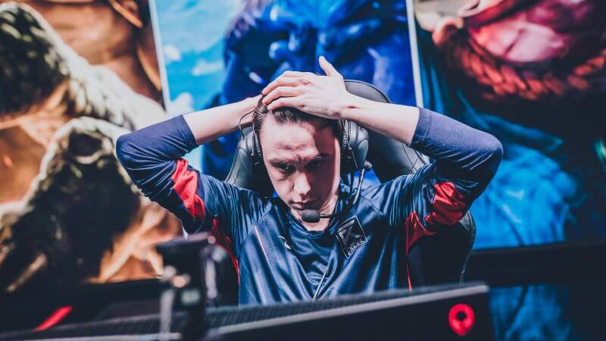
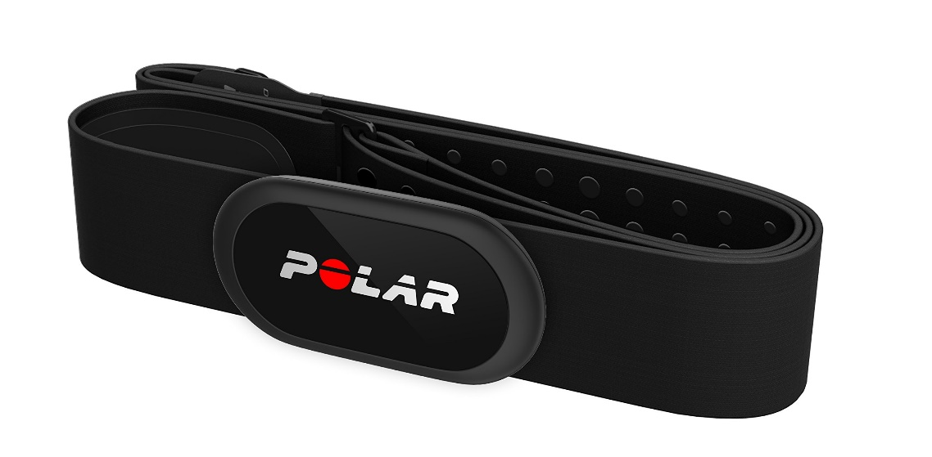
Next HRV PhD steps…
Welsh et al. (in planning) –
Validation and influence of pressure on HRV
Welsh et al. (in planning) –
Self-regulation intervention: Deep breathing
[Delete this box and add your logo]
@Philbirch02 / @benjamintsharpe
P.Birch@chi.ac.uk / B.Sharpe@chi.ac.uk
Welsh et al. (In Planning). Validation and Influence of Pressure on HRV.
Welsh et al. (In Planning). HRV intervention: Deep breathing.

Slide 13
So, what? What’s next? What do we need?
Enhance understanding
Funding
Participants
Expertise
Collaboration
[Delete this box and add your logo]
@Philbirch02 / @benjamintsharpe
P.Birch@chi.ac.uk / B.Sharpe@chi.ac.uk

Slide 14
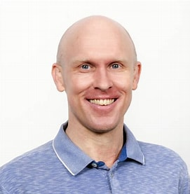
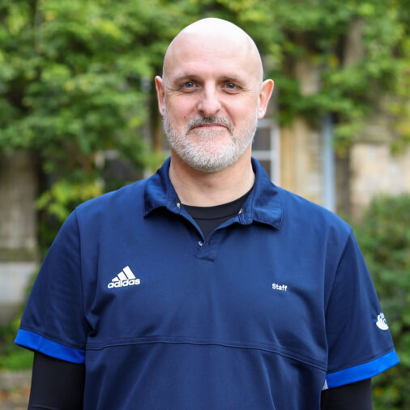
Thank you for listening. Any questions?
[Delete this box and add your logo]
@Philbirch02 / @benjamintsharpe
P.Birch@chi.ac.uk / B.Sharpe@chi.ac.uk
References available on request.

