Slide 1
Mental ill health in professional esports players: Prevalence and relationships
Phil Birch (University of Chichester)
Ben Sharpe (University of Chichester)
Angelica Beatriz Ortiz de Gortari (University of Bergen)
Aty Arumuham (King’s College London)
Matt Smith (University of Winchester)
Find me on Twitter: @PhilBirch02

Slide 2
Presentation aims
Introduce esports
Outline our study on mental ill health
Limitations and future research
Find me on Twitter: @PhilBirch02

Slide 3
Defining esports
Esports can be defined as the casual or organized playing of video games in a way that provides professional or personal development to the player (Pedraza-Ramirez et al., 2020).
Find me on Twitter: @PhilBirch02

Slide 4
Esports – key information
Worth:
$24.9 billion ​
(Ahn et al., 2020)​.
Prize pools:
>$30 million
​(McLeod et al., 2021).
Format:
Online &
LAN (face to face).
Splits (seasons):
Very limited off-season time.
Find me on Twitter: @PhilBirch02

Slide 5
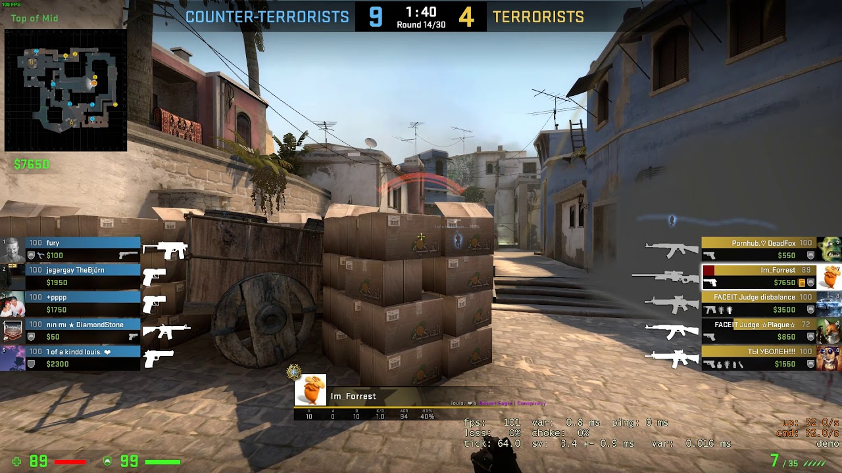
Esports genres
First-Person Shooter (FPS)
E.g., Counter-Strike: Global Offensive (CS:GO).
Military-based game where opposing teams try to defeat each other.
First-person view.
1 min 55 secs rounds.
Best of 30 rounds.
Best of 3 games.
Find me on Twitter: @PhilBirch02

Slide 6
My initial research question
What is the impact of stress on esports players?
Find me on Twitter: @PhilBirch02

Slide 7
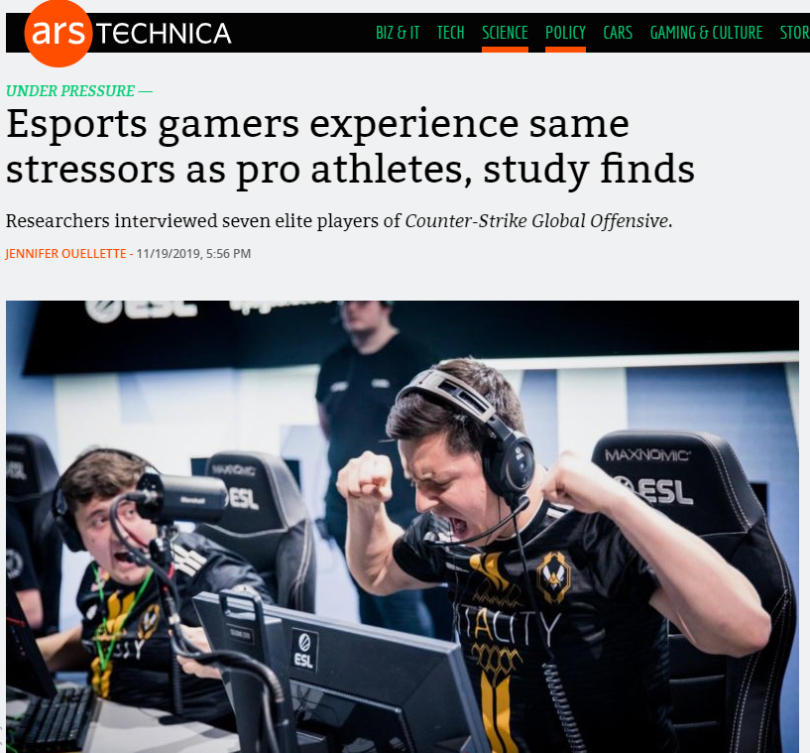
Smith et al. (2019) - Stress and coping media attention
UoC Press Report
Mentions: 80
Reach: 186,650,644
AVE: £1,073,241.20
Find me on Twitter: @PhilBirch02

Slide 8
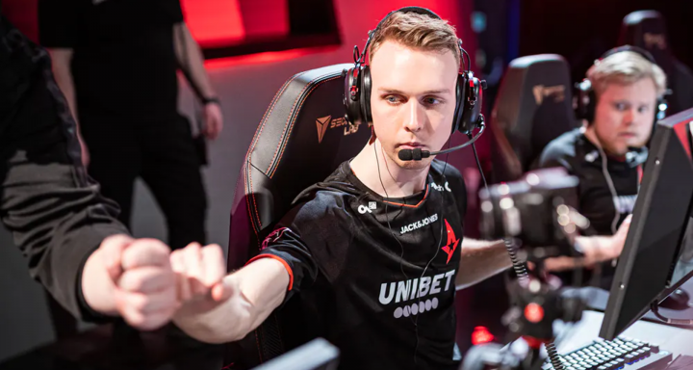
Stress and mental ill health in esports
Contacted by key stakeholders.
Professional
Student-based (NUEL)
More research needed to inform development of mental health support systems in traditional sports (Rice et al., 2016) and in esports…..
2020: Lukas “gla1ve” Rossander switched to the bench in order to recover from ongoing psychological stress and burnout.
Find me on Twitter: @PhilBirch02

Slide 9
Key terms
Mental health can be defined as a state of wellbeing in which every individual realises his or her own potential, can cope with the normal stresses of life, can work productively and fruitfully, and is able to make a contribution to his or her community (The World Health Organisation, 2014).
Mental ill health refers to a negative state of wellbeing, and severe mental ill health refers to diagnosable disorders such as depression or anxiety.
Find me on Twitter: @PhilBirch02

Slide 10
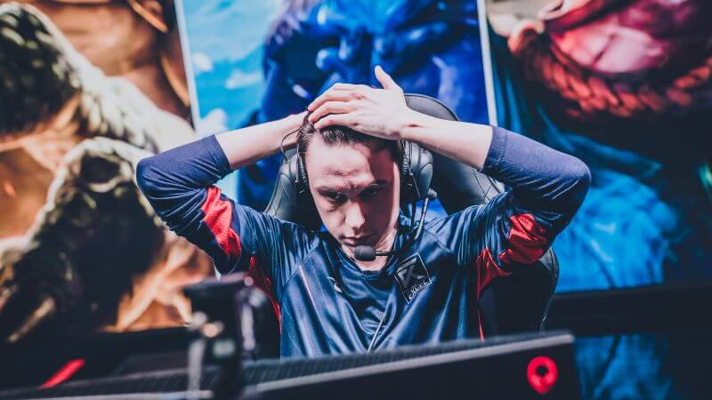
Mental health in FPS
Aim
Examine the correlates and prevalence of mental ill health in pro CS:GO players.
Participants/procedure
Pro (n = 51) CS:GO players;
17.1% of total registered pros.
76.5% played at least one €500k prize in previous 12 months.
Data was collected via Qualtrics over 5 months (during Covid).
Find me on Twitter: @PhilBirch02

Slide 11
Measures and hypotheses
Psychological distress:
Distress Screener
(Foskett & Longstaff, 2017)
General anxiety and depression:
General Health Questionnaire – short form
(GHQ-12; Goldberg et al., 1997).
Severe depressive symptoms:
Patient Health Questionnaire
(PHQ-9; Johnson et al., 2002).
Stressors
Mental ill health prevalence
Find me on Twitter: @PhilBirch02

Slide 12
Measures - stressors
Collated stressors from traditional sports (e.g., Sakar & Fletcher, 2016) and esports (e.g., Smith et al., 2019).
Expert panel of CS:GO players (n = 3) and coaches (n = 3) ranked stressor importance.
E.g., worries about skill level.
E.g., what to do after competing.
Competitive (n = 11)
Personal (n = 3)
E.g., contract issues.
Organisational (n = 9)
Find me on Twitter: @PhilBirch02

Slide 13
Main findings - stressors
Smith et al.
(2022)
Personal concerns
Game-specific uncertainty
DS, GHQ-12, PHQ-9
In-game pressure
Birch et al. (current study)
Personal stressors
DS (r = .34*), PHQ-9 (r = .46**)
Note. *p < .05. **p < .01.

Slide 14
Mental health prevalence findings
Distress screener
GHQ-12
82.4%
54.9%
Find me on Twitter: @PhilBirch02

Slide 15
Mental health prevalence findings
PHQ-9
25.5%
Find me on Twitter: @PhilBirch02

Slide 16
What do these findings mean?
Examining the Predictors of Mental Ill Health in Esport Competitors
Smith et al. (2022)
Birch et al. (in prep)
Personal stressors appear to impact mental health in pro players.
Prevalence of mental ill health in pro CS:GO appears alarming.
Further research is needed to underpin evidence-based healthcare provision.
Ana Pereira - mental health literacy in FIFA players.

Slide 17
Limitations and future directions
Response Bias
Cross-sectional correlation design
Causality
Direction
Further research is needed to underpin evidence-based healthcare provision to support mental health in esports.

Slide 18
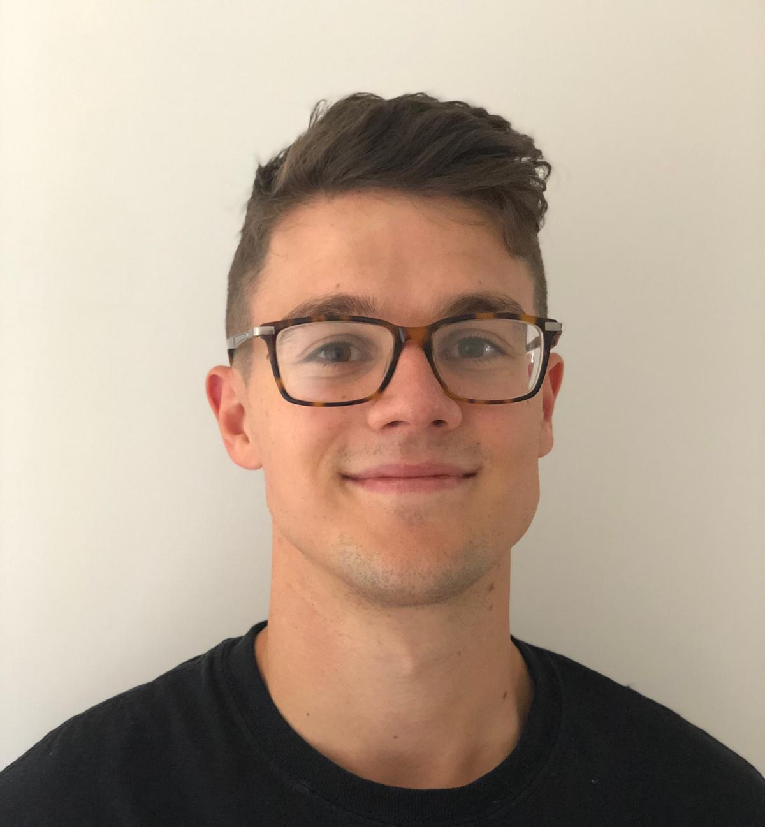
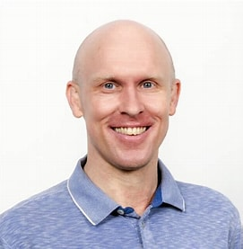
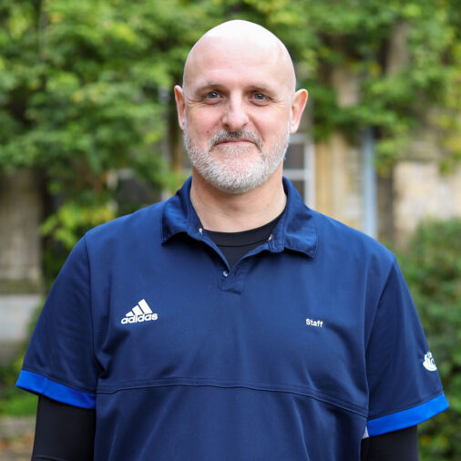
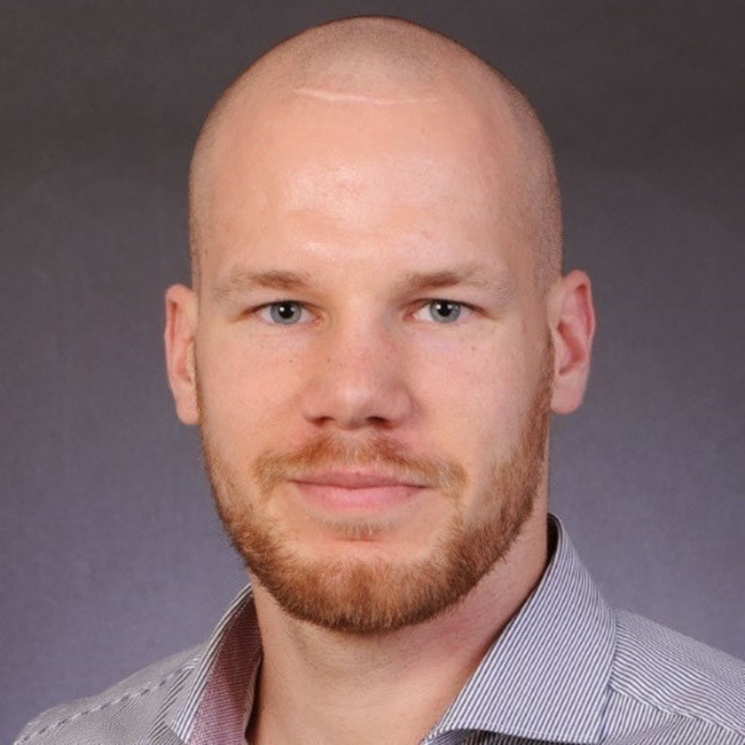
Thank you for your attention. Any questions?
Email: P.Birch@chi.ac.uk
Twitter: @philbirch02
Scan Me
References available on request.

