Slide 1
‘If only I could know what they are thinking?’ Applying Think Aloud to applied sport psychology practice.
Dr Amy Whitehead,
Dr Hayley McEwan,
Mr Steven Vaughan,
Dr Laura Swettenham
(additional team members: Dr Patricia Jackman, Dr David Tod, & Dr Phil Birch)

Slide 2
BPS Think Aloud Research Working Group
Amy Whitehead, David Tod, Steven Vaughan (Liverpool John Moores University),
Trish Jackman (University of Lincoln),
Phil Birch (University of Chichester),
Laura Swettenham (Cultiv8 Academy, and International Federation of Esports Coaches),
Hayley McEwan (University of the West of Scotland).
January 2020- December 2022
Think Aloud for applied Sport Psychology practice
To investigate the use of Think Aloud as an applied tool for sport psychologists to understand their athletes.

Slide 3
Session overview
To provide the background rationale for the need for this research working group.
To provide an overview of what we have done (our methods) since January 2020.
To present to you our composite vignette of how an Applied Sport and Exercise Psychologist has used Think Aloud within their practice with a client.
Gain your thoughts, feedback and reflections on the use of vignettes (stories) as a knowledge translation tool in applied sport psychology.

Slide 4
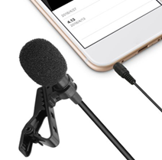
Golf
Cricket
Tennis
Australian rules football
Cycling
Coaches
Notes:
Do we add coach reflection in here?

Slide 5
Method

Slide 6
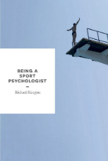
“…allow us to collect some data from his thought processes, while he was performing”
“..the data from think aloud would give me a starting point for the conversation and our next session”
Structural
Analysis
Intake
Needs analysis
Case formulation
Intervention choice
Intervention plan
Delivery, monitoring, and evaluation
Based on Keegan (2016)

Slide 7
Considerations for translating knowledge in sport psychology
The gap between research and applied practice has been a longstanding issue in the field (Hassmén et al., 2016).
This leads to a disconnect between what practitioners should do according to research evidence and what they actually do in the real world (Ely et al., 2021).
It is important to consider alternative methods of translating research into practice.
Stories can be a good mechanism as they involve 'showing' the reader rather than 'telling'.

Slide 8
Composite Vignette Development
Informed by our analysis, a storied representation of the use of TA by a practitioner was developed in the form of a composite vignette.
Review findings and re-read transcripts
One practitioner-athlete dyad selected as characters for the vignette
Composite vignette crafted, edited, re-crafted
Identified how each individual story related to our analysis
Relevant extracts selected from across all transcripts

Slide 9
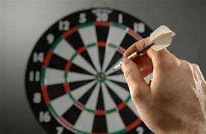
Our vignette

Slide 10
Your thoughts…
What was most memorable or stands out in your mind about the vignette?

Slide 11
Your thoughts…
What was the most surprising and/or unexpected thought from the vignette?

Slide 12
Your thoughts…
What interesting questions remain unanswered about the vignette?

Slide 13
Your thoughts
How might this be applied to your own context?

Slide 14
Your thoughts
Do you have any reservations about the use of TA in applied practice?
PB addition. Not sure we want to open this up at the end of the presentation, but it would it would add balance to the discussions.

Slide 15
Your thoughts
What do you know now that you didn’t know before about Think Aloud?

Slide 16
Follow up on our story:
We want to know if and how the vignette may (or may not) have resonated with you and would love to be able to follow up over the next 6 months.
Please let us know if you'd be happy to engage in an interview in the next few months by signing the consent form.

Slide 17
Thank you!
Dr Amy Whitehead – email A.E.Whitehead@ljmu.ac.uk Twitter @a_whitehead1
Dr Hayley McEwan, Email hayley.mcewan@uws.ac.uk Twitter @Scottishsportps
Mr Steven Vaughan, Email spssvaug@ljmu.ac.uk Twitter @sjvpsych
Dr Laura Swettenham, email laura.swettenham@gmail.com, Twitter @l_swettenham
(additional team members: Dr Trish Jackman, Dr David Tod, & Dr Phil Birch)

