Slide 1
Psychological Index of Individualised Esports Performance
Benjamin T. Sharpe¹, Nicolas Besombes², Matthew Welsh¹, Phil Birch¹.
¹University of Chichester, Chichester, UK
²Universite´ Paris-Descartes, Paris, France

Slide 2
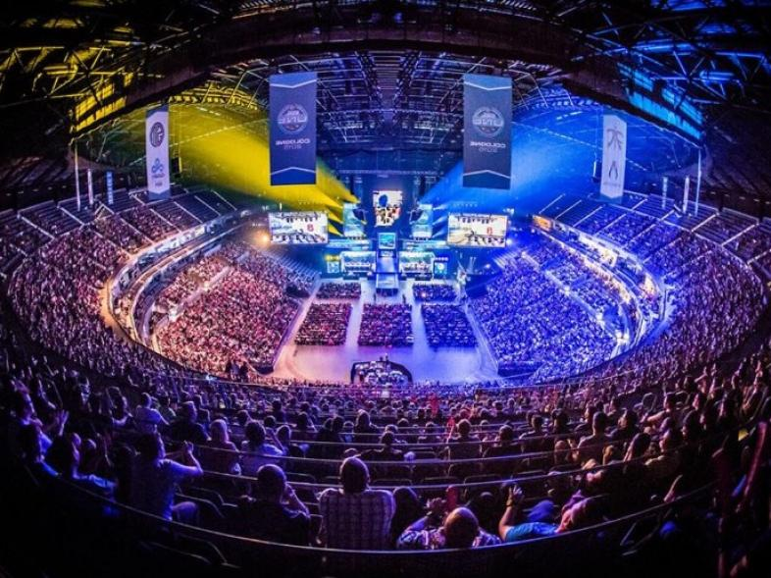
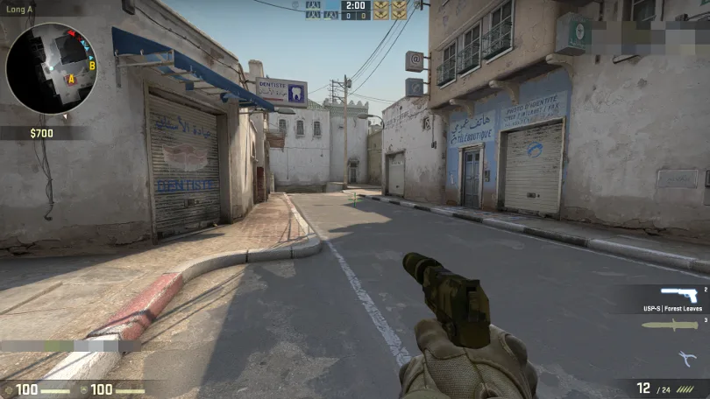
Our Target Esport: Counter Strike: Global Offensive
The top FPS video game consumed by players in the Western World.
With approximately 500,000 players at any given time, with a peak of over 900,000
The outcome of a single game is best-of-thirty rounds.
1

Slide 3
The Value Of Performance Measurement
Select traditional sporting athletes (Bhattacharjee & Saikia, 2014)
Manage sectors of industry (Bititci et al., 2012)
Evaluate health care quality (Werner & David, 2007)
Assess individual mental states (Lane, 2012)
Predict future success (Jin et al., 2020; Kennedy et al., 2013)
1

Slide 4
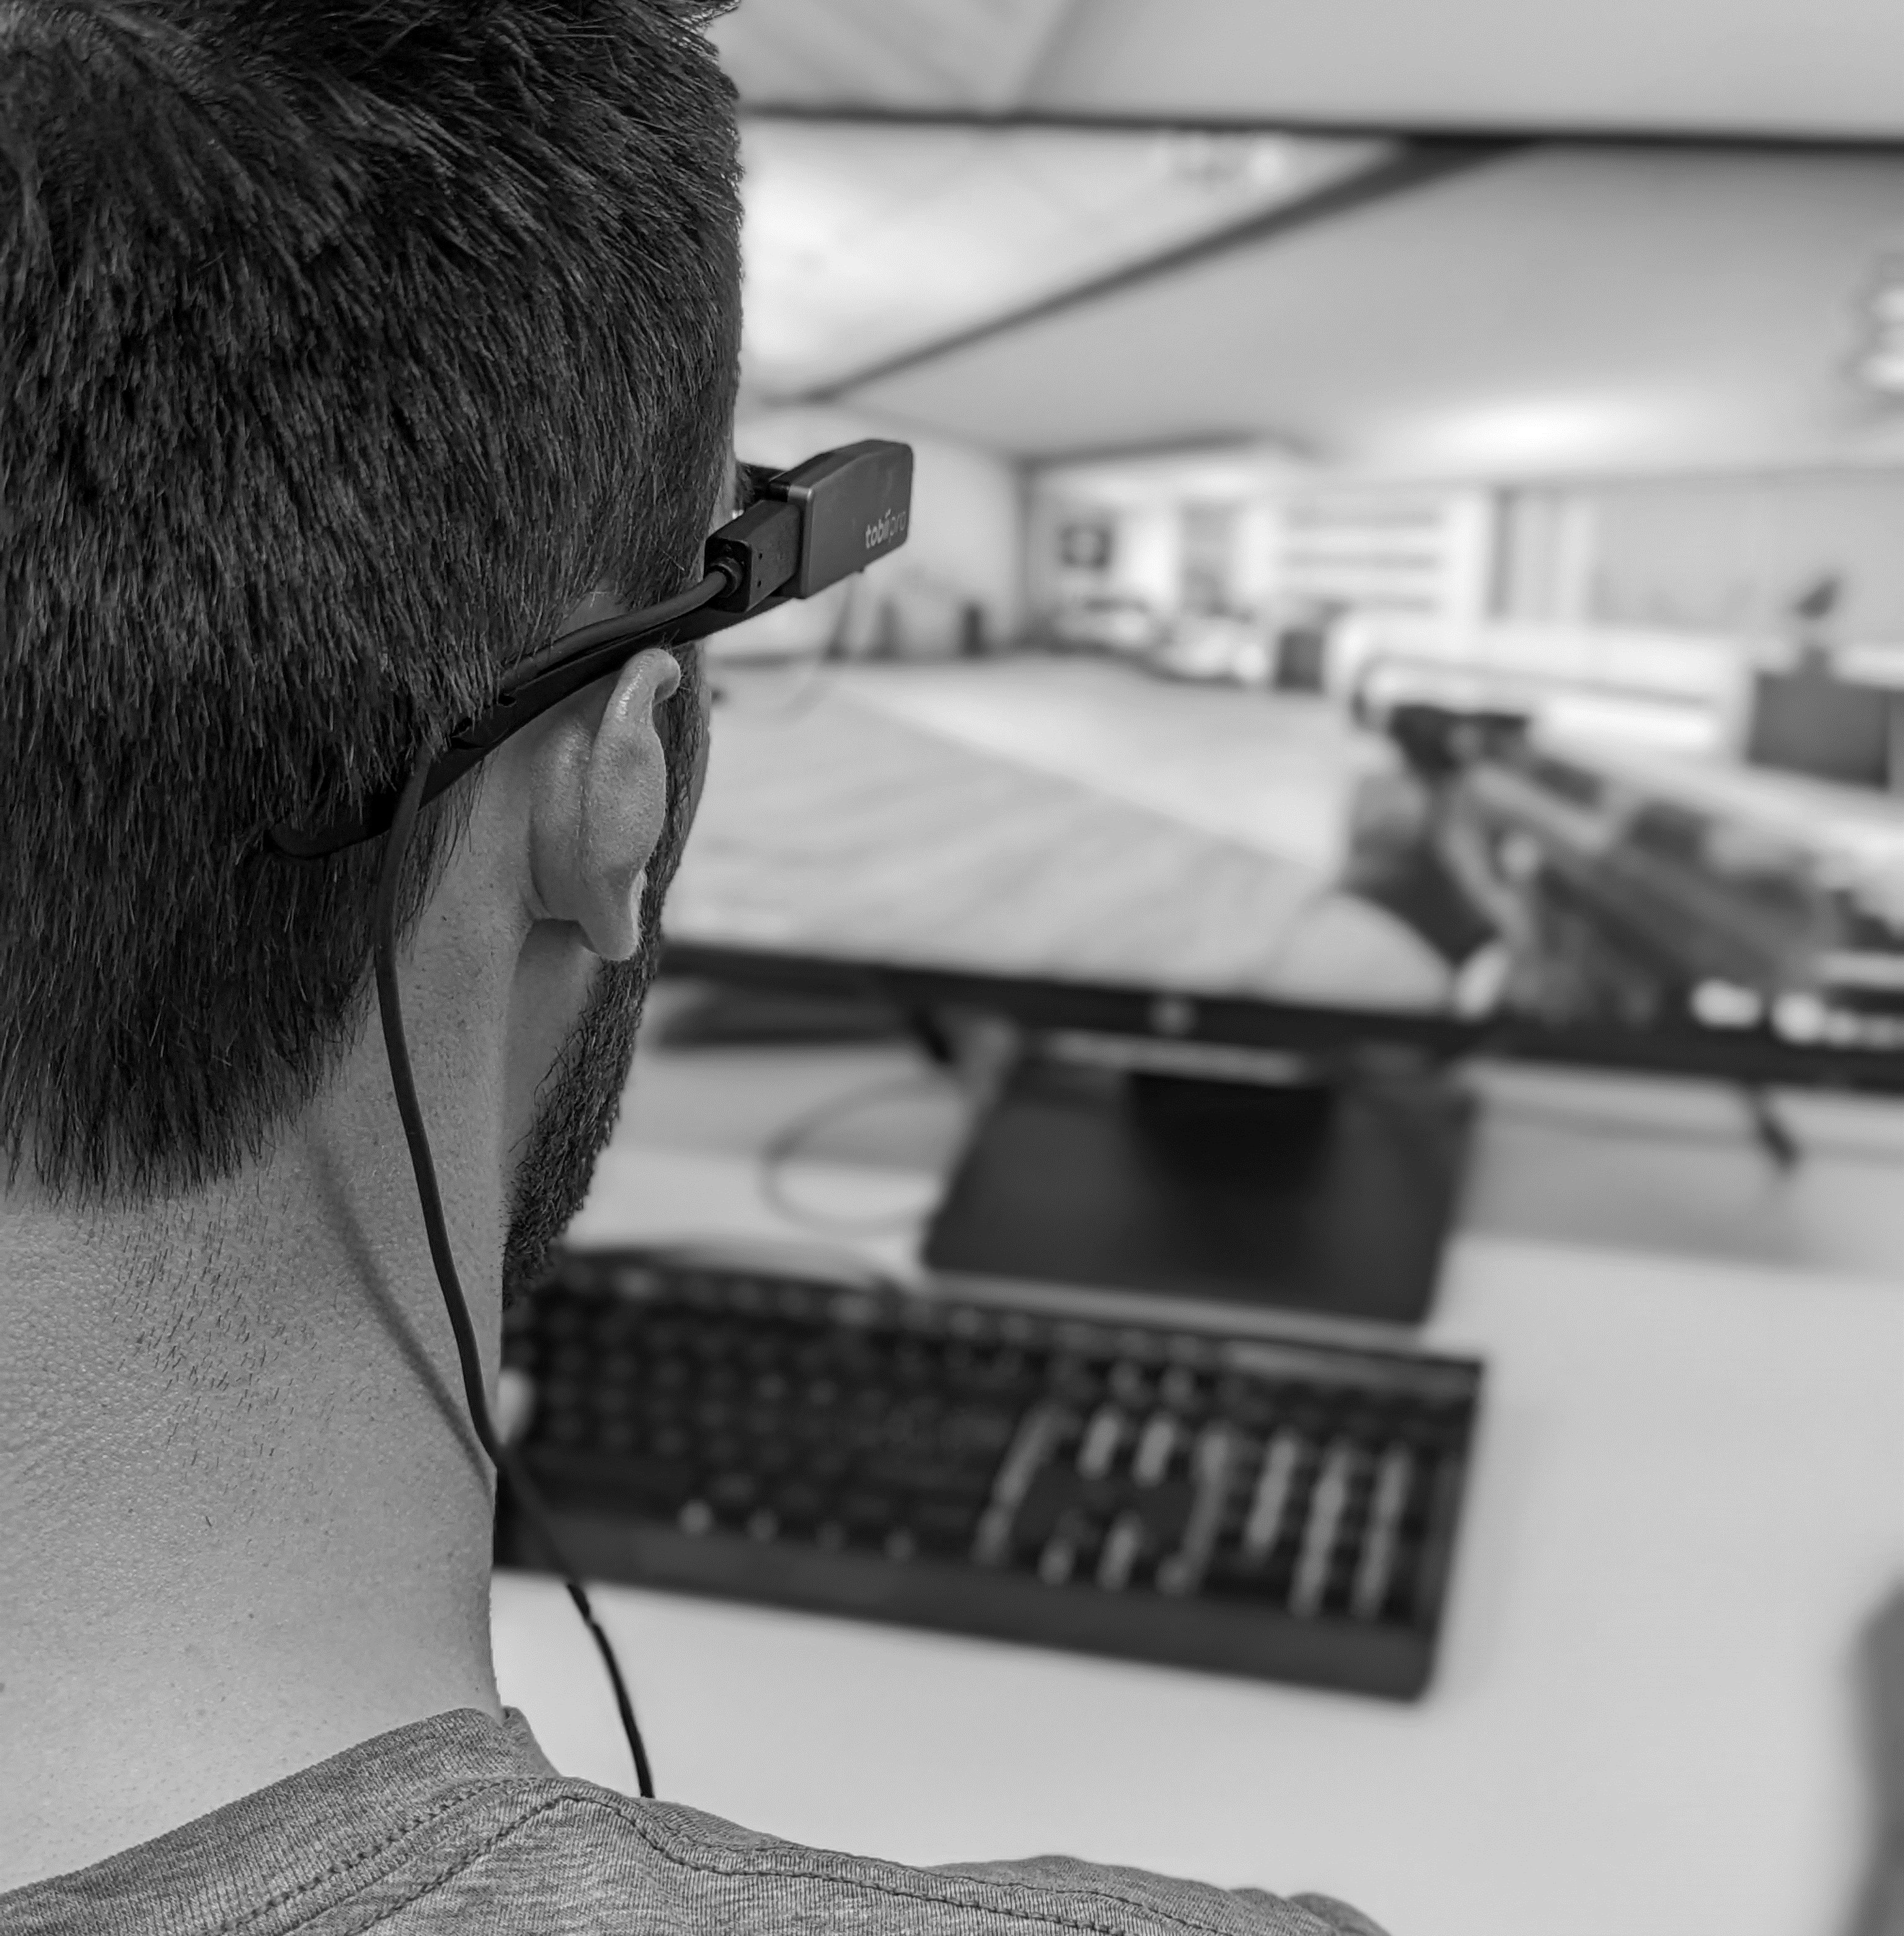
Current Developments
Impact of esports performance on individual psychophysiology (Leis & Lautenbach, 2020)
Influence of cognition on performance (Pedraza-Ramirez et al., 2020)
Test current theoretical understandings (Pluss et al., 2019)
Provided direction for future interventions (García-Lanzo et al., 2020; Poulus et al., 2020; Smith et al., 2022; Trotter et al., 2020)
Current Methodologies
Standalone accuracy (Neri et al., 2021)
Game score (Liu et al., 2021)
Perceived performance (Hopp & Fisher, 2017)
And many more (e.g., Behnke et al., 2020; Moen et al., 2021; Momi et al., 2018; Roebuck et al., 2018).
1

Slide 5
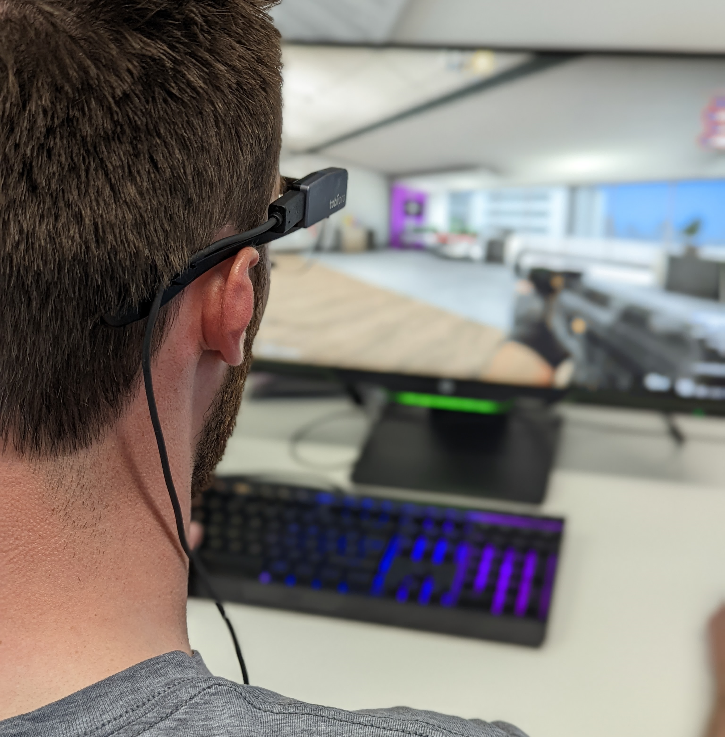
Current Developments
Impact of esports performance on individual psychophysiology (Leis & Lautenbach, 2020)
Influence of cognition on performance (Pedraza-Ramirez et al., 2020)
Test current theoretical understandings (Pluss et al., 2019)
Provided direction for future interventions (García-Lanzo et al., 2020; Poulus et al., 2020; Smith et al., 2022; Trotter et al., 2020)
Current Methodologies
Standalone accuracy (Neri et al., 2021)
Game score (Liu et al., 2021)
Perceived performance (Hopp & Fisher, 2017)
And many more (e.g., Behnke et al., 2020; Moen et al., 2021; Momi et al., 2018; Roebuck et al., 2018).
1

Slide 6
But, What Is Performance?
No justified means currently exist (Pluss et al., 2022; Leis et al., 2021; Pedraza-Ramirez et al., 2020)
A fundamental question that has been overlooked is how do we measure individual performance?
Our Approach
Literature review
Modified Delphi Method
1

Slide 7
But, What Is Performance?
No justified means currently exist (Pluss et al., 2022; Leis et al., 2021; Pedraza-Ramirez et al., 2020)
A fundamental question that has been overlooked is how do we measure individual performance?
Our Approach
Literature review
Modified Delphi Method
1

Slide 8
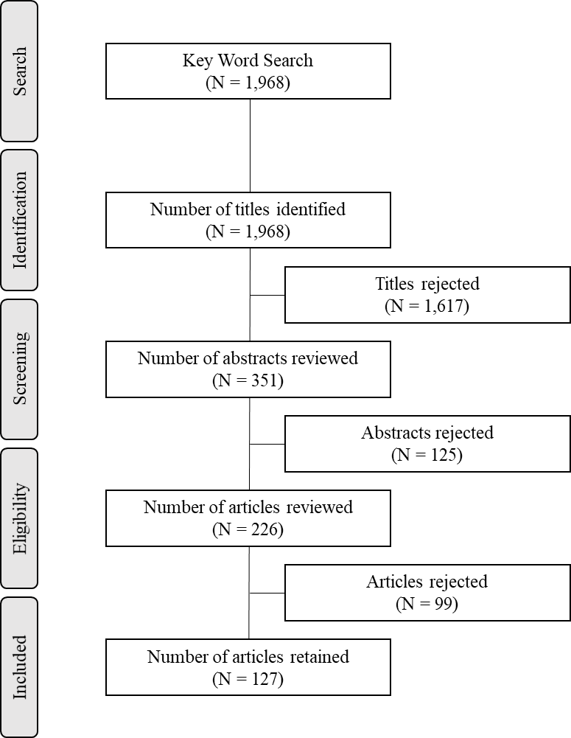
Literature Review
Total Variables = 32
Themes
Game metrics (7)
Skill (3)
Cognition (4)
Strategy (3)
Awareness (2)
Knowledge (4)
Experience (6)
Vigilance (3)
1

Slide 9
Modified Delphi Method: TEP
Technical Expert Panel (TEP)
Group A: Professional International CS:GO athletes (M = 6.01, SD = 1.92 years)
Group B: Esport researchers and esport practitioners (M = 8.94, SD = 3.51 years)
Group C: Esport researchers and esport practitioners (M = 5.16, SD = 2.89 years)
1

Slide 10
Modified Delphi Method: Consensus & Debate
70% Consensus
Reaction time, response time, and game score, processing speed, percentage accuracy, keyboard proficiency, and mouse control.
Latent variable approach (e.g., the value of composite scores)
Outcome measures
Semantics (e.g., what is performance?)
1

Slide 11
Semantic Considerations: Performance Breakdown
Action Performance –
‘Performance as a function of action (i.e., behaviour) may refer to the steps that are required by the role to achieve success (Ilgen & Schneider, 1991).’
Reaction time
Mouse control
Processing speed
Response time
1

Slide 12
Semantic Considerations: Performance Breakdown
Reaction time
Mouse control
Processing speed
Response time
Action Performance –
‘Performance as a function of action (i.e., behaviour) may refer to the steps that are required by the role to achieve success (Ilgen & Schneider, 1991).’
Outcome Performance –
‘the result of actions (Campbell et al., 1993).’
1

Slide 13
Semantic Considerations: Performance Breakdown
Reaction time
Mouse control
Processing speed
Response time
Action Performance –
‘Performance as a function of action (i.e., behaviour) may refer to the steps that are required by the role to achieve success (Ilgen & Schneider, 1991).’
Outcome Performance –
‘the result of actions (Campbell et al., 1993).’
Tournament outcome
Rounds won
Win or loss
1

Slide 14
Semantic Considerations: Action Performance
Task Performance –
‘an individual’s capacity to perform skills that collectively contribute to a performance outcome.’
Contextual Performance –
‘behaviours that do not directly influence performance outcome’
1

Slide 15
Semantic Considerations: The Take-home Message
Action Performance
Task Performance
Outcome Performance
Contextual Performance
1

Slide 16
Continuing The Discussion.
Contact Information:
Email: b.sharpe@chi.ac.uk
Twitter: @benjamintsharpe
Special Thanks:
Nicolas Besombes, Matthew Welsh, and the Expert Panellists
1

