Slide 1
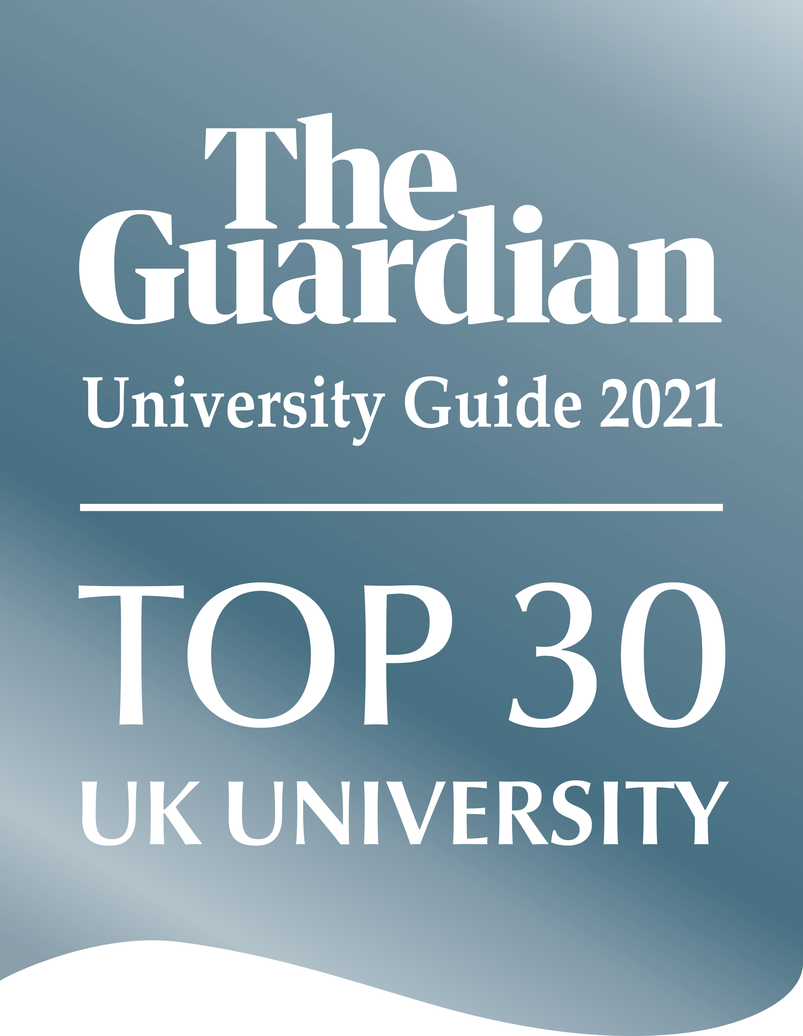
The Great Resignation: The Recruitment Crisis in the Hospitality Industry
Wendy Sealy
& Paula Jenkins

Slide 2
Objectives
Overview of the hospitality industry
Overview of the ‘Great Resignation’ in the UK with some facts and figures
We will look at factors causing the recruitment and retention crisis in UKs hospitality
Possible solutions and best practices
Time for discussion

Slide 3
What is the hospitality industry and what it is not

Slide 5
Why is the hospitality sector important?
At the start of the pandemic the industry employed 3.2 million people, produced £130 billion of economic activity and generated £49 billion in taxation for the UK government (Economic Insight, 2019).
In the next 10 years the industry is projected to produce around 72 million jobs (Ghani et al., 2022).
Hospitality businesses are close several days a week losing up to £21 billion in trade (McAlister, 2022).
At the end of 2022 there were 174, 000 unfilled vacancies in the Hospitality sector but by January 2023 this number has fallen to 149,000 (caterer.com)
Turnover rates in the hotel industry is double that of other industries (Malek, Klein, and DiPietro, 2018).

Slide 6
In the post Brexit area more than 190,000 EU nationals left the UK, a smaller number than a year earlier when almost 260,000 departed (Bloomberg.com, 2023; ONS.gov, 2022).

Slide 7
Brexit
Cost of visas
Pay the application fee - the standard fee ranges from £625 to £1,423 depending on your circumstances
Pay the healthcare surcharge - this is usually £624 per year
Support yourself when you arrive in the UK - you’ll usually need to have at least £1,270 available (unless you’re exempt)
Anyone newly recruited to work in the UK must qualify for Skilled Worker visas, Tier 2, which require a salary of at least £25,600 per year (
Common low-wage roles such as bar staff, cleaners, drivers, food processing labourers or baggage handlers are not eligible for work visas.
(https://www.gov.uk/skilled-worker-visa/how-much-it-costs)

Slide 8
Survey results
We conducted a survey with 55 business students.
We also did a lit review using google scholar by examining articles no earlier than 2018 and association and corporate reports. Articles dated in the 1990s were also consulted to understand the history behind the phenomenon.

Slide 9
Survey of 55 event management students
Negative image and poor reputation of industry (Linh H. Le, Hancer, Chaulagain, Pham, 2023)
Students perceive the industry as ‘ waitressing, poor paying jobs, poorly treated staff.
71% cited a poor work experience in the sector on placement or volunteering.
cited low pay, low prestige, long hours; poor benefits, limited career advancement (Linh H. Le, Hancer, Chaulagain, Pham, 2023)
These findings resonate with the work of Olin & West, 1994, Iverson & Deery, 1997, Pratton, 2003, Chapman 1999; Wan et al, 2014; Brian et al, 2107; park et al, 2017; Nachmias (2017) concur

Slide 10
Highest-paid graduate hospitality jobs, 4/5 star hotels/restaurants
General Manager, £75,000 - £136, 744
Food and Beverage Director, £45,000 – £102,000.
Director of Sales, £49,000- 90,717.00
Hotel Operations Manager, £50,000 – £114,000
Financial Controller, £47, 919 - £ 63,000
Human Resource Directors, £45,000-55,000
Sustainability Officer, £55,000
Housekeeping Director, £45, 236
Restaurant Manager, £45,000
Executive Chef, £40,000 – £85,000. ...
Training Managers, £35,000-48,000
Sales Manager, £37,000- £40,000
Event Manager, £28,000 - £44,000. ...
Sommelier (wines), £15,000 – £67,000. ...
(caterer.com; hospitalityjobsuk.com; ukindeed.com; totaljobs.com)

Slide 11
Emotional Labour
Hospitality employers depend on the emotional labour of workers and the ability to produce a positive emotional state in another person which activates the ‘pheromones’ in customers – 50% of the jobs are customer facing.
Emotional labour, work pressure and insincere emotions creates tension and stress. JS (Tsaur and Tang, 2012, Jung and Yoon, 2014, Choi et al., 2019; Wang, 2020).
Fatigue/Trauma
Burnout syndrome
(Lower immunity, frequent illnesses. Frequent headaches or muscle pain. Change in appetite or sleep habits, life threatening diseases)

Slide 12
Discrimination, bullying & unfair treatment
The industry in the UK is renowned for gender discrimination with several roles being feminised or masculinised such as ‘bar maid’, ‘housemaid’ etc; and poor career advancement, particularly for women (Calinaud, Kokkranikal & Gebbels, 2021).
High levels of unprofessionalism some of which occurs through conjugal relationships between staff (Sealy, Jenkins & Jalley, 2023; Ampofo, 2021).
Wrongful dismissal, victimization and the sexual harassment of female workers (Lopa & Gong, 2020). The sector is also known for fear management such as bullying and abuse, particularly in kitchens. Nepotism and favouritism.

Slide 13
‘Managers from Hell’ (Hight, Gajjar, Okumus, 2019)
Research indicates that 70% of managers in this sector are poorly trained or untrained leading to a lack of quality leadership (Cicerale, 2020; (Hight, Gajjar, Okumus, 2019).
High turn-over culture
Further research findings identified six themes relating to the attributes of bad managers: unprofessional, autocratic management style, poor leadership skills, unethical, poor operational and technical skills and poor decision and delegation skills (Hight, Gajjar, Okumus, 2019)
Lack of hard skills - Hospitality managers remain ignorant of proper forecasting, staffing, recruitment strategies and talent and leadership management development (Ghani, et al 2022).
Proper business forecasting leading to improper workforce planning in casual work and ‘0’ hour contracts as a mitigation strategy to manage the risk of uncertainty (Sealy, Jenkins & Jalley, 2023).
Corporate culture focusses on financial rewards based on cost savings and profits rather than staff or customer satisfaction.

Slide 15
The Millennial Worker
Aged between 19-30
Do not tolerate hostile work place. They want good working relationships, they like to be valued for their skills and knowledge.
They want good relationships with managers and they hold them to high standards. They want a positive work culture and supportive managers.
Do not appreciate rigid leadership styles and they expect fast career progression, life-work balance, and they value inclusion.
They expect CSR, sustainable practices and they expect to see them in action
They do not respect hierarchy as previous generations did.
Hierarchy need to earn respect.

Slide 16
The Millennial Worker
Focus on being happy. Not motivated by money.
Flexibility and opportunities to work from at home.
Comfortable work spaces and purposeful work.
Good life-work balance (Wood, 2019).
For example, when asked what they want most from their boss in the workplace, Gen Z cited positive attitude (42%) and clear targets (37%), while Millennials stated open communication and feedback (42%) followed by clear targets/instructions (38%) (Schroth, 2019; Segovia-Perez, Jianu, Tussyadiah (2023).

Slide 17
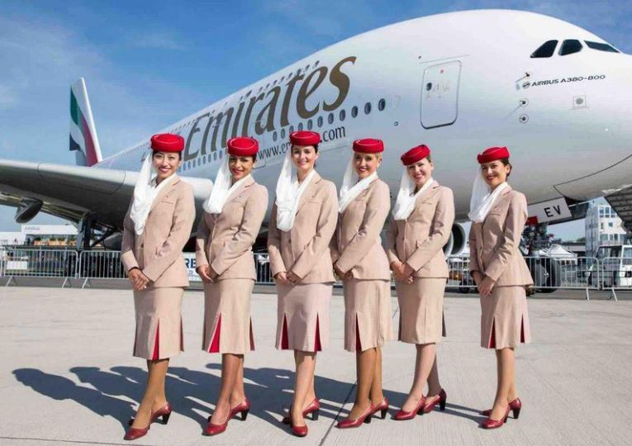
Employer branding, Emirates Airlines
Recruitment (Recruit in 150 cites using rigid tools and testing)
Development and training (Plateau Learning Management System)
Employee rewards and benefits (Special allowances increments and bonuses)
Renumeration (Competitive tax free basic salary, 4/5 *accommodation, stayover and transport allowances, profit sharing annual leave, gratuity, free tickets, educational allowances, dental & medical insurance; designer uniforms ….
Communications (interactive website with recruitment info for an international audience)
CSR
Leadership & diversity (is essential in generating new ideas and solving complex problems) Cabin crew speak multiple languages

Slide 18
Emirates airlines branding strategy outcomes
With the exception of air-crew turnover rates, the activities undertaken by the company has provided positive results. Regarding air-crew turnover, a deeper analysis into the underlying causes is required.
Main cause of leaving – Fatigue
Long shifts
Emotional labour- long hours on feet, abuse from customers is common
Untrained crew managers
Rigid shift rules
No unions and less robust employment legislation
(Jawahitha Sarabdeen, Nada El-Rakhawy and Haneen Niaz Khan, 2011)

Slide 19
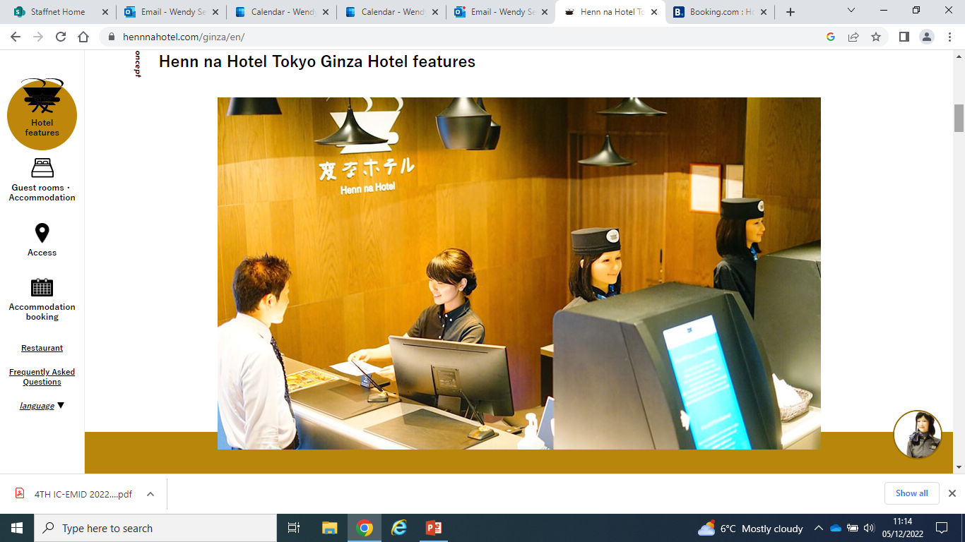
Artificial Intelligence
Hotel is fully automated with robots performing many functions
Robots speak multiple languages and greet and help customers at the front desk
Perform laborious tasks like handling luggage and other types of porterage
AI is helping hotels to make more informed decisions and increasing efficiency.
Humans are free to offer more high touch services or to deal with complex or non routine issues (Ivanov, Seyitoglu & Markova, 2020;Zlatanova & Popesku, 2019; Tracey & Swart, 2019)

Slide 20
Ranked 21st out of 121 universities in the UK

