Slide 1
Monitoring player groin health: An Evidence based (realistic) APPROACH
Neil Light 27/3/19

Slide 2
Aims:
Review necessity for groin monitoring
Available options
Interpret research findings
A clinically valid, yet realistic approach
RESEARCHER
CLINICIAN

Slide 3
Groin injury in football
12-14% of all injuries (time-loss)
Players play with symptoms
Symptoms carry over seasons
Junior => Senior injury

Slide 4
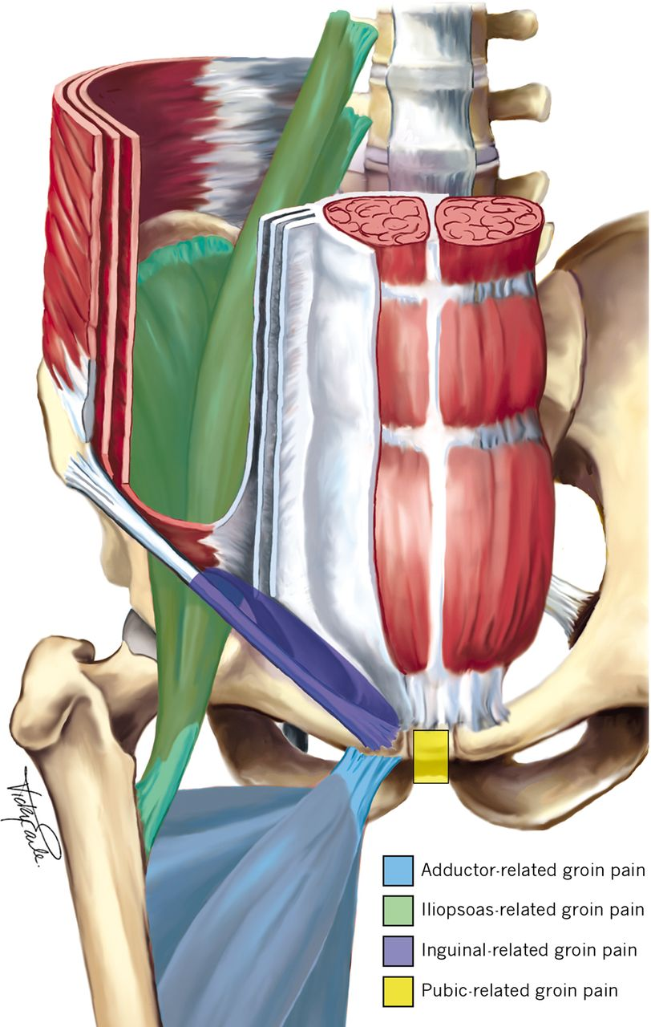
Long-standing groin pain
Adductor
Iliopsoas
Inguinal
Pubic
Weir et al. 2015

Slide 5
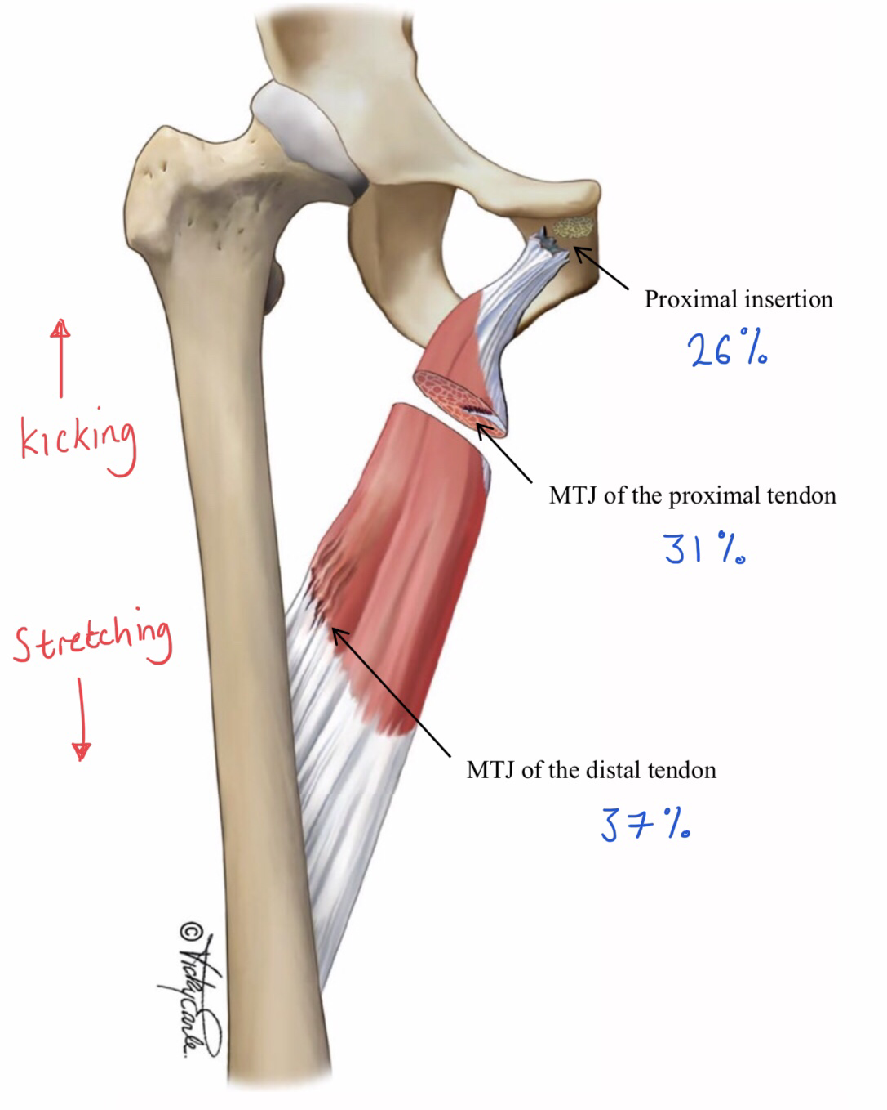
Acute groin pain
Adductor Longus 87%
Kicking > C.o.D > Stretch
Serner et al. 2016; 2018

Slide 6
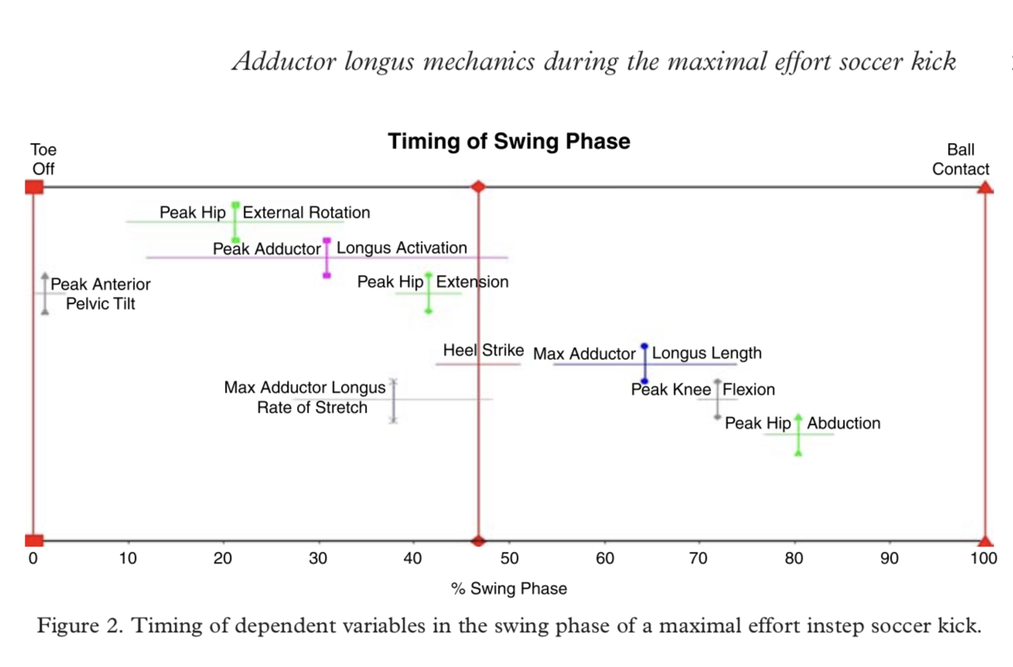
About Kicking
Charnock et al. 2009

Slide 7
Key RISK / discriminating factors
Previous groin injury
Reduced adductor strength
Low patient reported outcome measures
CLINICAL > IMAGING
Mosler et al. 2015; Serner et al. 2016

Slide 8
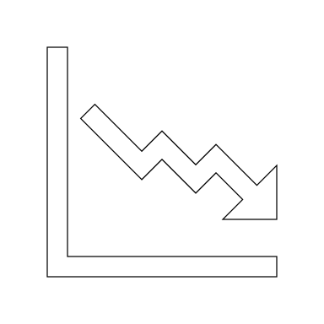
Reduced adductor strength
Precedes groin injury
4-fold risk increase
Predictive
Modifiable
Mosler et al. 2015; Crow et al. 2010; Engebretson et al. 2010; Delahunt et al. 2018

Slide 9
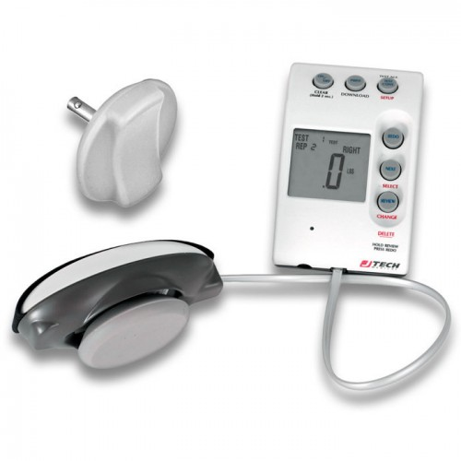
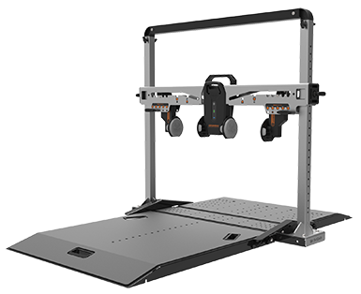
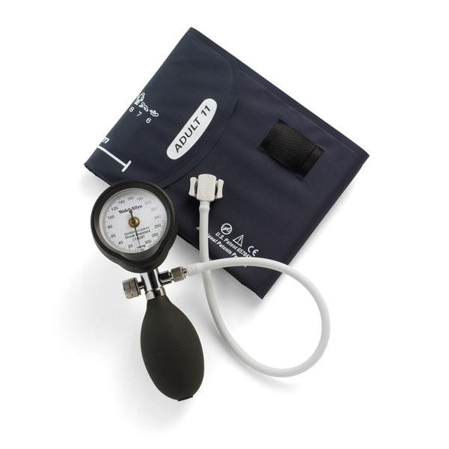
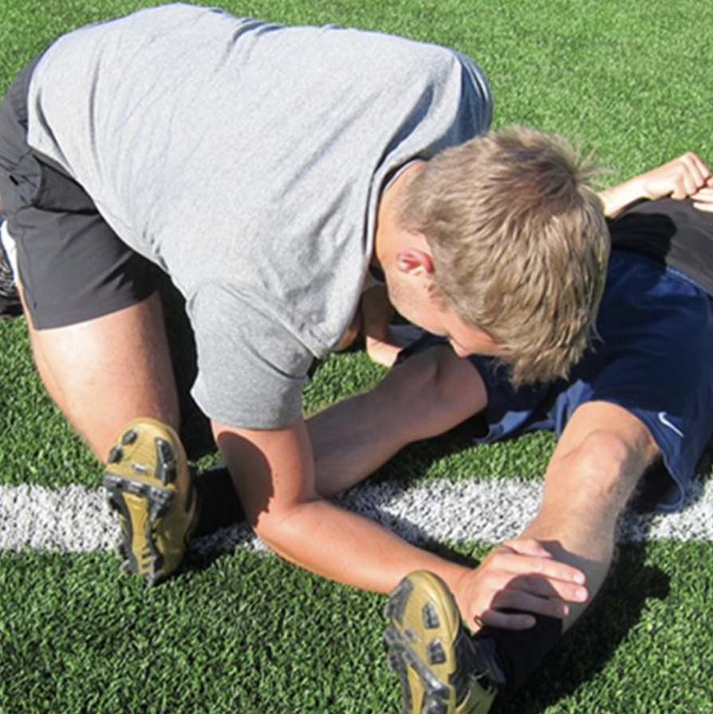
Test devices
Light & Thorborg, 2016 Ryan et al. 2019 Delahunt et al. 2011 Thorborg et al. 2017

Slide 10
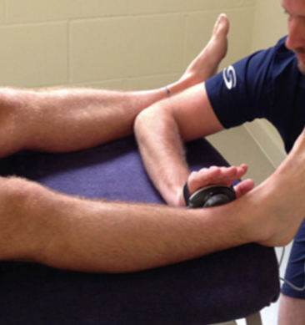
Position MATTERS
EMG
ANY DEVICE
COMFORT
STRESSFUL
NEEDS HHD
NOT COMFY

Slide 11
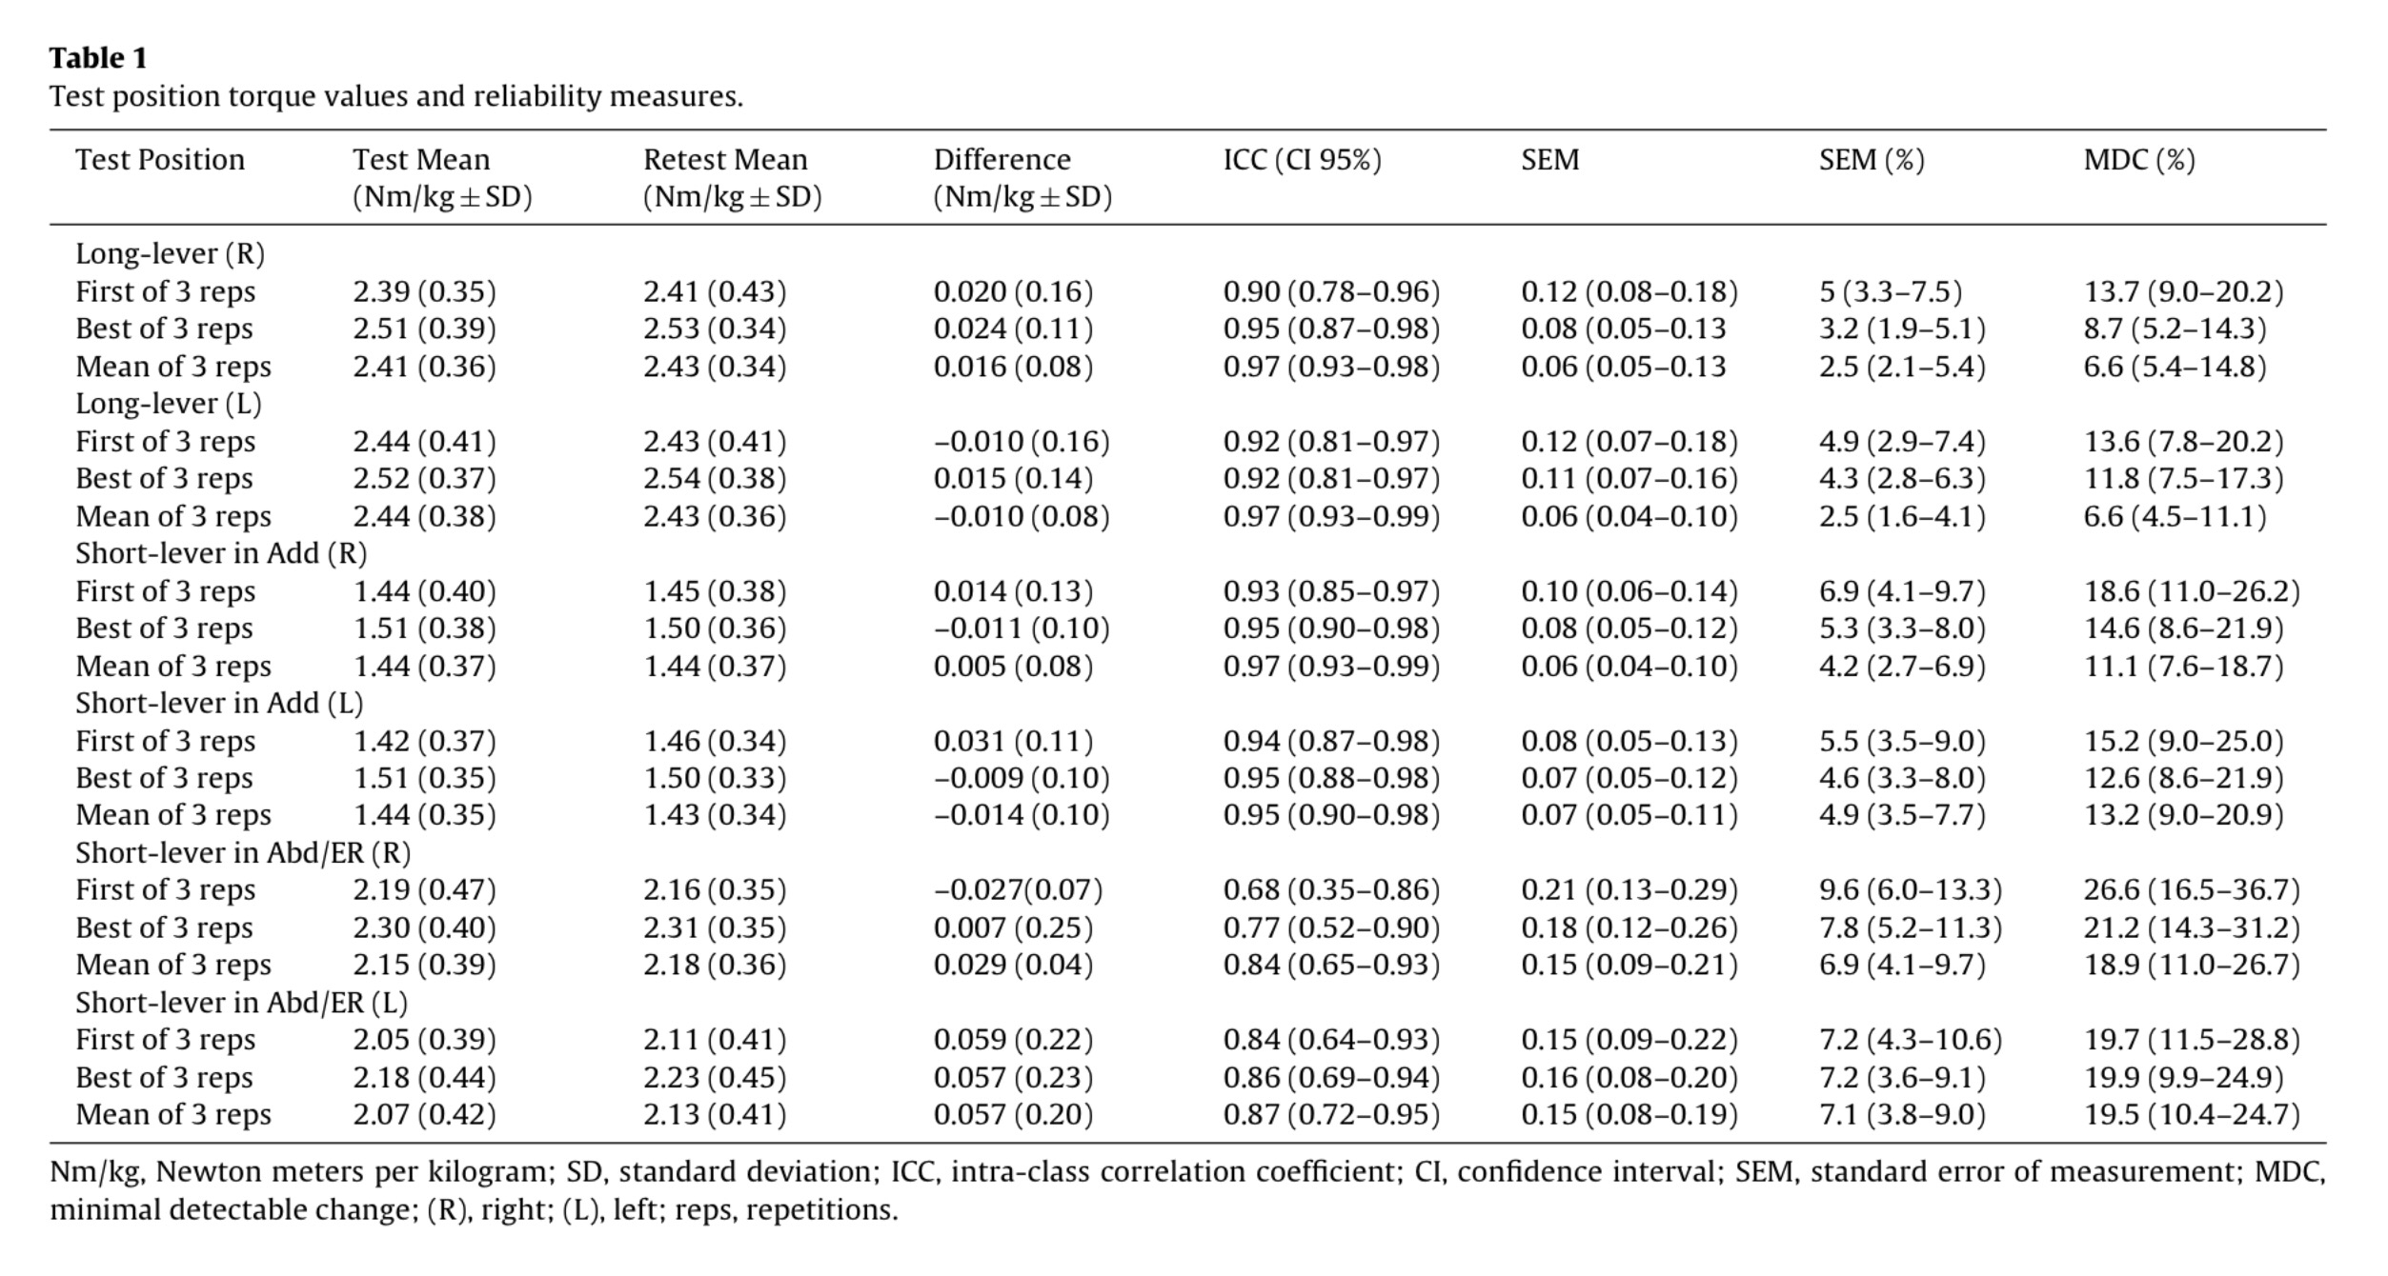
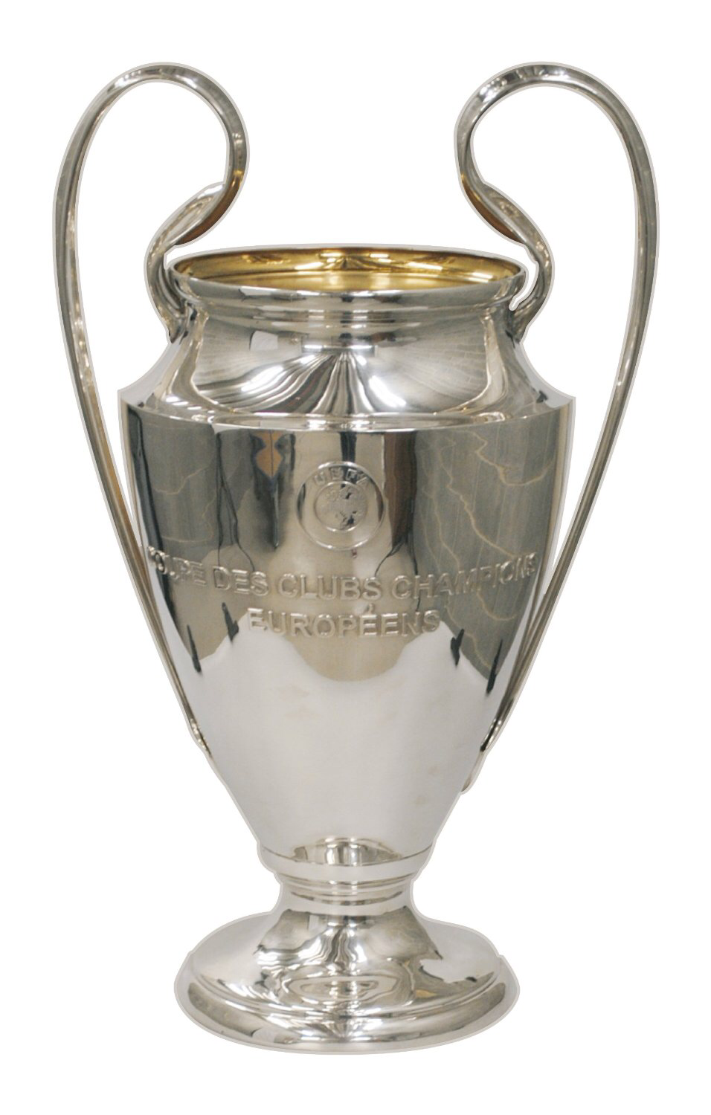
INTERPRETATION
SEM 2.5% (1.6-5.4)
MDC 6.6% (4.5-14.8)
69% ⬆ Nm/kg
Reliable
Precise
Stressful
…and EFFICIENT

Slide 12
Jtech HHD
Supine with arms extended (palms up) / mini bridge
HHD placed 5cm (3 fingers) superior to Med Malleoli
No Cx or Trunk flexion / Knees stay extended and toes pointing upwards
1 x sub-max prior to tests & 30s rest between MVC
Build up to max "go ahead – push – push – push –push relax“
PROTOCOL
Note: to weight adjust values
Lever length (m) & Body mass (kg)
- E.g. 220 (N) X 0.90 (M) / 72 (KG) = 2.75 (Nm/kg)
* lever length is leg length minus 5cm

Slide 13
Reliability
60 degree knee angle
SNR sensitive to recovery
6.3% SWC & 0.94 ICC
R vs L ☺
Pain relation & effort questionable

Slide 14
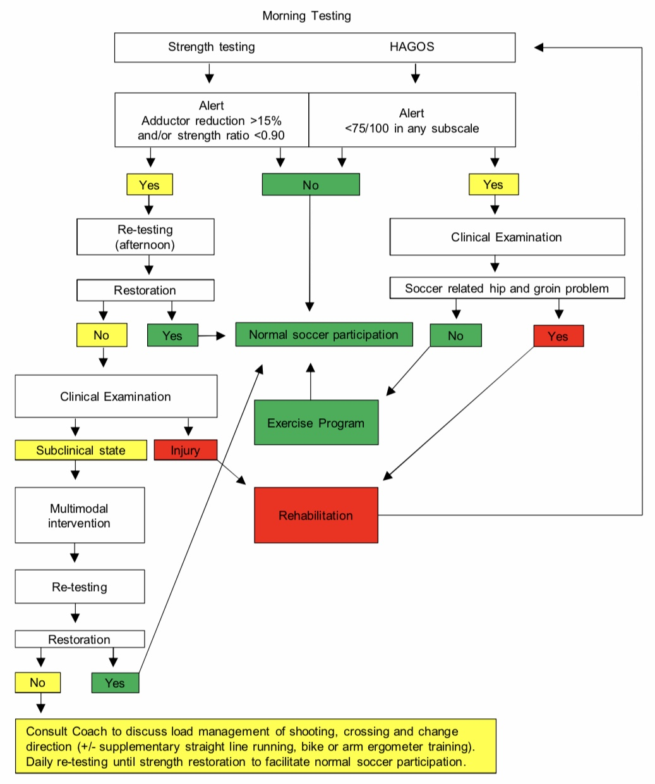
Realistic monitoring ?

Slide 15
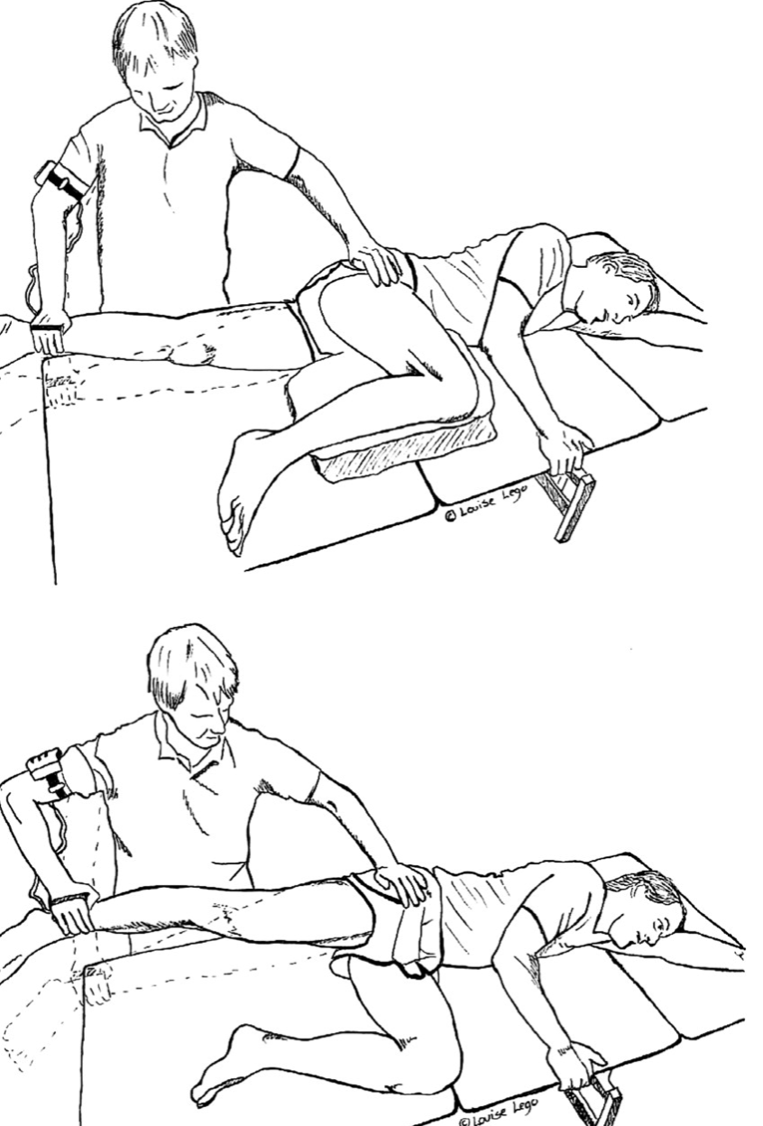
BREAK / ECCENTRIC testing
Controlled
Time consuming
Revealing

Slide 16
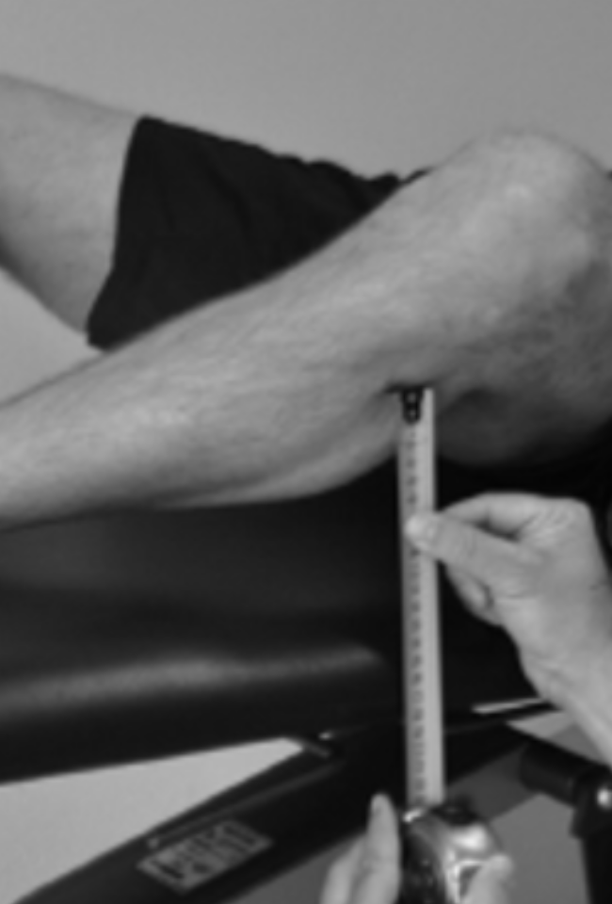
Associated tests ?
BKFO
Passive ABD
Resisted outer range ADD
Biomech Ax
Abdominal squeeze

Slide 17
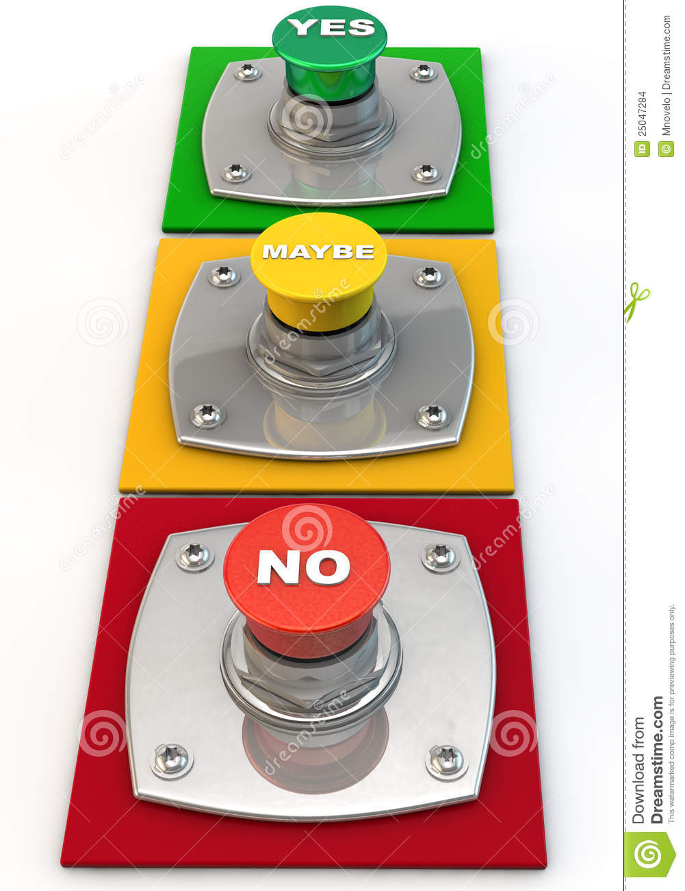
Significant Squeeze reduction
YES
NO
TALK & EXAMINE
(inc uni-lateral)
MODIFY / INTERVENE
UNAVAILABLE

Slide 18
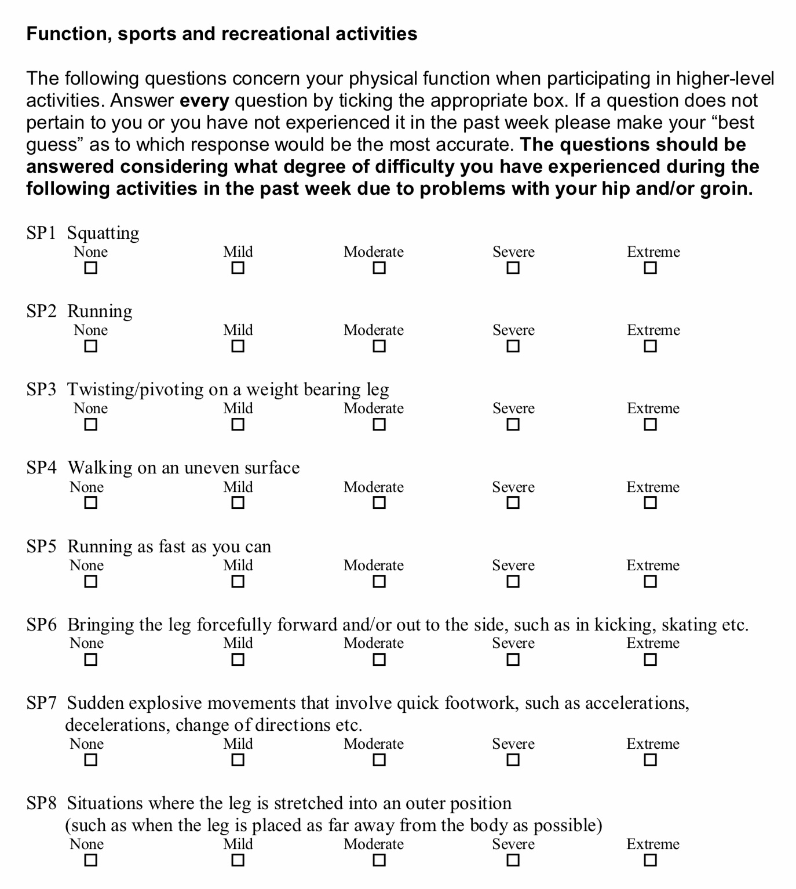
Don’t neglect PROM’s
Squeeze association (Light et al. 2018)
Predictive value ? (Delahunt et al. 2018)
Used by 3/64 academies (Light et al. 2018)
Day one of pre-season surprises (implications)
(Un-published)

Slide 19
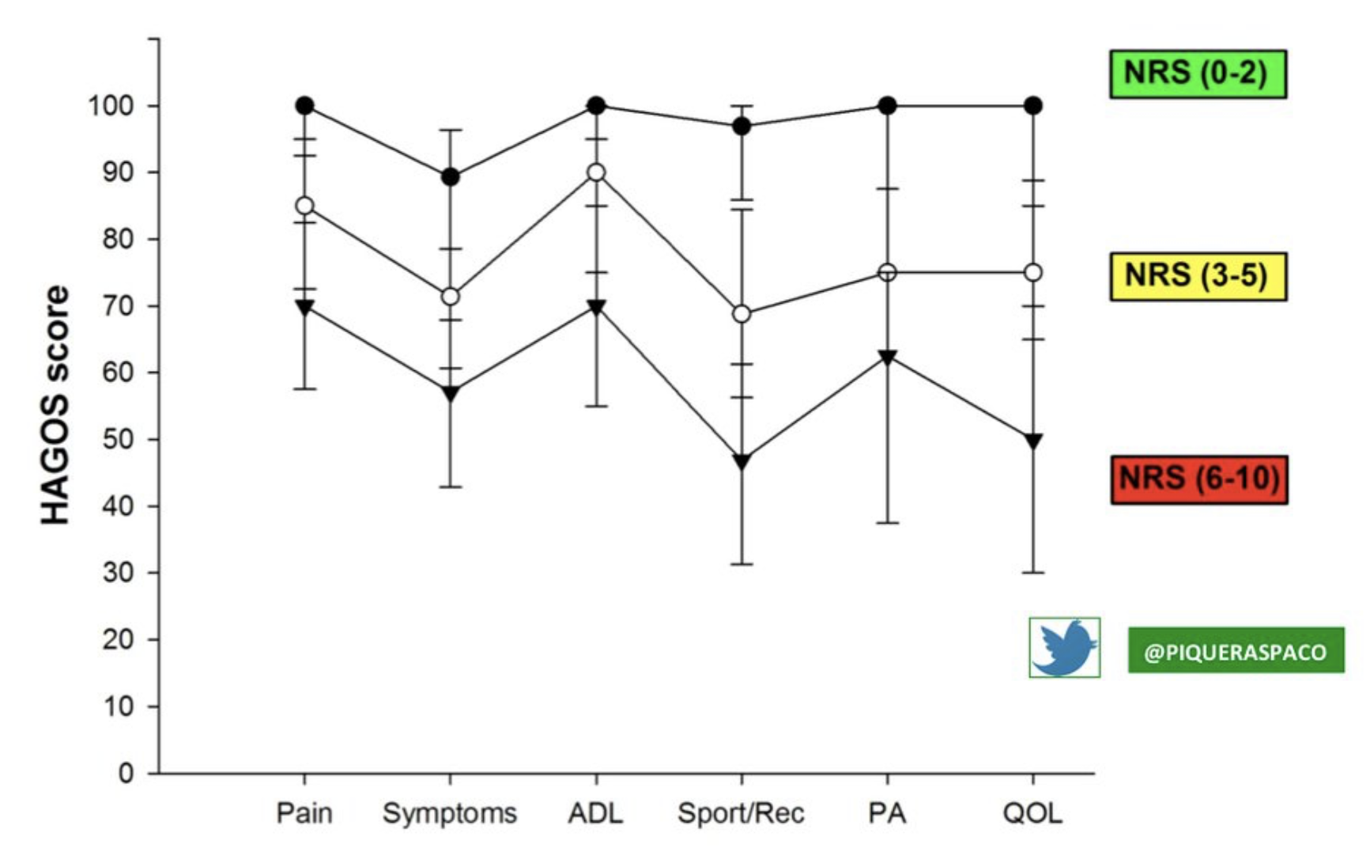
DON’T NEGLECT YOUR HANDS
Useless to gauge % strength
But…w NRS = association to symptoms

Slide 20
Recommendations (efficiency driven)
Confident substitutions
Weekly squad monitoring (m+2)
Groin bar or HHD Long-lever squeeze
Meaningful reduction = meaningful investigation
Regular
Cuff 0 & 45 / NRS squeeze / HAGOS sport
Share / refer
Detection = prevention

Slide 21
n.light@chi.ac.uk

