Slide 1
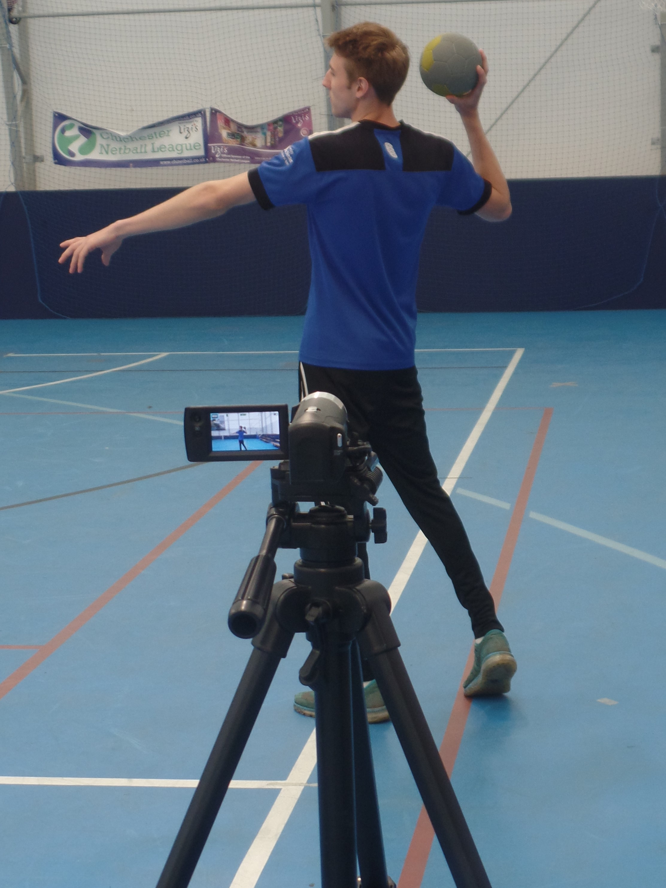
Using video and statistical feedback to reflect on pedagogical behaviours Craig Pulling and Jack Court Department of Physical Education, Chichester Institute of Sport, University of Chichester, U.K Contact: c.pulling@chi.ac.uk
INTRODUCTION
Reflective practice has been shown to be of paramount importance within teaching (Brookfield, 2017). Video offers the potential to support the reflection of teaching (Rich & Hannafin, 2009), however, little is known about the use of statistical feedback for reflective practice.
Aim: To investigate how video and statistical feedback can be used for the reflection of pedagogical behaviours by physical education teachers.
METHOD
Three male fully qualified PE teachers
Filmed teaching two blocks of three physical education lessons.
Pedagogical behaviours were recorded using an adapted version of the CAIS (Cushion, Harvey, Muir & Nelson, 2012).
Statistical feedback on the pedagogical behaviours were presented to the participants.
Semi-structured interviews.
A thematic analysis was conducted to analyse the data.
FINDINGS
Three themes were identified:
1. Value and acceptance of video and statistical
feedback
2. Increased self-awareness of pedagogical
behaviours
3. Reflecting on the pupils’ perspective.
“I think it’s all brilliant. I have been teaching for
12 years and I have never been analysed in this
way. I think as a teacher it can only be a good
thing because you have to evaluate and be
critical”. (Participant A)
“With this particular group I was very involved and spent a lot of time on instruction with the children not being active. This is potentially something I could have done differently”. (Participant B)
“Through watching the videos and the breakdown of the data you start noticing what you are doing, and thinking why am I doing that?” (Participant A)
“Very useful to see how I teach, rather than how I think I teach”. (Participant B)
CONCLUSION
The application of video and statistical feedback was an accepted and effective way of enabling physical education teachers to reflect on their pedagogical behaviours. Implementing the use of video and statistical feedback may be useful in developing the pedagogy of physical education teachers.
REFERENCES
Brookfield, S. D. (2017). Becoming a critically reflective teacher (2nd edition). San Francisco, CA: Jossey Bass.
Cushion, C., Harvey, S., Muir, B., & Nelson, L. (2012). Developing the Coach Analysis and Intervention System (CAIS): Establishing validity and reliability of a computerised systematic observation instrument. Journal of Sports Sciences, 30(2), 203–218.
Rich, P. J., & Hannafin, M. (2009). Video annotation tools: Technologies to scaffold, structure and transform teacher reflection. Journal of Teacher Education, 60(1), 52-67.

