Slide 1
Embodied Consciousness During Meditative Moving: Neurocognitive Theories
Aska Sakuta
PhD Candidate
University of Chichester

Slide 2
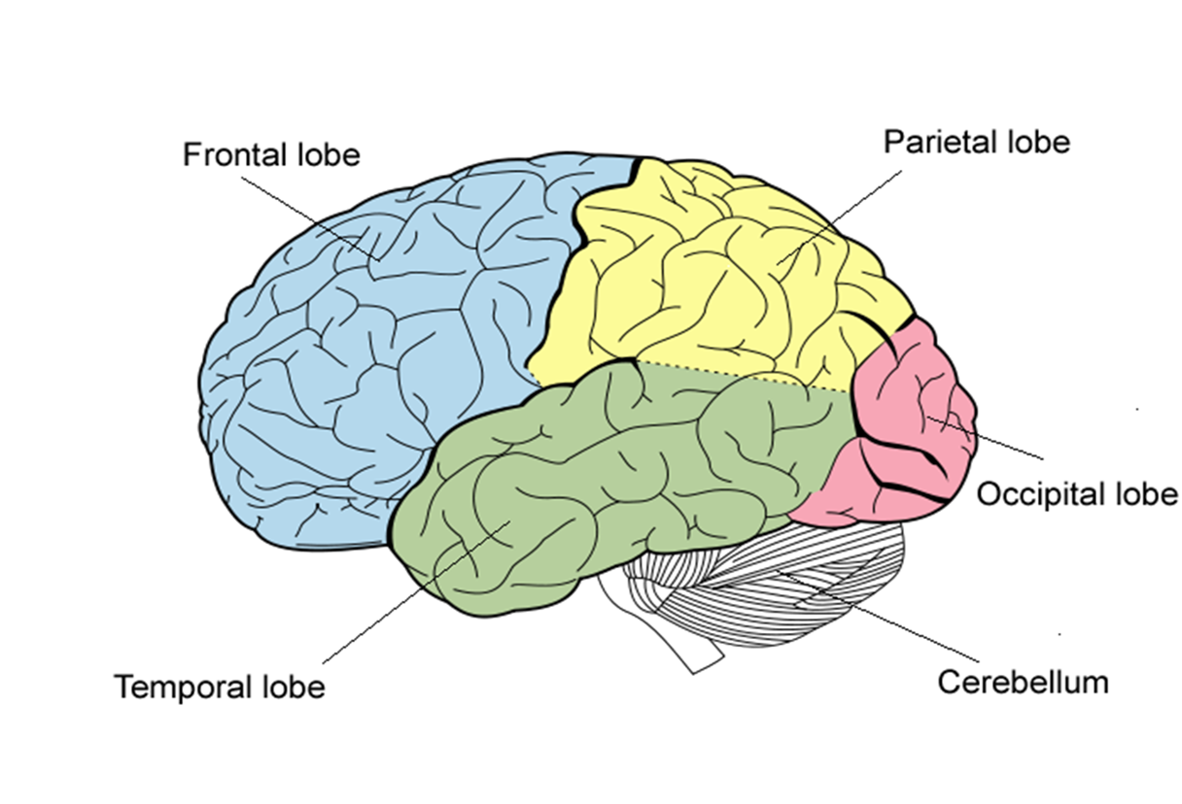
Background of Research
‘Flow’ (Csikszentmihalyi, 1990) as an embodied experience
Occurs during somatic/meditative movement episodes
Possibly causing…
‘Hypofrontality’
(Dietrich, 2003)
‘Selflessness’
(Dor-Ziderman et al, 2013)
‘Allocentricism’
= Enhanced movement performance?
(Austin, 2010)
Deactivation
Activation?

Slide 3
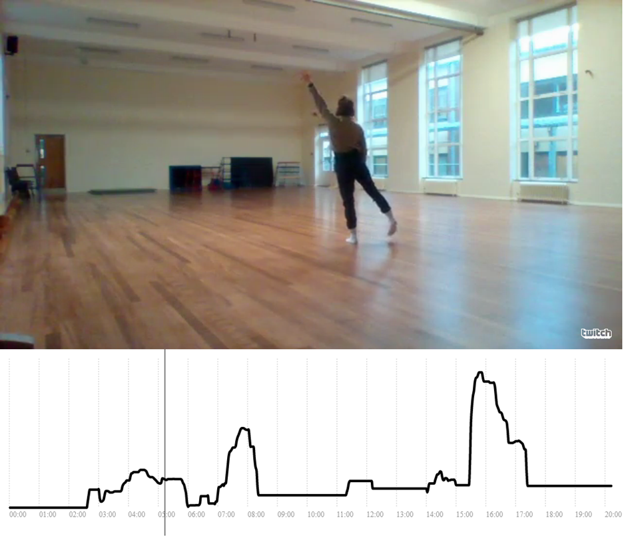
Method
Lack of methods to observe brain activity in movement…
Question: are there changes in movement qualities during Flow?
Observation + interview
1 Mover + 4 Observers: 20min. performance
Real-time measurement of observers’ perception
Post-performance interview on Mover & Observer

Slide 4
Pilot data: quantitative
Data:
X axis = time
y axis = perceived level of Meditative Flow
*05:00 – 08:00
= 3min. out of 20min.
= 300 – 480sec.
Patterns:
Low / decrease during
350 – 380sec.
Rise during 380 – 480sec.

Slide 5
Pilot data: quantitative
Data:
X axis = time
y axis = perceived level of Meditative Flow
*15:00 – 18:00
= 3min. out of 20min.
= 900 – 1080sec.
Patterns:
Rise during 900 – 930sec.
High during 930 – 980sec.
Decrease / low during
980 – 1080sec.

Slide 6
Pilot data: qualitative
Perceived level of Meditative Flow | Observed movement qualities
High or increasing | High speed fluid changes (speed, quality, etc.), intense energy, continuation, sequential, spontaneous, naturally unfolding
Low or decreasing | Low speed, hesitation, lack of continuity, consciously ‘placed’

Slide 7
References
Austin, J. H. (2010). The thalamic gateway: how the meditative training of attention evolves toward selfless transformations of consciousness. Effortless Attention. A New Perspective in the Cognitive Science of Attention and Action, 373-407.
Csikszentmihalyi, M. (1990). Flow: The psychology of optimal performance. NY: Cambridge UniversityPress.
Dietrich, A. (2004). Neurocognitive mechanisms underlying the experience of flow. Consciousness and Cognition, 13(4), 746-761.
Dor-Ziderman, Y., Berkovich-Ohana, A., Glicksohn, J., & Goldstein, A. (2013). Mindfulness-induced selflessness: a MEG neurophenomenological study. Frontiers in human neuroscience, 7, 582.

