Slide 1
Early Years Teacher: a Posthuman identity
Nikki Fairchild
BERA Conference
16th September 2015

Slide 2

Aims of this presentation
To chart progress of my doctoral studies;
To consider how Posthumanist theorising can build on concepts of professional identity;
This paper reflect on ways to use Posthumanist theorising with data separate to my doctoral studies;
To details my next steps.

Slide 3
Researcher becomings
End of second year of my doctoral studies;
Close reading of Posthumanist theory, particularly work of Deleuze and Guattari (1984; 1987);
Reflecting on MacLure (2010: pp. 277) who argues theory should ‘offend and interrupt’ and offer possibilities for opening up new thinking;
Considering how to put Posthumanist theory to work within my research.

Slide 4
Why Posthumanist theorising?
Different philosophical position to explore the decentred subject (Wolfe, 2010).
  (Re)framing of binary opposites (Jones and Holmes 2014);
  Social world as mobile, messy, creative, changing and open ended, sensory and affective (Coleman and Ringrose 2013);
  Mindful of the instability of the divide between theory and practice (Coleman and Ringrose 2013).

Slide 5
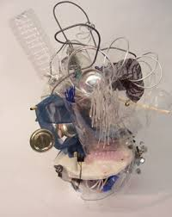
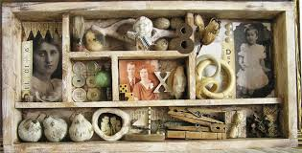
Key terminology (1)
Assemblage
Objects, utterances, institutions, bodies and fragments interrelate…..as a mix rather than a hierarchy. These entanglements form a ‘cabinet of curiosities’ (MacLure, 2013: 165).

Slide 6
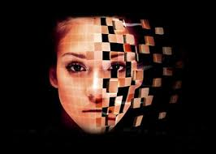
Key terminology (2)
Becoming
Subjectivities are multiplicities. Subject characterised by flows of forces, intensities, desires and are continually formed and reformed by ‘dynamic individuation’ from which the changing self emerges. (Deleuze and Parnet, 1987: 93, citied in Taylor, 2013).
The process is a metamorphosis - no end product – constantly changing (Braidotti, 2002).

Slide 7

Key terminology (3)
Molar – Regimes of power – fixed and fitted into pre-existing categories (macro);
Molecular – The little cracks, micro-politics of becoming, the ruptures (micro);
Lines of flight – Changes in direction the molar and molecular interactions.

Slide 8
A Posthuman identity….
Identity - society makes sense of a changing world (Deleuze and Guattari, 1987);
When bodies are stratified a stable sense of self produces of ‘the thinking, speaking political subject’ (Hickey-Moody and Malins, 2007, p. 5);
Difference is positive and productive - new ways of becoming (Deleuze, 1994);
Subject - continual becoming enmeshed and connected with other bodies, nature and machines (Gibson, 2006).

Slide 9
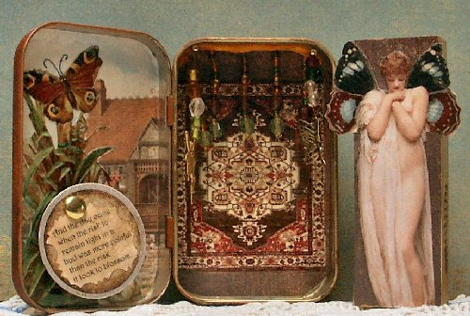
How do I intend to use Posthumanism?
I propose to chart professional becomings as a way to move forward current conceptualisations of professional identity:-
Relational assemblage reflect the material working of power and move beyond social construction to social production (Coole and Frost, 2010 pp. 7).
Ontological positioning - move beyond ‘the mind-matter and culture-nature divides of transcendental humanist thought’ (Van der Tuin and Dolphijn, 2010, pp. 155) to a position of ‘and……and….and’ rather than binary dualisms of self and other.
Agency is greater than human actions (Fox and Alldred, 2015) and that the affective nature of relational networks and human and more than human assemblages become important (DeLanda, 2006).

Slide 10
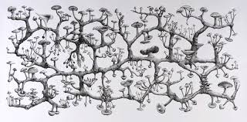
Early Years Teacher placement events
Semi-structured interview data collected from a small scale research project funded by the HEA;
All participants (n=13) had taken part in Early Years Teacher/Professional Status training (having limited early years experience);
Data analysed using a rhizomatic analysis to chart lines of flight and minutiae of professional practice (Honan and Sellars, 2006).

Slide 11
Event 1 - Laura
Student Assemblage
University~books/reading~placement~professional standards~other students~children~placement staff~assessment~expectations
“For me it was I had to get very organised have the activity really well planned and when I go to the teacher and need to be able to explain this within a minute. ‘Look I have witnessed this activity between the children and they seem to like it so I want to do it’. It has to be really clear, concise and precise. ‘Can I have five minutes of your group time or can I set this up in free play’? The first setting I had to stay quiet for three months and try not to do too much. They were being a little more sensitive about being told what to do by the student. When I did the activity I needed to make sure it was done well and tidy so staff did not feel like I had given then more jobs.” (Full pathway Early Years Professional candidate)
Professional becoming
Nursery Assemblage
Children~staff~policies and proceedures~Early Years Foundation Stage~practice~parents~ environment and resources~students

Slide 12
Event 2 - Ava
School assemblage
Placement~staff~parents~ children~ethos and philsophy~phonics~EYFS~ curricula expectations
“There was one particular child…..he was virtually mute in the nursery but was very chatty at home so I picked up on his interests. Combined that with the least messy sensory play I could find and he really responded well and I could move up and up to messier play and she watched him come out of himself and he was really chatty and he joined me with the phonics and the sounds, she could not get him to sound out his sounds, so I did big musical games in the hall like we did statutes and then added to sound out a snake ‘SSSSSS’ and spiders and that kind of thing and he would giggle and be a part of it…so she videoed that (my activities) and showed it to the parents….” (Full Pathway Early Years Professional candidate)
Professional Becoming
Student Assemblage
Childs needs and interests~curricula expectation~environment~video~parents~Staff~assessment~ professional standards
Affective response

Slide 13
Event 3 - Isabelle
Affective response
“I received a lot of information about child development which I find useful day to day. There were different themes looking at management style and multi-agency working. Most of this was new information and was beneficial, getting the references allowed me to look in the library or go onto Amazon. Having the initial topic then allowed me to investigate further….I think in the mixed session where they [more experienced students] had been in business for years and things where we would go ‘is that normal’ they would all look at us and go ‘yes’! After 15 years in the field they might have looked at us and thought we were silly.” (GEP Early Years Teacher Trainee)
Student Assemblage
University~knowledge~library~ books~Amazon~experienced students~information
Professional becoming

Slide 14
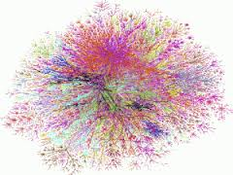
What does this show us?
Entering the assemblage allows professional becomings to be viewed as a process of (re)making a thing;
The events in this paper detail machinic assemblages in action;
All three participants experienced their own becomings as nomads (Braidotti, 2011);
Professional becomings can explore and (re)configure complexity within the everyday lives of practitioners.

Slide 15
Next Steps
Continue with close reading and grappling with dense and challenging theory;
Finalise methodology chapter
Thesis upgrade at the end of December 2015;
Data collection 2015;
Continue to consider data analysis……

Slide 16
Bibliography (1)
Braidotti, R. (2002) Metamorphosis: Towards and Materialist Theory of Becoming. Cambridge: Polity.
Braidotti, R. (2011) Nomadic Theory. The Portable Rosi Braidotti. New York: Columbia University Press.
Coleman, R. & Ringrose, J. (Ed.) (2013) Deleuze and Research Methodology. Edinburgh: Edinburgh University Press.
Coole, D. H. and Frost, S. (2010) (Eds.) New Materialisms: Ontology, agency, and politics. Durham, NC: Duke University Press.
DeLanda, M. (2006) A New philosophy of society. London: Continuum.
Deleuze, G. (1994) Difference and repetition. London: Athalone Press.
Deleuze, G. and Guattari, F. (1984) What is philosophy? Trans. By G. Burchell and H. Tomlinson. London: Verso.
Deleuze, G. and Guattari, F. (1987) A Thousand Plateaus: Capitalism and Schizophrenia. London: Bloomsbury Academic.
Fox, N. J. and Alldred, P. (2015) New materialist social inquiry: designs, methods and the research-assemblage, International Journal of Social Research Methodology, 18 (4), 399-414.
Gibson, B. E. (2006) Disability, Connectivity and Transgressing the Autonomous Body, Journal of Medical Humanities, 27, 531-546.

Slide 17
Bibliography (2)
Hickey-Moody, A. and Malins, P. (2007) Introduction: Gilles Deleuze and Four Movements in Social Thought, in A. Hickey-Moody and P. Malins (Eds.) Deleuzian Encounters. Studies in Contemporary Social Issues. Basingstoke: Palgrave MacMillan.
Honan, E. and Sellars, M. (2006) So how does it work? – rhizomatic methodologies. Engaging Pedagogies: Australian Association for Research in Education International Conference, Adelaide, SA: AARE.
Jones, L. & Holmes, R. (2014) ‘Studying play through new research practices’ in L. Brooker, M. Blaise & S. Edwards (Ed) The Sage Handbook of Play and Learning in Early Childhood. London: Sage.
MacLure, M. (2010) ‘The Offence of Theory’. Journal of Education Policy. 25(2), pp. 277-286.
MacLure, R. (2013) ‘Classification or Wonder? Coding as an Analytical Practice in Qualitative Research’, in Coleman, R. & Ringrose, J. (Ed.) Deleuze and Research Methodology. Edinburgh: Edinburgh University Press.
Taylor, C. A. (2013) ‘Mobile Sections and Flowering Matter in Participant-Generated Video: Exploring a Deleuzian Approach to Visual Sociology’ , in Coleman, R. & Ringrose, J. (Ed.) Deleuze and Research Methodology. Edinburgh: Edinburgh University Press.
Van der Tuin, I. and Dolphijn, R. (2010) ‘The transversality of new materialism’, Women: A Cultural Review, 21, 153-171.
Wolfe, C. (2010) What is Posthumanism. Minneapolis: University of Minnesota Press.

Slide 18

Contact Details
Title, Nikki Fairchild
Senior Lecturer
Department of Childhood, Social Work and Social Care,
University of Chichester,
College Lane,
Chichester,
West Sussex,
PO19 6PE.
Tel: 01243 816287
Email: n.fairchild@chi.ac.uk

