Slide 1
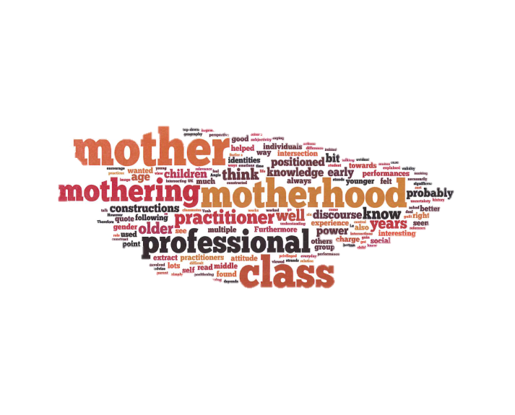
“Because I am a Mother, I am a better practitioner”:
An unexpected theme arising from the analysis of pilot study
Eva Mikuska
INTRODUCTION
RESULTS & DISCUSSION
The aim of the pilot study was to trial my main research which explores the experiences of mature students who are also mothers, studying a higher education degree in early years. The main aim was to:
Test the semi structured interviews schedule which lasted on average of 35 minutes,
Test the data analysis technique and the theoretical framework,
To develop a research question and research plan
An unexpected findings arose from the narratives which was linked to the recurrent theme of maternal discourse. The discussion were divided under two subgroups:
How discourses of motherhood are mobilised to construct the professional self;
The intersections of gender, age, class, and motherhood in constructions and performances of the professional self.
The following example illustrates that the discourse of motherhood is used to construct the image of an ideal early years’ professional; the “mother” is seen as doing right things, and this becomes the hegemonic norm. This quote is in line with the assumption that being a mother makes one a better childcare worker and that mothering can (has) be used as a form of power.
“Because I am a mother, I am a better practitioner…my emotions are totally different to someone who hasn’t got children but who works as a practitioner with lots of children because I see it as the other’s (mother) perspective and I think that I am more emotional probably because I am a parent, more so…”
METHODS
A qualitative approach was followed, involving semi-structured interviews with three recently graduated early years practitioners who started their careers as parent helpers. By “giving voice” (Mauthner and Doucet, 1998) to this group of people, their experiences were heard and explored by using a thematic narrative approach (Riessman, 2000).
The study followed a Foucauldian- informed feminist poststructuralist framework.
The interview focused on (1) the reason why the respondent joined the course, (2) the last two years of the respondent’s experience as a student and practitioner, (3) the way parent helpers are position and positioning themselves within their work and the university environment, and (4) the role of the respondent in the setting.
To discuss the next example, Butler’s (1990) view on the maternal discourse is that it is also performative, where individuals subjectivity changes over time through the ways they are positioned and positioning themselves, offers the reason behind the following performance. In the next quote the motherhood experience (participant has six children, with the oldest being 12 years old) has helped to overcome the issue of “not being in control”.
“Being a student, I found it difficult because I’m always the person in charge, and you go into a classroom, and suddenly, I am not in charge and you’re very much at the bottom of the pile, and I think I was older as well in group where there were lots of younger practitioners I felt a bit uncomfortable to start with…. and I found myself turning into the mother role in the group…”
CONCLUSION
In the pilot study, the importance of the maternal discourse within the early years context in the literature and during the interview process was not acknowledged. Therefore, conducting a pilot study is vital to evaluate the feasibility and appropriateness of the research design prior to the performance of a full-scale research project (van Teijlingen, and Hundley, 2001).
Overall, this pilot study has highlighted the gaps in the knowledge in the literature as well as the need to adjust the research design prior to conducting the main research.
REFERENCES
Butler, J., 1990. Gender Trouble. London: Routledge.
Mauthner, N.S. and Doucet, A., 1998. Reflection on a Voice-Centered Relational Method of Data Analysis: Analysing Maternal and Domestic Voices. In: J. Ribbens and R. Edwards, eds. (1998). Feminist Dilemmas in Qualitative Research: Private Lives and Public Texts. London: Sage, pp. 119-144.
Riessman, C., 2000. Analysis of Personal Narratives. In: A. E. Fortune, W. Reid and R. Miller, eds. (2000). Qualitative Research in Social Work. Chichester: Columbia University Press, pp. 168-192.
van Teijlingen, E. R. and Hundley, V., 2001. The importance of pilot studies. Social Research Update, 35. [online] Available at: <http://sru.soc.surrey.ac.uk/SRU35.html> [Accessed: 12 May 2014].
For further information please contact Eva Mikuska at e.mikuska@chi.ac.uk or visit the University of Chichester website http://eprints.chi.ac.uk/profile/421
SRHE Conference 2014
SRHE Annual Research Conference 10-12 December 2014 SRHE Newer Researchers Conference 9 December 2014

