Slide 1
TILT ON ESPORTS
Conceptualization and measurement
Iván Bonilla(UAB)
Andrés Chamarro(UAB)
Phil Birch (UC)
Benjamin T. Sharpe (UC)
Adrián Martín-Castellanos (UAX)
Diego Muriarte (UAX)
Carles Ventura (INEFC)

Slide 2
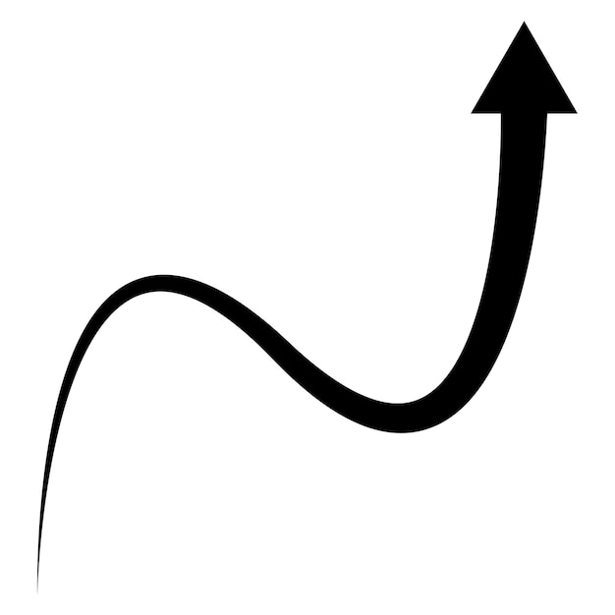
INTRODUCTION
The world of esports is experiencing rapid expansion, as projected figures for 2025 anticipate a significant increase in both regular subscribers (318 million) and casual viewers (322.7 million). This reflects a notable increase of 19.12% over the previous year (Gough, 2023).
At the same time, research in this area has seen steady growth over the past decade (Reitman et al., 2020), with academic research spanning diverse areas, such as economics (e.g., Cranmer et al., 2021 ) and sport science (e.g. Sharpe et al., 2023a; 2023b).

Slide 3
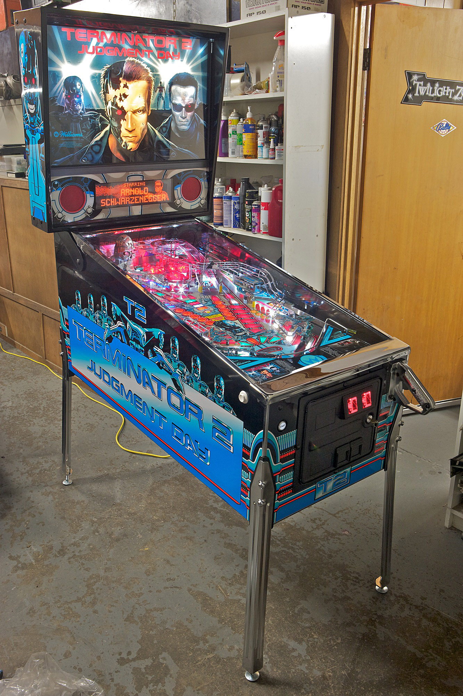
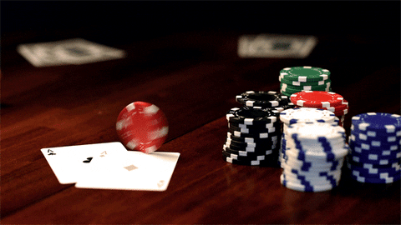
Introduction
Started in pinball → Evolved in Poker → Established in esports
Browne (1986) characterized Tilt as a mental state marked by a loss of control, which directly influences a player's playing style, including strategic decisions, gambling, risk taking, and endurance through losing streaks. prolonged.

Slide 4
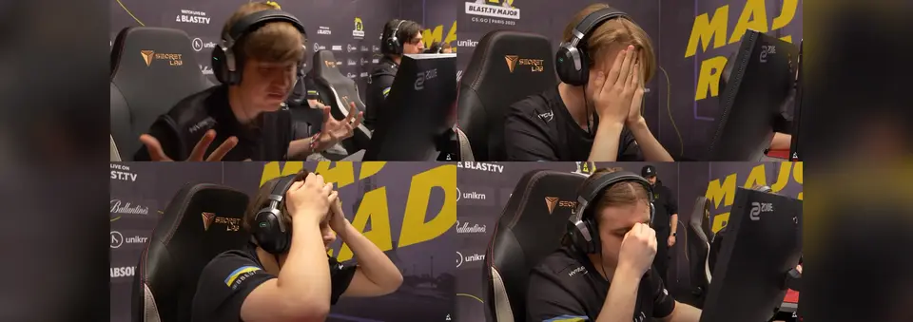
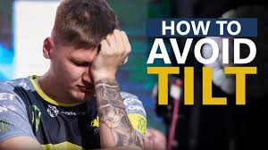
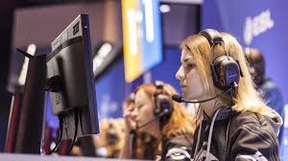
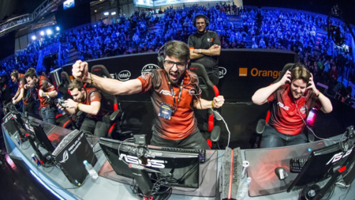
Introduction

Slide 5
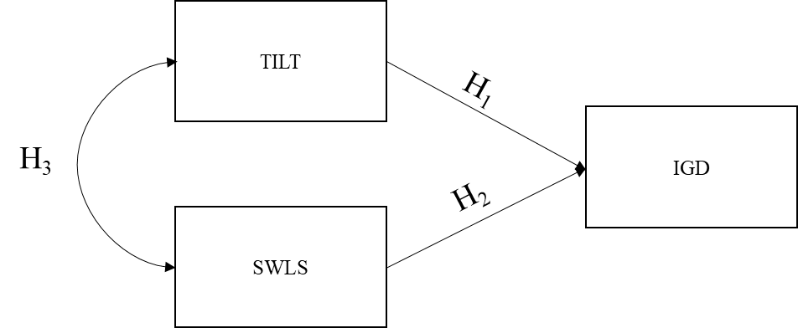
Objectives
Description and definition of TILT on esports players
Psychometric measurement
Relationship with other psychological variables

Slide 6
Method
QUALITATIVE PHASE 1
Interviews (27 coaches and players)
Analysis of the interviews
First version (170 items)
Analysis by 6 experts
Second version (103 items)
Revaluation
Third version (53 items)

Slide 7
Method
QUANTITATIVE PHASE 2
Validation of the scale internally (N=488)
Fourth version 18 items (7 causes/11 consequences)
External validation (N=488)
Use of SEM and IGD and SWLS relationship.
Final version 18 items (7 causes/11 consequences)

Slide 8
Results
“Behavior that increases gradually with repeated errors, by oneself or others in a context where performance is required, which generates frustration. This causes anger, emotional lability, decreased performance, attention, and recurrent negative thoughts about the error or defeat. Tilt is closely related to stressful situations, varying from seconds to hours, with an average duration of 30 min.”
Frustration Anger Lost of Control
Decision Making Mood Swings In-game Behavior

Slide 9
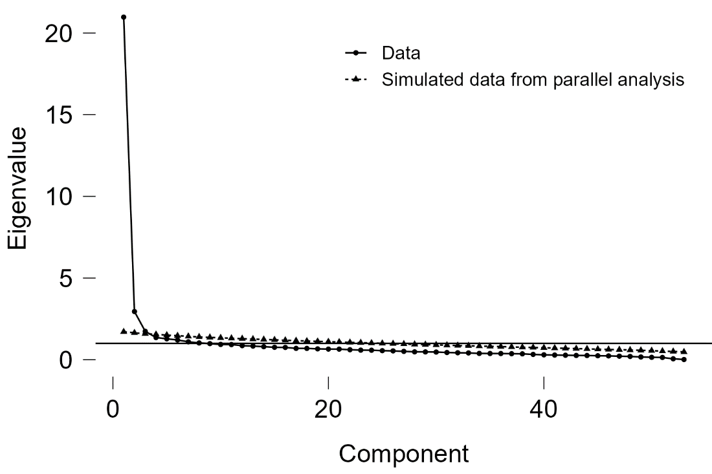
Results
Once the factor structure was determined, reliability was evaluated using Cronbach's Alpha (α) and McDonald's Omega (ω) coefficients. For the total inclination scale, McDonald's Omega was calculated as ω = .922 (.912-.932), while Cronbach's Alpha was α = .921 (.910-.931). Similarly, for the subscale measuring causes, McDonald's Omega was ω = .855 (.836-.875), and Cronbach's Alpha was α = .854 (.834-.873). For the subscale measuring consequences, McDonald's Omega was ω = .891 (.877-.906), and Cronbach's Alpha was α = .890 (.875-.904).

Slide 10
Results

Slide 11
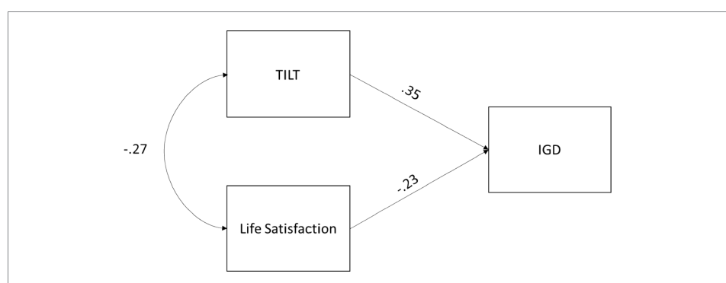
Results

Slide 12
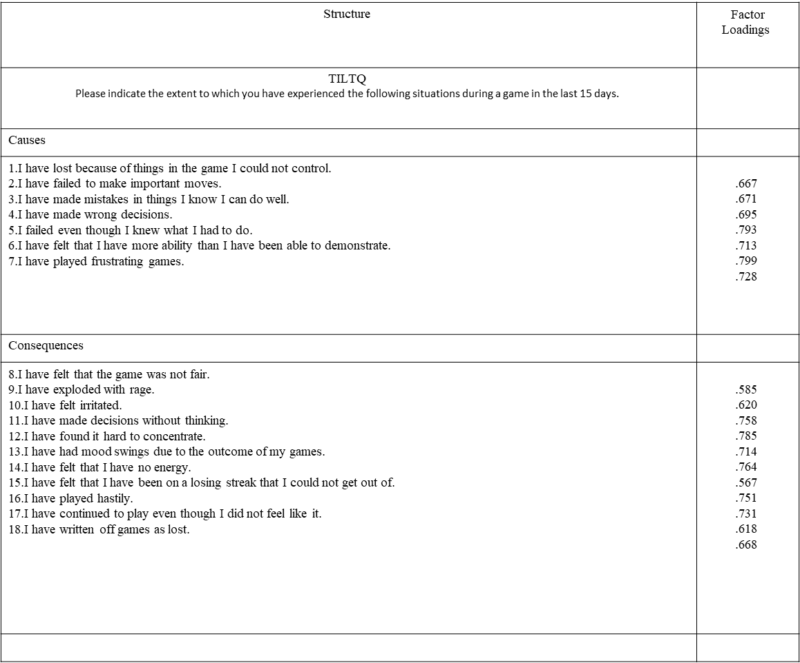
Results

Slide 13
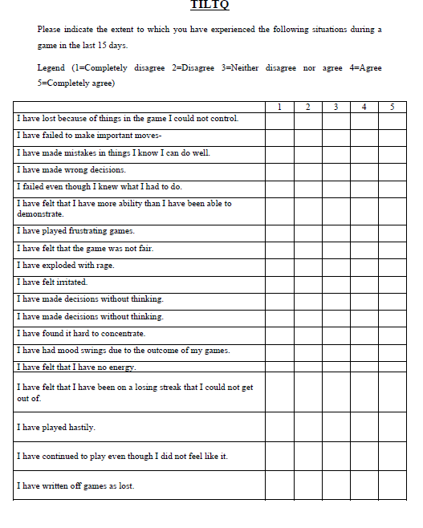
Results

Slide 14
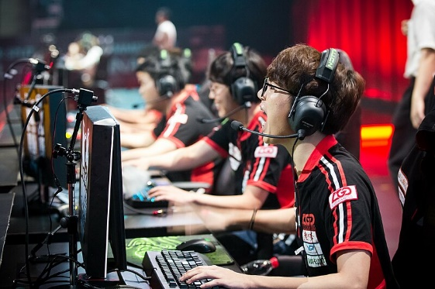
Discussion
New research area
Does it work in real contexts?
Relationship with other variables?
Can it be intervened/treated?
Is it exclusive to esports?
Will it continue to develop?
Cultural changes?
And the amateur players?

Slide 15
TILT ON ESPORTS
Conceptualization and measurement
Iván Bonilla(UAB)
Andrés Chamarro(UAB)
Phil Birch (UC)
Benjamin T. Sharpe (UC)
Adrián Martín-Castellanos (UAX)
Diego Muriarte (UAX)
Carles Ventura (INEFC)

