Slide 1
Performance Psychology in the Arena of Esports
By Dr Phil Birch
Find me on Twitter: @PhilBirch02

Slide 2
Presentation aims
Introduce myself.
Introduce esports.
My research journey.
Moving forwards.
Find me on Twitter: @PhilBirch02

Slide 3
Introduction
Senior Lecturer in Sport and Exercise Psychology at University of Chichester.
Teach two psychology of esports modules on BA Esports degree.
Researcher in performance psychology.
Find me on Twitter: @PhilBirch02

Slide 4
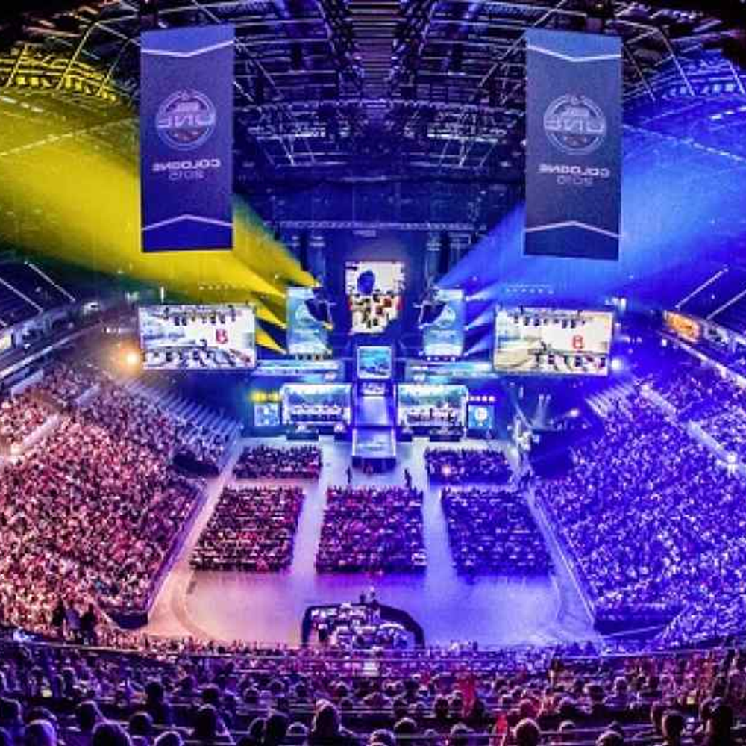
How did my research interest in esports start?
Find me on Twitter: @PhilBirch02

Slide 5
Performance psychology in esports
Find me on Twitter: @PhilBirch02

Slide 6
Defining esports
Esports can be defined as the casual or organized playing of video games in a way that provides professional or personal development to the player (Pedraza-Ramirez et al., 2020).
Find me on Twitter: @PhilBirch02

Slide 7
Esports – key information
Worth:
$24.9 billion ​
(Ahn et al., 2020)​.
Prize pools:
>$30 million
​(McLeod et al., 2021).
Format:
Online &
LAN (face to face).
Splits (seasons):
Very limited off-season time.
Find me on Twitter: @PhilBirch02

Slide 8
Esports genres
First-Person Shooter (FPS)
Multiplayer Online Battle Arena (MOBA)
E.g., Counter-Strike: Global Offensive (CS:GO).
Military-based game where opposing teams try to defeat each other.
E.g., League of Legends (LoL).
Fantasy battlefield arena game where opposing teams try to defeat each other.
Find me on Twitter: @PhilBirch02

Slide 9
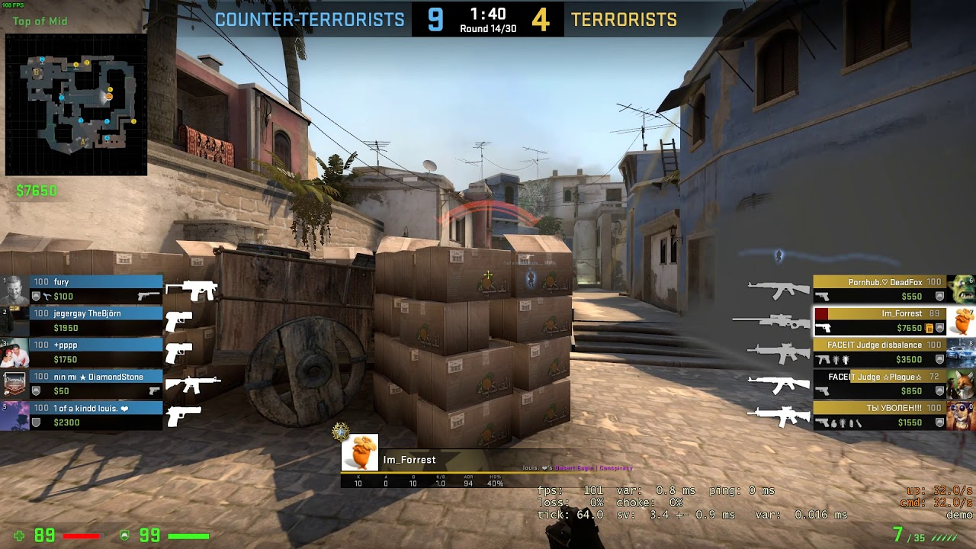
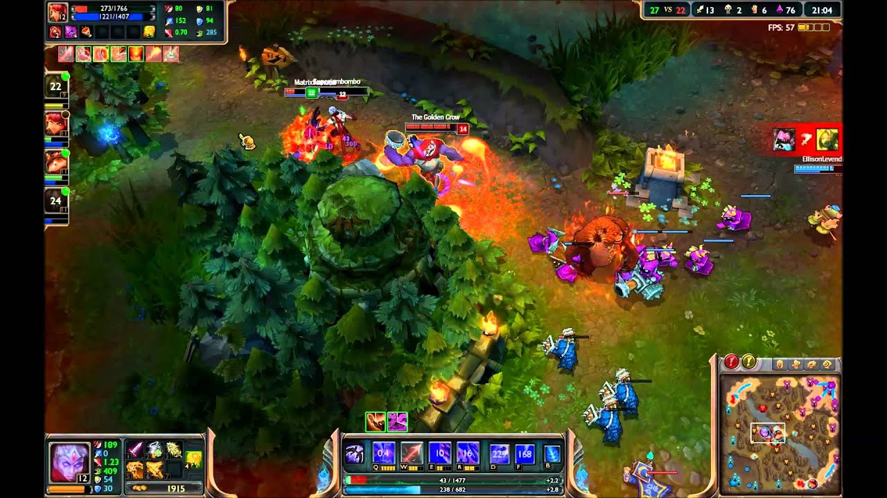
CS:GO
League of Legends
First-person view.
1 min 55 secs rounds.
Best of 30 rounds.
Best of 3 games.
Third person view.
~35 mins per game.
Best of either 3 or 5 games.
Find me on Twitter: @PhilBirch02

Slide 10
My initial research question
What is the impact of stress on esports players?
Find me on Twitter: @PhilBirch02

Slide 11
Research timeline
Smith et al. (2019)
Leis et al. (2022)
Identifying stressors and coping strategies of elite esports competitors
Examining the predictors of mental ill health in esports competitors
Sharpe et al.
(in prep)
Welsh et al.
(in prep)
The use of heart rate variability in esports
Performing under pressure in esports:
a three-experiment study
Smith et al. (2022)
Birch et al. (in prep)
Interviews
Questionnaires
Psychophysiology

Slide 12
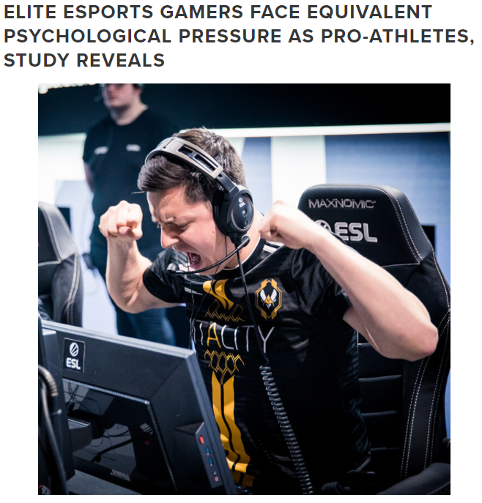
Stress and coping in CS:GO (Smith et al., 2019)
Aim
Examine the stressors faced and coping methods used in professional esports players.
Participants
Seven male professional CS:GO players.
Two to six years of playing experience in esports (M = 3.43, SD = 1.37).
Find me on Twitter: @PhilBirch02

Slide 13
Findings - Stressors
Internal
Team Issues
Communication issues.
Communication/criticism from in-game leader (IGL).
Intra-team criticism.
Lack of confidence in teammates.
Individual Issues
Life balance.
Difficulties with managing lifestyle.
External
Scrutiny and criticism
From opposition.
Criticism in social media.
Event issues
Logistics.
Live audience.
Arnold et al.
Sarkar et al.
Find me on Twitter: @PhilBirch02

Slide 14
Findings – stressors
“I was very micro-managed by the leader and if you died somewhere before they’d told you to make a move then, you’d get screamed at, like literally screamed at down the microphone, calling people on the team sh*#, and say like ‘you’re stupid.’”
Team issues – communication issues (IGL)

Slide 15
Findings - coping
If you start playing scared you don’t wanna die, you don’t want to make a mistake. . . just playing really passively and not really going for anything and not playing how you would usually play.
Avoidance coping – playing passively
Nicholls et al. (2007)
Find me on Twitter: @PhilBirch02

Slide 16
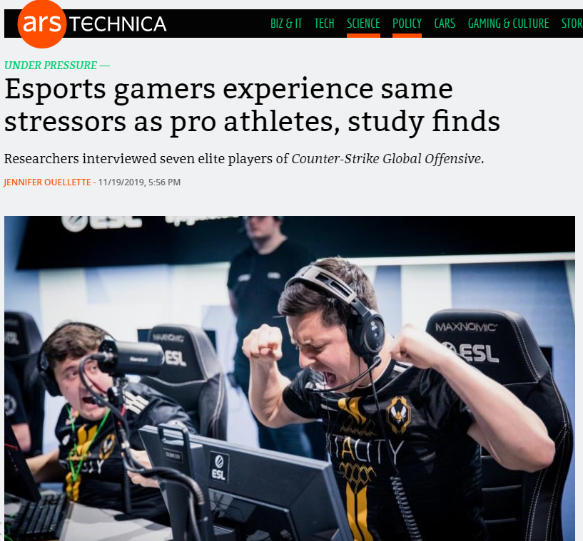
Media attention
UoC Press Report
Mentions: 80
Reach: 186,650,644
AVE: £1,073,241.20
Find me on Twitter: @PhilBirch02

Slide 17
Stress and coping in League of Legends (Leis et al., 2022)
Aim
Examine the stressors, associated responses, and coping methods used in professional esports players.
Participants
12 male professional LoL players.
6 and 11 years of experience playing LoL (M = 8.83, SD = 1.52).
Stressors
Performance expectations
Internal evaluation
Team issues
Audience and social media
Environmental constraints
Find me on Twitter: @PhilBirch02

Slide 18
Findings - coping
Social network
Attentional regulation
Increasing effort
Consumption strategies
Dissociation
Self-regulation
Find me on Twitter: @PhilBirch02

Slide 19
What do these findings mean?
Smith et al. (2019)
Leis et al. (2022)
Identifying stressors and coping strategies of elite esports competitors
Allows us to better understand what stressors are faced and how these are managed.
Develop evidence informed stress management strategies.
More longitudinal research is needed.
Dylan Poulus
Oliver Leis
Interviews

Slide 20
Research timeline
Smith et al. (2019)
Leis et al. (2022)
Identifying stressors and coping strategies of elite esports competitors
Examining the predictors of mental ill health in esports competitors
Sharpe et al.
(in prep)
Welsh et al.
(in prep)
The use of heart rate variability in esports
Performing under pressure in esports:
a three-experiment study
Smith et al. (2022)
Birch et al. (in prep)
Questionnaires

Slide 21
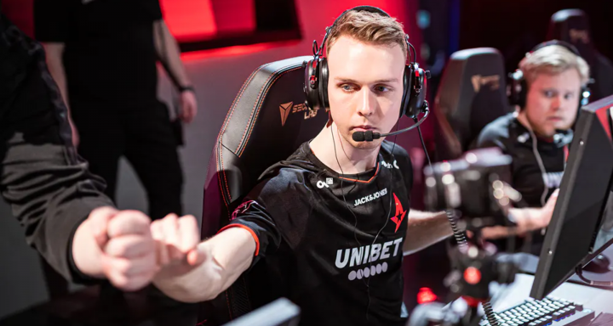
Stress and mental ill health in esports
Contacted by key stakeholders.
Professional
Student-based (NUEL)
More research needed to inform development of mental health support systems (Rice et al. 2016).
2020: Lukas “gla1ve” Rossander switched to the bench in order to recover from ongoing psychological stress and burnout.
Find me on Twitter: @PhilBirch02

Slide 22
Key terms
Mental health can be defined as a state of wellbeing in which every individual realises his or her own potential, can cope with the normal stresses of life, can work productively and fruitfully, and is able to make a contribution to his or her community (The World Health Organisation, 2014).
Mental ill health refers to a negative state of wellbeing, and severe mental ill health refers to diagnosable disorders such as depression or anxiety.
Find me on Twitter: @PhilBirch02

Slide 23
Mental health in FPS
Smith et al. (2022)
Aim
Examine the predictors of mental ill health in university-based FPS players.
Participants/procedure
Students (n = 313) who competed in FPS;
CS:GO (n = 165)
Valorant (n = 68)
Rainbow Six Siege (n = 80)
Data was collected via Qualtrics over 2 months (partly during UK Covid lockdown).
Birch et al. (in prep)
Aim
Examine the correlates and prevalence of mental ill health in pro CS:GO players.
Participants/procedure
Pro (n = 51) CS:GO players;
17.1% of total registered pros.
76.5% played at least one €500k prize in previous 12 months.
Data was collected via Qualtrics over 5 months.
Find me on Twitter: @PhilBirch02

Slide 24
Measures and hypotheses
Stressors
Sleep:
Pittsburgh Sleep Quality Index
(Buysse et al., 1989).
Burnout:
Athlete Burnout Questionnaire
(Raedeke & Smith, 2001).
Social phobia anxiety:
Social Phobia Inventory
(Connor et al., 2000).
Psychological distress:
Distress Screener
(Foskett & Longstaff, 2017)
General anxiety and depression:
General Health Questionnaire – short form
(GHQ-12; Goldberg et al., 1997).
Severe depressive symptoms:
Patient Health Questionnaire
(PHQ-9; Johnson et al., 2002).
Mental ill health prevalence in pro sample
Find me on Twitter: @PhilBirch02

Slide 25
Smith et al. (2022) – student-based stressors
Stressors
Teammate concerns
In-game pressure
Teammate interactions
Personal concerns
Game-specific worry
IGL-specific interactions
Game-specific uncertainty
Developed 57 stressors
Scrutinised by key stakeholders
PCA used to categorise stressors
Resulted in 33 stressors
Find me on Twitter: @PhilBirch02

Slide 26
Birch et al. (in prep) – pro stressors
Collated stressors from traditional sports (e.g., Sakar & Fletcher, 2016) and esports (e.g., Smith et al., 2019).
Expert panel of CS:GO players (n = 3) and coaches (n = 3) ranked stressor importance.
E.g., worries about skill level.
E.g., what to do after competing.
Competitive (n = 11)
Personal (n = 3)
E.g., contract issues.
Organisational (n = 9)
Find me on Twitter: @PhilBirch02

Slide 27
Main findings - stressors
Smith et al.
(2022)
Personal concerns
Game-specific uncertainty
DS, GHQ-12, PHQ-9
In-game pressure
Birch et al. (in prep)
Personal stressors
DS (r = .34*), PHQ-9 (r = .46**)
Note. *p < .05. **p < .01.

Slide 28
Mental health prevalence findings
Distress screener
GHQ-12
82.4%
54.9%
Find me on Twitter: @PhilBirch02

Slide 29
Mental health prevalence findings
PHQ-9
25.5%
Find me on Twitter: @PhilBirch02

Slide 30
What do these findings mean?
Examining the Predictors of Mental Ill Health in Esport Competitors
Smith et al. (2022)
Birch et al. (in prep)
Personal stressors appear to impact mental health in both university-based and pro players.
Prevalence of mental ill health in pro CS:GO appears alarming.
Further research is needed to underpin evidence-based healthcare provision.
Ana Pereira - mental health literacy in FIFA players.
Questionnaires

Slide 31
Research timeline
Smith et al. (2019)
Leis et al. (2022)
Identifying stressors and coping strategies of elite esports competitors
Examining the predictors of mental ill health in esports competitors
Sharpe et al.
(in preparation)
Welsh et al.
(in preparation)
The use of heart rate variability in esports
Performing under pressure in esports:
a three-experiment study
Smith et al. (2022)
Birch et al. (in prep)
Psychophysiology

Slide 32
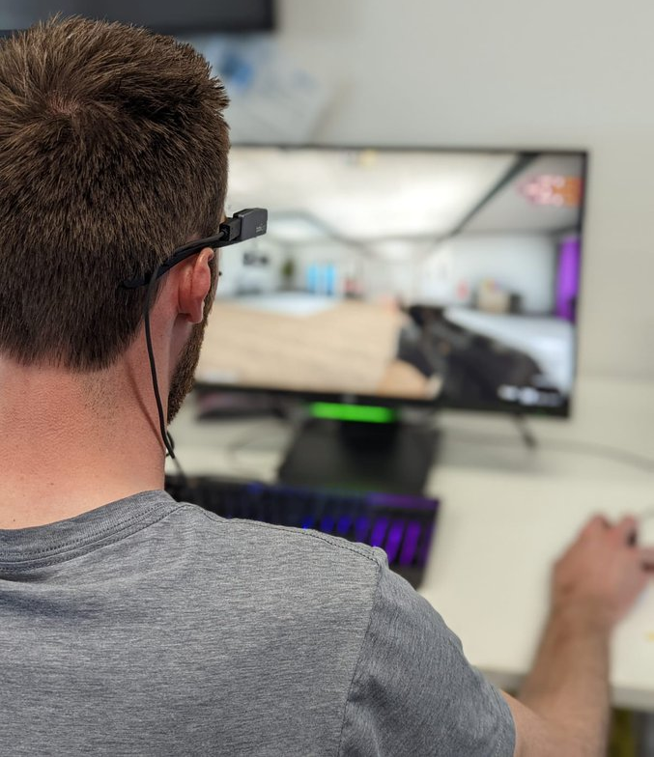
Sharpe et al. (in prep) – Performing under pressure
Participants
28 national professional (fully salaried) CS:GO players.
≥ five national tournaments in the past two years (M = 19.18, SD = 10.92).
Design – two experimental counterbalanced conditions.
Pressure (4 trials)
Negative feedback, streamed and live audience of ‘potential recruiters’. (Leis et al., 2022; Poulus et al., 2021; Smith et al., 2019, 2022).
Control (4 trials)
No specific instructions or stressors were provided.
Task
Simulated time-trial.
Find me on Twitter: @PhilBirch02

Slide 33
Sharpe et al. (in prep) – gaze behaviour findings
t(27) = -4.57,
p < 0.007,
d = .662.
t(27) = 7.35,
p < 0.007,
d = .326.
311.82
206.75
140.54
193.54
Find me on Twitter: @PhilBirch02

Slide 34
Sharpe et al. (in prep) – performance findings
t(27) = -10.09, p < 0.007,
d = .752.
t(27) = 12.08,
p < 0.007,
d = .915.
51.12
88.30
80.04
40.96
Find me on Twitter: @PhilBirch02

Slide 35
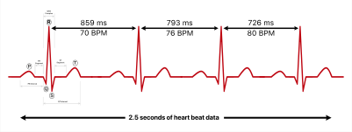
Welsh et al. (in prep) – Systematic review of HRV in esports
Heart Rate Variability (HRV) represents the changes in time between successive heartbeats (Berntson et al., 1997; Camm et al., 1996; Akselrod et al., 1981).
Higher HRV is (typically) good.
Greater capacity to increase or decrease HR.
HRV research in SEP often lacks theoretical underpinning leading to inconsistent measurement
(Mosley & Laborde, 2022).
HRV reflects self-regulation
Yet….
Find me on Twitter: @PhilBirch02

Slide 36
Welsh et al. (in prep) – Systematic review of HRV in esports
Aim: To systematically review how HRV has been utilised within esports research.
Inclusion: ​
Empirical study​
HRV in any esports context​
Assess participants at any level in esports​
English language​
Exclusion:​
Non peer review​
Pre-existing clinical illness
Other than Internet Gaming Disorder​ (IGD)
Opinion pieces or reviews
10,732 records identified
7 articles included
8,297 records screened
Identification
Screening
Included
50 full texts
Find me on Twitter: @PhilBirch02

Slide 37
Welsh et al. (in prep) – Main conclusions
Stress* (self-regulation)
Physiological reaction of players
(Andre et al., 2020; Bennet et al., 2022).
There is high inter-participant variability – facing different in game stressors
(Bennet et al., 2022).
Internet gaming disorder (IGD)
Individuals with IGD may have lower LnHF during gaming (Hong et al. 2018).
Reduction in HF may be linked to IGD (Thayer et al., 2009).
Applications
Underpinning - 0
Laborde et al. (2017) – 3*
Theory
Methodological
recommendations
Malik (1996) - 2
Find me on Twitter: @PhilBirch02

Slide 38
What do these findings mean?
Sharpe et al.
(in prep)
Welsh et al.
(in prep)
The use of heart rate variability as a marker of self-regulation in esports
Performing under pressure in esports:
a three-experiment study
Successfully manipulated pressure
Pressure impacted performance.
Both eye tracking and HRV may be promising means to test theory in esports.
More high quality/robust research is needed!
Psychophysiology

Slide 39
Research timeline
Smith et al. (2019)
Leis et al. (2022)
Identifying stressors and coping strategies of elite esports competitors
Examining the predictors of mental ill Health in esports competitors
Sharpe et al.
(in prep)
Welsh et al.
(in prep)
The use of heart rate variability in esports
Performing under pressure in esports:
a three-experiment study
Smith et al. (2022)
Birch et al. (in prep)
Interviews
Questionnaires
Psychophysiology

Slide 40
Reflections from the Past Driving the Future in Sport & Exercise Science
Can we navigate “Chaos in the brickyard?”
Bernard K. Forscher (1963)
Application
Research
Theory
Find me on Twitter: @PhilBirch02

Slide 41
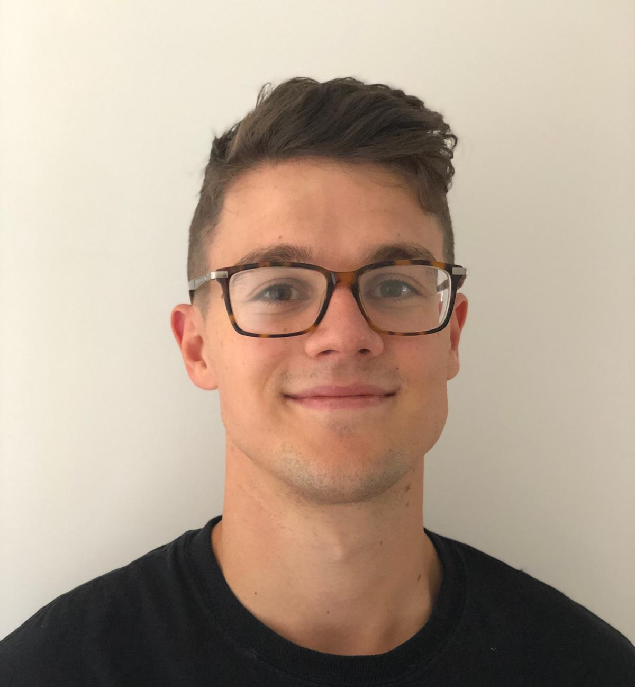
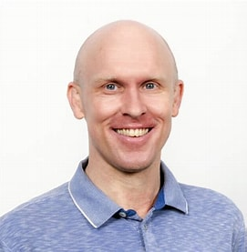
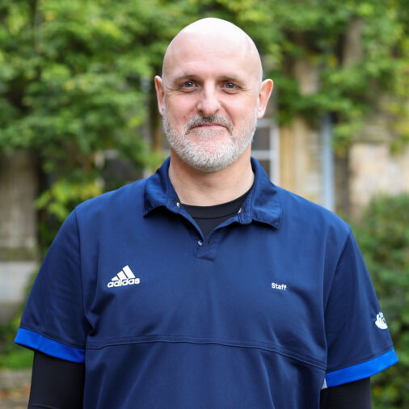
Thank you for your attention. Any questions?
Email: P.Birch@chi.ac.uk
Twitter: @philbirch02
Scan Me
References available on request.

