Slide 1
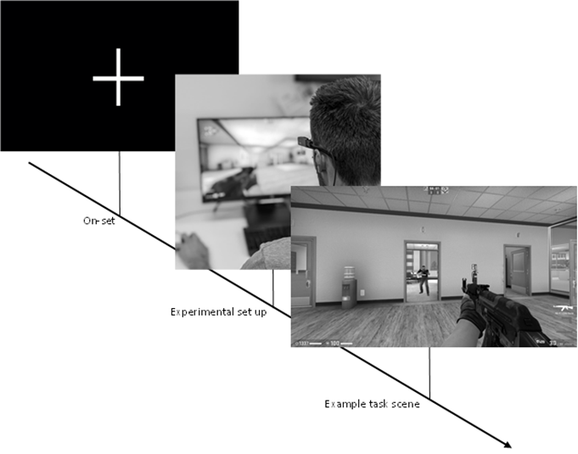
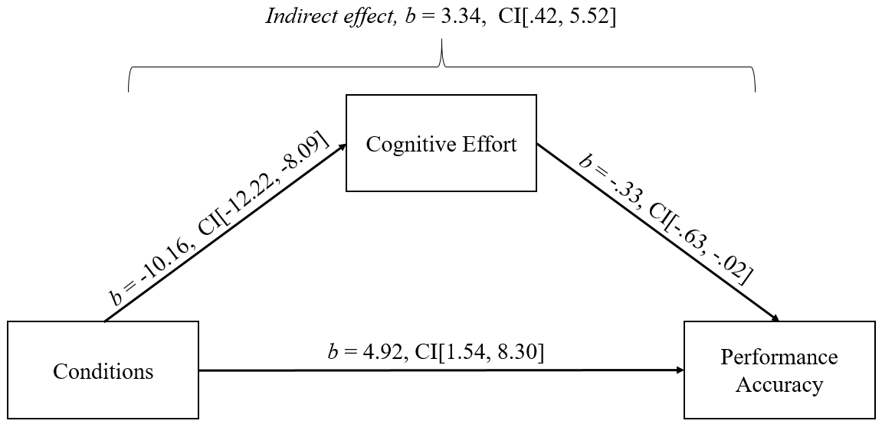
Performing under Pressure in Esports: A Three-Experiment Paper
Benjamin T. Sharpe (@benjamintsharpe)
Emmanuel A. C. Obine (@ObineEmmanue)
Introduction
Much like traditional sporting domains, esport performers are often presented with a variety of stressful conditions. However, researchers have only recently started to discuss the psychological mechanisms underpinning esports performance. As such, there is a need to better understand the impact of stress on esports performance.
Method
All participants took part in the two experimental conditions (stressor vs. control), which were counterbalanced to negate the potential of order effects. Performance was measured through total time taken to complete the simulated CS:GO time-trial and percentage accuracy (i.e., hits vs. misses) in hitting targets (see image below). A head-mounted mobile eye tracker was used to simultaneously record participants eye movements. A range of stressors were introduced to elicit a high-pressure condition, including negative feedback, a streamed audience (i.e., Twitch.TV), a live audience of ‘potential recruiters’, a leader board demonstrating participants performance scores, amongst others. While the control condition included none of the above stressors.
Results
The study revealed that the pressure condition resulted in a significant increase in task completion time and decreased accuracy. Differences in individual gaze behaviour were observed across the tested conditions, with higher search rates in the pressure condition. Additionally, quiet eye duration was significantly reduced in the pressure condition compared to the control condition, which is consistent with prior research demonstrating negative effects of pressure on accuracy and quiet eye periods. The shorter final fixation may indicate a diversion of resources away from the goal-directed system, leading to decreased task-relevant information detection and impaired motor response timing and accuracy.
Stress influences gaze behaviour, quiet eye durations, and esport action performance
Benjamin T. Sharpe^{*,1}, Emmanuel A. C. Obine¹, Phil D. J. Birch², Chris Pocock², & Lee J. Moore³
¹Institute of Education, Social and Life Sciences, University of Chichester, Chichester, UK
²Institute of Sport, Nursing and Allied Health, University of Chichester, Chichester, UK
³Department for Health, Faculty of Humanities and Social Sciences, University of Bath, Bath, UK
Discussion
Findings revealed that the high-pressure scenario was associated with reduced visual efficiency, reductions in action performance, increases in effort and anxiety, and a perception of threat. The present study contributes to the stress-performance relationship in esports and highlights a critical need for interventions to alleviate the negative influences of esport stressors on performance (e.g., arousal reappraisal).
Exploratory Analysis
Cognitive effort, as recorded through pupillometry, significantly mediated the relationship between condition on accuracy. There was a significant indirect effect of experimental conditions and accuracy through cognitive effort (b = 3.3372, 95% BCa CI [.42021, 5.5161]; see Figure below) – so what?
Are you an esport player/athlete? Would you like to be a participant in our next study?
Are you a researcher? Would you like to collaborate on a future project?
Please scan the QR code below and get in contact:
Selected References
Sharpe, B. T., Besombes, N., Welsh, M. R., & Birch, P. D. (2023). Indexing Esport Performance. Journal of Electronic Gaming and Esports, 1(aop), 1-13.
Smith, M., Sharpe, B. T., Arumuham, A., & Birch, P. (2022). Examining the Predictors of Mental Ill Health in Esport Competitors. Healthcare, 10, (4), 626.

