Slide 1
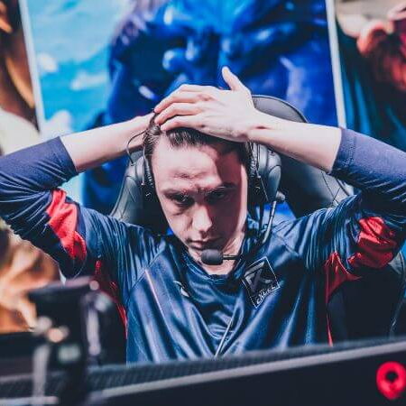
Mental ill health in professional esports athletes: Prevalence and relationships
Phil Birch
Ben Sharpe
Angelica B. Ortiz de Gortari
Aty Arumuham
Matt Smith

Slide 2
Defining key terms
Mental health can be defined as ‘a state of wellbeing in which every individual realises his or her own potential, can cope with the normal stresses of life, can work productively and fruitfully, and is able to make a contribution to his or her community’ (The World Health Organisation, 2014, pp. 231).
Mental ill health refers to a negative state of wellbeing, and severe mental ill health refers to diagnosable disorders such as depression or anxiety.
1

Slide 3
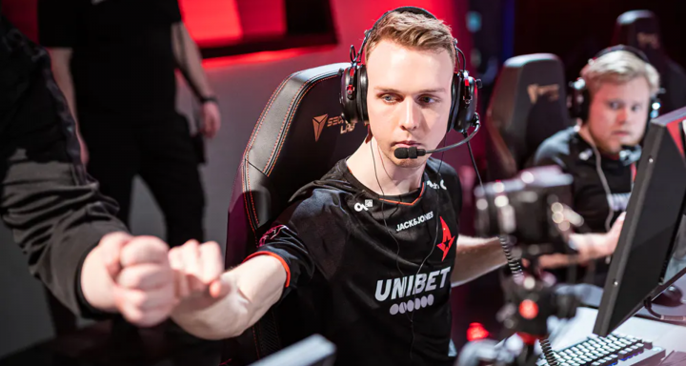
Stress and mental ill health – elite athletes
Exposed to more than 600 Stressors (Arnold et al. 2012).
More research needed to inform development of mental health support systems (Rice et al. 2016).
Lukas “gla1ve” Rossander switched to the bench to recover from ongoing psychological stress.
2

Slide 4
Stress and mental ill health in esports
Pereira et al. (2021) (FIFA)
High prevalence of mental ill health
37% depressive symptoms
22% anxiety symptoms
Distress positively related to:
Depressive symptoms
Anxiety symptoms
Smith et al. (2022)
(University-based FPS esports competing at a high level)
Predictors
Stressors
Burnout
Social phobia anxiety
Sleep
Outcome
Mental ill health
4

Slide 5
Aims and hypotheses
1) Explore prevalence of mental ill health symptoms in pro esports sample.
2) Examine relationships between relevant variables.
Mental ill health
Anxiety/depression
Severe depressive symptoms
Psychological distress
Stressors
Burnout
Sleep
5

Slide 6
Method
Participants
n = 72 (116 in total, 44 incomplete)
Age: M = 23.4, SD = 4.2
Level: Pro (M_{months} = 35.6, SD = 29.3)
Genre: FPS
CS:GO = 51
Valorant = 12
R6S = 7
Overwatch = 2
Prize money: 30.6% at least one €500k+
Procedure
Online survey via Qualtrics
Data collection
Jan 2022 – June 2022
6

Slide 7
Method - measures
Stressors
Collated stressors from traditional sports (e.g., Sakar & Fletcher, 2016) and esports (e.g., Smith et al. 2019).
Expert panel of players and coaches ranked stressor importance.
11 Competitive (e.g., worries about skill level)
9 Organisational (e.g., contract issues)
3 Personal (e.g., what to do after competing)
7

Slide 8
Method - measures
Psychological distress: Distress Screener (Foskett & Longstaff, 2017)
Recently suffered from worry, felt tense, suffered from listlessness (lack of interest, energy, or spirit).
General anxiety and depression: General Health Questionnaire – short form (GHQ-12; Goldberg et al., 1997).
Severe depressive symptoms: Patient Health Questionnaire (PHQ-9; Johnson et al., 2002).
Sleep: Pittsburgh Sleep Quality Index (Buysse et al., 1989).
Burnout: Athlete Burnout Questionnaire (Raedeke & Smith, 2001).
8

Slide 9
Why do FPS and FIFA players have different distress levels?
Main findings - prevalence
Distress screener*
GHQ-12*
PHQ-9*
60%
Pereira: FIFA Fosket: Traditional sports
9

Slide 10
Main findings - stressors
*Smith et al.
(2022)
Personal concerns
Game-specific uncertainty
DS, GHQ-12, PHQ-9
In-game pressure
Current professional sample
Competitive stressors
DS (r = .25**)
Personal stressors
DS (r = .38**), PHQ-9 (r = .39**)
Note. *p < .05. **p < .01.
*Sample: University-based FPS esports players competing at a high level
10

Slide 11
Main findings – burnout
Smith et al.
(2022)
Reduced sense of accomplishment
DS, GHQ-12, PHQ-9
Emotional & physical exhaustion
Current professional sample
Reduced sense of accomplishment
DS (r = .44**), GHQ-12 (r = .26**),
PHQ-9 (r = .59**)
Emotional & Physical exhaustion
DS (r = .41**), PHQ-9 (r = .44**)
Note. *p < .05. **p < .01.
11

Slide 12
Main findings – sleep
Smith et al.
(2022)
Disturbance
DS, GHQ-12, PHQ-9
Daytime dysfunction
Current professional sample
DS (r = .29*), GHQ-12 (r = .30**),
PHQ-9 (r = .50**)
Disturbance
Daytime dysfunction
DS (r = .51**), GHQ-12 (r = .30**),
PHQ-9 (r = .62**)
Note. *p < .05. **p < .01.
12

Slide 13
Limitations and future directions
Response Bias
Cross-sectional correlation design
Causality
Direction
Further research is needed to underpin evidence based healthcare provision to support mental health in esports.
13

Slide 14
Conclusions
In contrast to professional FIFA players and traditional sports professionals, pro-FPS players have higher prevalence of distress, anxiety and depression.
The prevalence of mental ill health in our sample is high and more research is needed in other titles/genres.
We hope our findings can inform the development of evidence-based interventions designed to target specific aspects of stress, sleep, and burnout to improve the mental health of those who compete professionally in esports.
13

Slide 15
IJESPORTS: - special issue on mental health in esports
Research articles Perspective pieces Reviews
Donate 20% of the money from the special issue to the most voted mental health charity relate to youth and video games.
Submissions authored entirely by post graduate students will have all fees waived.
Submission dates: 01 Feb 2023 to 31 July 2023
https://www.ijesports.org/pages/authorguidelines
Section editor: Angelica Ortiz de Gortari
Angelica.ortizdegortari@uib.no

Slide 16
Thank you for your attention
Please get in touch.
Collaboration?
Ideas?
Constructive criticism?
Help (e.g., with data collection)
Email: P.Birch@chi.ac.uk
Twitter: @philbirch02
Angelica.ortizdegortari@uib.no
14

Slide 17
Stressors identified
Stem used: Please indicate (scale 1-10) how stressful the following situations are for you (1 = not stressful; 10 = extremely stressful).
Performance
• Fear of failure
Organisational
• Lack of logistical support from organisation
Personal
• What to do after being an esports competitor
13

