Slide 1
Embodied Flow States and its Role in Movement Performance
Aska Sakuta
PhD Candidate
University of Chichester

Slide 2
Background of Research
Somatic practices: sensory awareness (Williamson et al., 2010)
Roots in Eastern philosophy (Zen Buddhism)
Element of ‘meditation’ embedded in movement
Pre-reflective state of consciousness =‘Flow’?
(Csikszentmihalyi, 1990)
Notes:
Let me begin with a brief introduction of my research background, which involves somatic movement practices, Eastern tradition, and Flow.
Somatic practices, such as the Alexander Technique and the Feldenkrais Method involve a process of listening deeply to the body, and becoming aware of sensory signals that arise through movement. Many somatic practices have emerged since the mid-1900’s, and have become deeply integrated into dance education and training throughout the past few decades.
Around the same time, Eastern philosophies began to gain interest in the West, challenging the cartesian mind-body duality, informing not only early somatic pioneers but also the discipline of phenomenology, and ideas on embodied cognition.
Eastern traditions highlight an element of ‘meditation’ that is embedded in somatic movement processes, in that they often facilitate a sense of heightened awareness and deep sensory attunement. By meditation, I am referring to processes like: mindfully attending to one’s own body, engaging in non-judgemental modes of self-reflection, elements of mental & physical relaxation, and ‘letting go’ of self-inhibiting rational thoughts. These approaches can be applied in many different movement episodes, unlimited to those that are explicitly defined as ‘somatic’ or ‘meditative’ practices.
During these meditative movement instances, a pre-reflective state of consciousness is thought to appear, as a result of continuously focusing on the present moment of experience. One’s awareness becomes deeply rooted in the sensory signals that arise during each moment, creating a non-reflective, or non-analytical state of consciousness. This present-centred, deeply immersed state of bodily awareness can be related to the state of Flow, a concept first introduced by psychologist Mihaly Csikszentmihalyi in the late 20th century. Flow is often defined as a state of deep immersion, effortless concentration, and sharpened intuition, and is heavily researched in the field of positive psychology.
Based on these backgrounds, my thesis focuses on Flow experiences that appear during meditative or somatic movement approaches, but before I move onto my research questions and methodologies, allow me to introduce some neurocognitive theories surrounding this area of research.

Slide 3
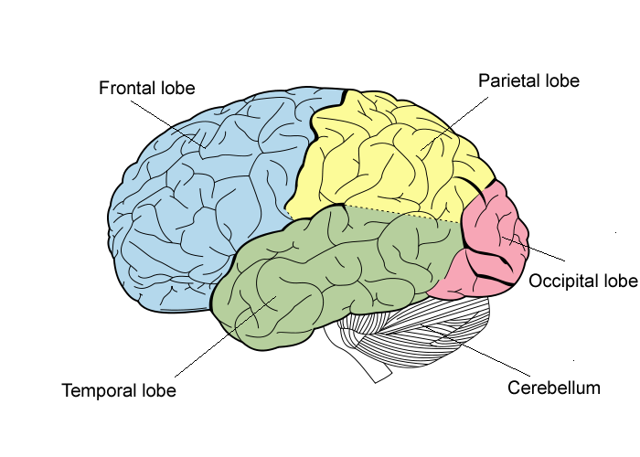
Neurocognitive Theories
During Flow…
“Hypo-frontality”
Deactivation of areas in the frontal lobe
No interference from explicit system
Efficient, implicit processing
(Dietrich, 2004)
Deactivation
Notes:
During Flow experiences, researchers have suggested that there is a deactivation that occurs in the areas of the frontal lobe – a state which they call ‘hypo-frontality.’
Regions in the frontal lobe, namely, the dorsolateral prefrontal cortex, is thought to be one of the core structures which support explicit information processing. This includes rule-based or declarative thinking (e.g. semantics, predictive decision-making) and voluntary, or deliberate actions.
Implicit systems, on the other hand, govern procedural, or experience-based knowledge, and can be expressed through automatic, or unintentional manifestations of physical and mental skill.
In other words, whereas the explicit system represents the ‘what,’ the implicit system represents the ‘how.’
It is thought that, experiences of ‘effortlessness,’ or ‘automaticity’ that characterise Flow states, imply that the explicit system is less active during these states, and that the implicit system is more engaged.

Slide 4
Neurocognitive Theories
During meditation…
“Self-less” state
Three levels of ‘self’: releasing NS & ES
Deepest level: no ownership, no ‘self’
Non-egocentric state
(Dor-Ziderman et al., 2013)
Levels of ‘self’ | Activation:
Narrative Self: Autobiographic, self-referential thoughts | Frontal regions
Minimal (Experiential) Self: Awareness of the ‘I’ experiencing the present moment | Parietal regions
“Self-less”: No intentions / passing through moment-to-moment experience | Thalamic structures?
Notes:
Neuroscientists who study meditative states and techniques have come up with a similar line of reasoning, stating that, during meditative activities, frontal regions of the brain are less active than in other, non-meditative instances in everyday life.
They support this notion through neurological representations of the ‘self,’ explaining that the frontal regions of the brain are associated with autobiographic or objective self-processing, and the parietal regions of the brain are associated with subjective, experiential self-processing; they call these two self-representations the Narrative and Minimal Self, respectively.
During meditative activities, the brain engages with real-time sensory cues (e.g. breath, heart-beat, proprioception), which shifts one’s attention away from self-reflective or autobiographical thoughts. This roots the meditator’s attention into the immediate first-person experience of being the ‘self,’ causing their self-awareness to shift from the Narrative to the Minimal Self.
The researchers also point out an even deeper level of self-representation that appears through meditation, which is the ‘Self-less’ state; in this deepest state, the meditator releases both the Narrative and Minimal Self, simply receiving the moment-to-moment experience as it arises without intention. This state is characterised by a feeling of not ‘owning’ any of the sensations that appear, as the experiences seem to arise without conscious decision or action. The passivity of this experience creates an illusion of not owing a unified or autonomous body, which marks the essence of this ‘Self-less’ state.
In terms of the brain, the theory suggests that such states involve deactivations not only in the frontal regions, but also the parietal regions, as the Minimal Self, or the subjective, first-person representations also disappear.

Slide 5
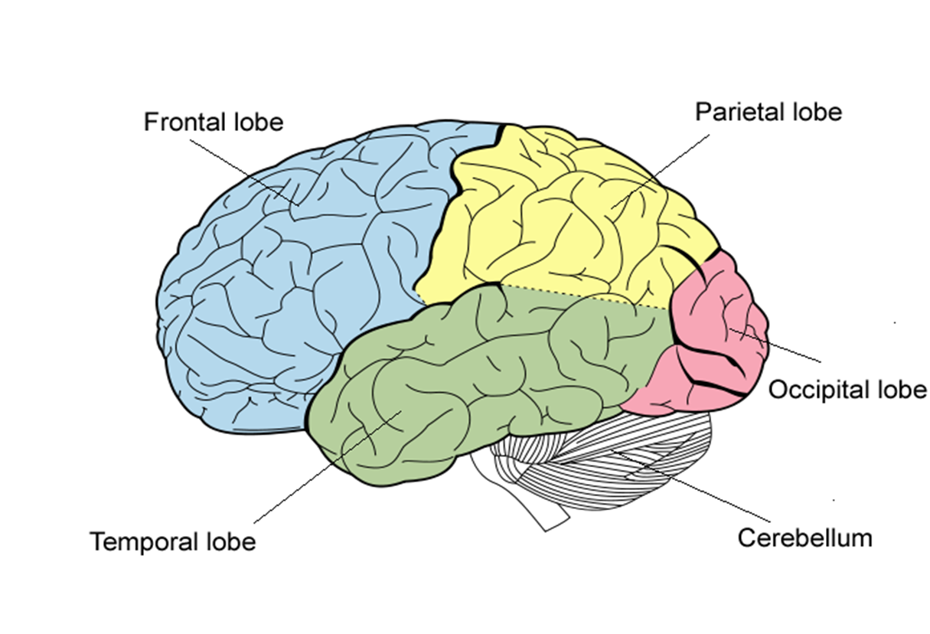
Neurocognitive Theories
During Meditative Flow…
“Allocentricism”
Deactivation of dorsal pathway, giving rein to ventral pathway
Enhancement in implicit motor control?
Enhanced movement performance?
(Austin, 2010)
Deactivation
Activation?
Notes:
Assuming that Flow experiences that occur in somatic or meditative movement episodes can be thought of as Meditative Flow, the previously mentioned deactivations are highly relevant theories in defining the phenomenon at hand.
Another neuroscientist, James Austin, has looked at similar phenomena that occur in meditative instances, theorising that there is an energy affordance caused by deactivations in the frontal and parietal regions.
Austin distinguishes between an ‘allocentric’ and ‘egocentric’ way of processing information, which relates to how we, as animals, try to survive in a constantly changing environment. He says that the ‘egocentric’ system, represented by the dorsal pathway within the brain, processes and filters sensory information in a way that supports the task at hand. For example, visual information reaches the occipital lobe, travels through the parietal lobe, then reaches the frontal lobe where the information is used to determine the next course of action. By contrast, the ‘allocentric’ system, represented in the ventral pathway, continuously receives and retains sensory information that are seemingly irrelevant to the task at hand. This system is crucial in picking out signals of danger, even when one is preoccupied in a task.
Austin theorises that, during meditative states, the deactivation in the dorsal pathway (i.e. parietal & frontal lobes), allows for an increased activation in the ventral pathway and other regions of the brain. This means that, along with the appearance of increased intuition and sharpened sensory awareness, there may also be an enhancement in implicit motor control.
Taking all of these theories into account, I hypothesised that Meditative Flow states during movement could involve an enhancement in movement performance.

Slide 6
From theory to practice…
Hypotheses:
‘Meditative Flow’ seems to occur within somatic movement
‘Meditative Flow’ might influence movement performance
Limitations in method:
Lack of methods to measure brain activity during movement
→ No neurological proof that ‘Meditative Flow’ has occurred
Lack of methods to track & analyse improvised* movement
No quantitative proof that movement qualities have changed
*Many movement practices that have ‘somatic’ or ‘meditative’ elements are improvisational (evidence from previous survey study)
Notes:
Having examined various theories on Meditative Flow experiences and its relationship to movement, I raised the following hypotheses: (read slide)
However, there are certain limitations in testing these hypotheses; for instance, while there are methods of measuring brain activity, like EEG ad fMRI, these methods often do not accommodate movement-based activities. This makes the task of measuring ‘Meditative Flow’ during movement very difficult to accomplish.
Another obstacle is measuring movement outcomes to test the second hypothesis: does ‘Meditative Flow’ influence movement performance? Although there are multiple systems to capture movement qualities, like 3D motion capture, they often involve wearable tracking systems that disrupt the mover’s performance. Moreover, these systems struggle to capture the changes that occur in movement quality, especially when the movement is improvised and unpredictable. This is a significant limitation, considering that many ‘somatic’ or ‘meditative’ movement practices involve improvised - rather than choreographed - movements.
Having explored these quantitative methods which seem to pose crucial problems, I decided to approach my questions through a more phenomenological and qualitative method.

Slide 7
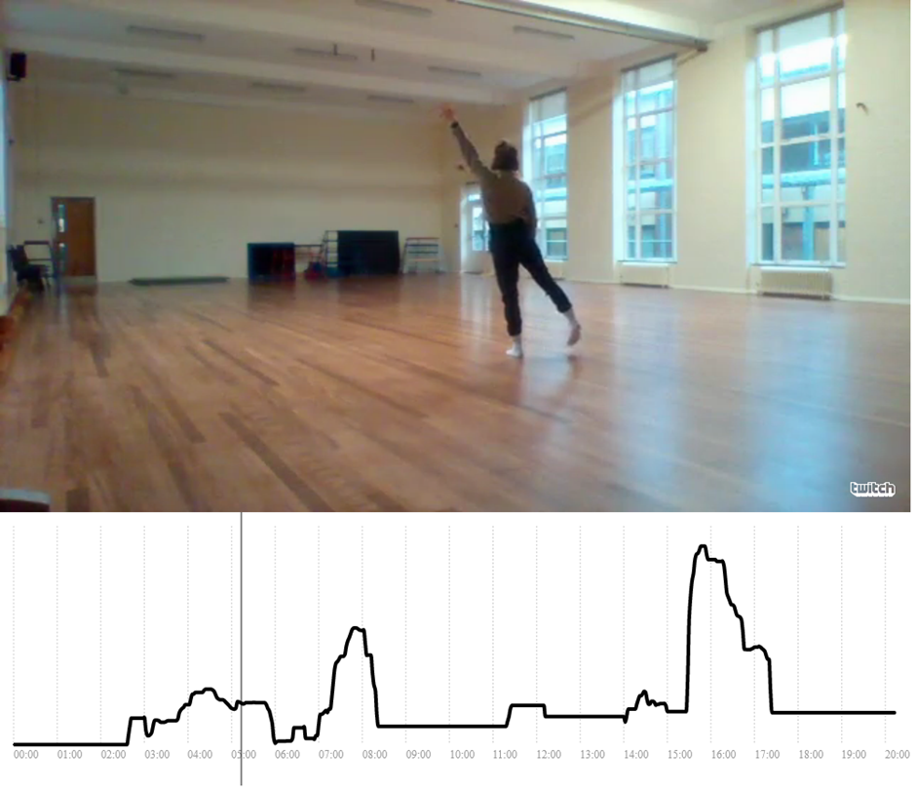
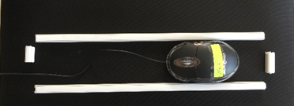
Method: phenomenological approach
Questions:
1. Does Meditative Flow influence movement?
2. What might that look & feel like?
Observation + interview
1 Mover + 4 Observers: 20min. performance
Real-time measurement of observers’ perception (used in reflection)
Post-performance interview on Mover & Observer
Verbal reports (interview responses)
Visual reports (drawn line graphs)
Notes:
In my study, I focused on the idea that ‘Meditative Flow’ may influence movement performance: the questions I asked are (read slide – ‘Questions’)
Here, the idea was that observers may be able to identify certain movement qualities that signify the mover’s Meditative Flow state, simply by watching the performance.
For the study, I recruited 1 mover who has experienced Meditative Flow during their regular movement practice, and 4 observers who had at least 3 years of experience in watching, analysing, and articulating their thoughts on that movement performance.
The mover would first perform a 20min. segment of their regular movement practice, as the observers sat and watched. During the performance, the observers operated a device that recorded their real-time perceptions on the mover’s Meditative Flow level (point to mouse device), so that they can later reflect on those first impressions alongside the performance footage.
After the performance, the mover also operated the same device as they viewed a video playback of their own performance. When the mover was done reviewing the footage, they were interviewed on their Meditative Flow experience during the performance. Here, a drawn line graph was created, that shows a visual representation of the mover’s Meditative Flow levels throughout time. The line graph was primarily based on the mouse recording, but adjustments were made by the mover upon their reflection.
The observers were also interviewed one-on-one in a similar style, all producing a visual line graph on their perception of the mover’s Meditative Flow experience. The observers were also asked to explain why they thought the mover was experiencing that specific level of Meditative Flow, and how certain movement qualities may have informed that interpretation.
Through this process, I obtained a set of verbal responses on both the mover’s and observers’ experiences, and a set of visual representations which show the mover’s and observers’ perceived levels of Meditative Flow (and their changes) throughout time.
This was repeated for 3 trials, which left me with 3 mover reports (visual & verbal) and 12 observer reports (visual & verbal).

Slide 8
Mover vs Observer line graph (digitalised)
Notes:
Here are examples of the drawn line graphs, manually digitalised into a quantified time-series data. (explain mover/observer & trials)
The first step of the analysis was to determine whether the observers’ perceptions of the mover’s Meditative Flow level matched the actual experience of the mover.
At first glance, the observers’ graphs seem to resemble the overall structure of the mover’s.
However, each graph seemed to have a unique signature of level representation. For instance, some have multiple sharp inclines and declines creating box-shapes across the graph, while others have curvilinear progressions that make it difficult to determine exact shifting points. There are also micro-shifts within a narrow range of levels across the graph, which may be quantitatively significant, but perhaps not too prominent to the mover herself. Therefore, it was difficult to compare the graphs directly against each other to determine a conclusive result on their overall similarity.
This raised an alternative approach, which was to distinguish between phases of “agreement” and “non-agreement” between the mover and observers. By identifying specific timeframes of agreement, we may be able to better understand the relationships between [the level of Meditative Flow, the mover’s experience, or the point in time during the performance] and [the observers’ ability to recognise the mover’s mental state].

Slide 9
Analysis: visual comparison of phases
1. Identification of phases in Mover’s line graph
Changes in trajectory + interview responses
2. Check agreement between Mover & Observer
Changes in level from previous phase
Trajectory of the line within the phase
Example:
…for Mover vs Obs. 1 – 4 × 3 trials = 12 comparisons
 |  | Phase 1 | Phase 2 | Phase 3 | Phase 4 | Phase 5 | Phase 6 | Phase 7 | Phase 8
Mover | level change | - | 20.08 | -3.37 | -1.63 | 8.00 | 7.07 | 14.63 | -2.31
 | shape | incline | plateau | (unstable) | plateau | incline | dent | incline | decline
Obs.1 | level change | - | 43.23 | 22.09 | -16.02 | 10.67 | 20.34 | 5.78 | 9.81
 | shape | plateau | incline | (unstable) | dec./plat. | incline | incline | incline | plateau
Notes:
I will breeze through the analysis process to save time, but please ask me questions later if you’re curious.
Here, you can see that I’ve split up the mover’s graph into 8 phases, based on the changes in trajectory, and the their verbal reports from the interview.
The phases were then mapped onto the observers graph, to see whether there were any similarities: I looked at the changes in average level from one phase to the next, and the overall trajectory of the line within the phase.
For example, phases 1 and 2 show a similar change in overall level, but are different in terms of trajectory. I recorded all of these comparisons on a table like the one you see there, and made notes on which phases showed agreement on both level and trajectory.
----------------------------------------------------------------------------------------------------------------------------
While some quantitative methods were considered, it was decided that a visual/qualitative analysis is best suited to identify areas of agreement and non-agreement. This naturalistic approach was considered especially relevant because the line graphs are not representations of objective numerical data, but of subjective perceptions of the participants, developed visually and qualitatively.
First, I sectioned the mover’s graph into multiple phases, based on the changes in trajectory, and the mover’s interview responses (here, I have 8 phases).
Then, I compared each of these phases to the observer’s, paying attention to a.) the changes in average level from one phase to the next, and b.) the overall trajectory of the line within the phase. For example, the changes in level from phase 1 to 2 are similar, whereas the changes between 3 and 4 are not; on the other hand, phases 5 and 6 are similar in shape, but 2 and 4 are not.
I made a table of similarities and differences for all observers versus the mover, for all 3 trials, and highlighted the phases that showed notable similarities as “agreement” phases. For example, this set of graphs are similar in phases 5 and 7. Phase 2 is very different in shape, but because the changes in level from phase 1-2 are similar, it is highlighted as a semi-similar phase.
Here, “agreement phase” means that the observers’ perception seemed to agree with the mover’s experience. Everything else can be considered a “non-agreement phase.”

Slide 10
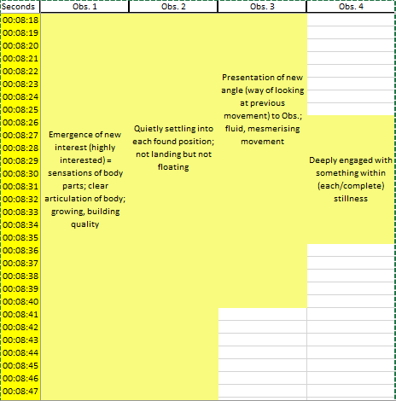

Analysis: verbal agreements (high / low)
Colour-code Observers’ comments in High vs Low
Actual (Mover’s) experience in ‘seconds’ column
Identify agreements: 3 or more Observers match the Mover
Combine results with phase comparisons
Notes:
Next, I moved on to the verbal responses. Here, you can see that the observers’ comments are mapped onto a vertical time line, and colour-coded as either yellow or blue based on whether the comments seemed to imply a higher or lower level of Meditative Flow.
The mover’s actual experience is represented in the ‘seconds’ column, as you can see by the brighter yellow and blue.
I looked through the whole 20min. to see where 3 or more of the observers agreed on the ‘high’ or ‘low,’ and integrated those results with the line graph comparisons to confirm whether each Agreement phase actually had moments of unanimous agreement.
-----------------------------------------------------------------------------------------------------------------------------
Next, I moved on to the verbal responses. Here, you can see that the observers’ comments are mapped onto a vertical time line, and colour-coded as either yellow or blue based on whether the comments seemed to imply a higher or lower level of Meditative Flow. (These ‘highs’ and ‘lows’ were based on my own interpretation of the context in which these comments were given)
The mover’s comments were also examined, and mapped onto the ‘seconds’ column through the same colour-codes – yellow and blue – based on whether they experienced higher or lower Meditative Flow.
Looking at the colour-codes, I captured moments in time wherein 3 or more observers would agree with the mover on whether the segment was high or low in terms of Meditative Flow – these were considered “agreement” moments. These are ‘moments’ because the ‘phases’ that were identified earlier were usually a few minutes long – a lot of things can happen within a few minutes. I wanted to know that there were specific ‘moments’ (within these ‘phases’) that all (or at least most) of the observers agreed on their perception.
The captured agreement moments were then combined with the results of the visual line graph analysis, in order to further confirm the validity of mover-observer “agreement”

Slide 11
Results: Agreement vs Non-agreement
 | High / Increased | Low / Decreased | Neutral
Agreement | 12 phases | 3 phases | 0 phases
Non-agreement | 1 phases | 4 phases | 4 phases
Most Agreement phases are in High / Increased
Non-agreement phases in Low / Decreased or Neutral
= Observers tend to identify High / Increases more accurately than Low / Decreases or Neutral levels
= Higher Meditative Flow level manifests in movement performance?
Agreement phases in Low / Decreased phases involve abrupt, full pauses in movement
Pauses in High / Increased phases are “pregnant” & “alive,” full of possibilities
= Stagnant, resting pauses in movement can be considered observable Low / Decrease
Qualitative questions:
What does it feel like, and what does it look like? → thematic analysis on comments & footage…
Notes:
Here is the final result: on this table, you can see how many “agreement phases” fell in segments of high/increased, low/decreased, or neutral levels of Meditative Flow. Similar with the “non-agreement” phases.
We can see that most agreement phases fell in the high or increased levels, and the non-agreements fell in low, decreased, or neutral levels.
This may imply that observers tend to identify high or increased levels of Meditative Flow more accurately than low, decreased, or neutral levels. One interpretation of this result is that higher Meditative Flow levels could be influencing the mover’s performance in some way, allowing the observers to accurately recognise the heightened level through certain movement qualities that they see.
However, what do we make of the fact that there are 3 “agreement phases” that fell in the low and decreased levels? Looking at the observers’ comments, I noticed that these low “agreement phases” involved an abrupt, full pause in movement. Although there were other pauses that appeared in high or increased levels, those pauses were described by the observers as ‘pregnant,’ ‘alive,’ and ‘full of possibilities.’ This could imply that, while higher levels of Meditative Flow are generally easier to identify for the observers, there are instances in which the observers can reliably identify a sudden decline in Meditative Flow level, especially when there is an abrupt pause in movement, leading onto a stagnant, resting state.
Now that I have explored the question of whether observers can identify the mover’s Meditative Flow state (and what conditions allow for that to happen), I move on to my next question: what do those levels look like to the observers, and what does it feel like for the mover?

Slide 12
Thematic results: cyclical model
Entering
Experience
Releasing
Settling
Following
Movement
Consistency in momentum
Internal listening
Continuity in movement
Opening
Experience
Risk-taking
Emerging ideas
Movement
Open to the ‘unknown’
Exploration
Honesty
Growth & expansion
Riding
Experience
Surrendering:
NO THINKING
Automaticity:
NO ‘SELF’
Movement
Effective use of weight & momentum
Ease
Liveliness
Nuanced texture
Ebbing
Experience
Natural closure in idea
Halted by distraction
Rational thinking: self-evaluations, decision making
Movement
Abrupt pause
Resting on floor
Stagnant
Noticeable effort
Uninviting
Resetting
Experience
Releasing: judgements on previous actions
Settling: returning to self
Opening
Notes:
In order to answer these questions, I conducted a thematic analysis on the movers’ and observers’ interview responses, with specific attention to the phases in which the two parties agreed on their perceptions.
Firstly, the movers’ accounts signified that the experience of Meditative Flow involves a cyclical process of fluctuating levels, wherein 5 distinct stages appear - on the chart, you can see these stages labelled as: entering, opening, riding, ebbing, and resetting, which happen one after the other. You’ll also see that the entering stage appears only in the beginning, and from there onwards, it’s replaced by the resetting stage.
The entering stage involves a process of releasing distractions, settling into the self, and following kinetic energies. The opening stage, then, introduces a driving force to take risks, which expands movement possibilities and further allows new ideas to emerge. The riding stage, which is the peak, quintessential state of Meditative Flow, is where there is no explicit thinking – just as described in the neurocognitive literature – and there is no self-awareness, because everything seems automatic. The ebbing stage is where the Meditative Flow level starts to decrease, due to either a natural closure in the idea, or a halting sense of distraction. This causes a break in concentration, where rational thinking and self-analysis comes back into focus and floods the mover’s awareness. The final stage of resetting is very similar to the entering stage, in that it involves releasing distractions and settling into the body, but it seems to involve more of a challenge because the mover is trying to release self-criticisms on what has just happened in the ebbing stage.
The list of ‘movements’ that are presented beneath the mover’s ‘experiences’ are what the observers’ witnessed during each stage, and indeed there were some consistencies within the entering, opening, and ebbing stages. However, I’d like to focus on the riding stage, because this stage is what represents the ‘peak’ experience of Meditative Flow within the cycle: in this stage, the observers identified effective uses of weight and momentum, as well as a sense of ease in the mover’s performance. They also said that there was a liveliness to the performance, and the movements showed a nuanced texture of softness and sharpness together, which are reminiscent of an animal’s dexterity of the body. These accounts might give us a hint as to what sort of movement qualities are externally observable during high levels of Meditative Flow, and how those qualities might be defined as the aforementioned “implicit motor efficiency” during states of Flow and meditation.
With these results, I am currently trying to develop a theoretical interpretation of how these performance qualities might characterise Meditative Flow, and what those qualities might imply in the context of dance performance and movement aesthetics.

Slide 13
References
Williamson, A., Batson, G., Whatley, S. and Weber, R. (2015) Dance, Somatics and Spiritualities: Contemporary Sacred Narratives. Bristol, U.K.: Intellect Books.
Austin, J. H. (2010) 'The Thalamic Gateway: How the Meditative Training of Attention Evolves Toward Selfless Transformations of Consciousness', in Bruya, B. (ed.) Effortless Attention: A New Perspective in the Cognitive Science of Attention and Action. MA: MIT Press, pp. 373-407.
Csikszentmihalyi, M. (1990) Flow: the Psychology of Optimal Experience. 1st edn. New York: Harper Perennial.
Dietrich, A. (2004). ‘Neurocognitive Mechanisms Underlying the Experience of Flow.’ Consciousness and Cognition, 13:4, p.746-761.
Dor-Ziderman, Y., Berkovich-Ohana, A., Glicksohn, J., & Goldstein, A. (2013). ‘Mindfulness-induced Selflessness: a MEG Neurophenomenological Study.’ Frontiers in human neuroscience, 7

