Slide 1
The sustained effectiveness of interventions on childhood physical activity (PA): a systematic review and meta-analysis of controlled studies
Jamie Sims
Supervisors:
Dr Peter Scarborough
Dr Charlie Foster

Slide 2
Consequences of insufficient PA
Non-communicable diseases
Risk Factors
Cardio-vascular disease
Type II diabetes
Specific cancers
Dementia
Falls
Depression
Bone density
Elevated blood glucose
Hypertension
Energy balance
Adiposity
Cardio-respiratory fitness
Functional movement skills

Slide 3
Seeds of low PA sown in childhood
Consequences of childhood PA levels observed through three routes¹:
The direct impact of low PA levels on health outcomes and risk factors in childhood
The direct physiological longer-term impact of low PA levels in later life
The indirect psychological impact of low PA habits
PA behaviour tracks ‘reasonably well’ across time²
Stability reduces at periods of transition (e.g. adolescence)
Broad pattern of decline through later childhood and adolescence
Boreham & Riddoch (2001)
Telama (2009)

Slide 4
Interventions to increase childhood PA
Frameworks for intervention
Social ecological level – individual, intra-personal, institutional, community or systemic
Domain specific – leisure, household, transportation, occupation (education)
Population approaches to intervention
E.g. Change 4 Life, taxation, curriculum
Treatment approaches to intervention
E.g. MEND, fat camps

Slide 5
Do PA interventions work? Do effects persist?
Van Sluijs (2007) found evidence for effective interventions in schools where the family was also involved, but overall found little consistent effect for intervention
Dobbins et al (2012) found school-based interventions showed some effect for younger children at increasing PA
Kamath et al (2008) found some evidence to support effectiveness at increasing PA, but no effect on BMI
Metcalf et al (2012) investigated 40 controlled studies that used pre-post accelerometry data
Consistently identify minimal/negligible effect
No review has demonstrated effectiveness at follow-up

Slide 6
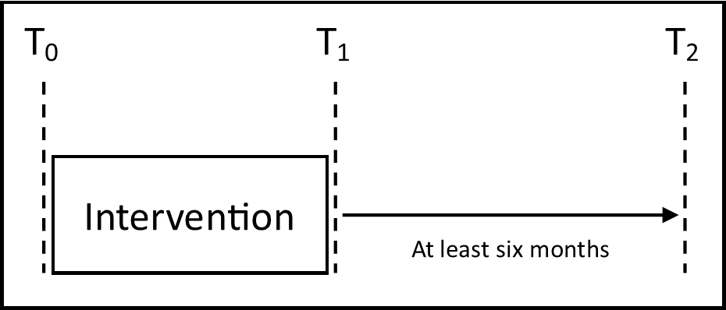
Aims of this review
Systematically review controlled studies that measured whole-day PA levels at least six months post-intervention
Conduct a meta-analysis of the effect sizes of intervention vs. control group at follow-up
Investigate specific sub-group differences

Slide 7
Methods
Systematic search strategy and study selection
Participants: Children aged between 5 and 18 at baseline
Intervention: Any intervention with the intention of increasing PA, independent or in conjunction with other schemes
Control: No additional PA in control group
Outcome: Whole day MVPA or TPA using self-report or objective measurement
Statistical analysis
Meta-analysis of primary outcomes
Specific sub-group analyses
Meta-regression of effects by specific variables

Slide 8
Search Strategy
PubMed, MEDLINE, EMBASE, PsychINFO, ScienceDirect, SportDiscus and Google Scholar (first 1,000)
January 1991 to January 2014
English language terms and studies only
child* OR adolescen* OR “young people”
AND
“physical activity” OR sport* OR cycl* OR walk* OR “physical education” OR “television view*” OR “tv view*” OR sedentary OR danc* OR “physical inactivity” OR “physical fitness” OR lifestyle OR exercise OR screen time OR “active travel*” OR commut*
AND
clinical trial OR control* trial OR random* OR trial OR evaluation OR effect* OR random* sample OR control*

Slide 9
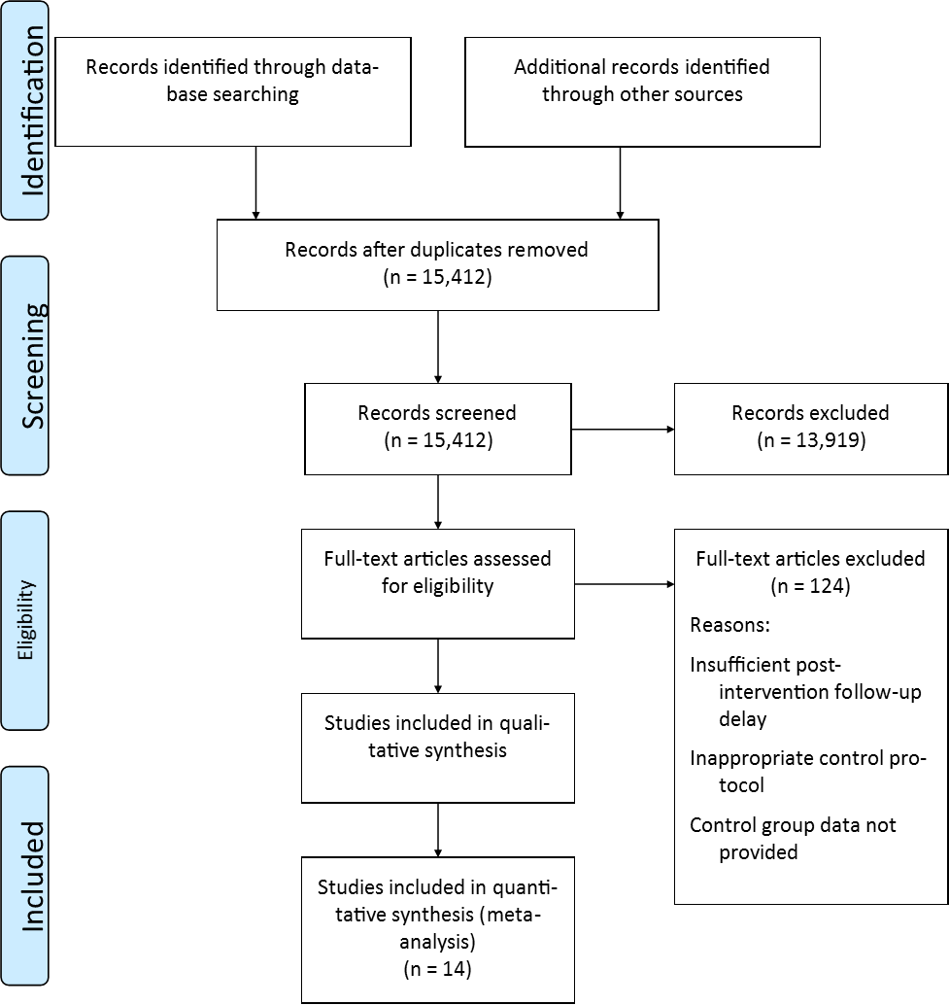
Study selection
Excluded Studies
PRISMA Flow Chart
Clear lack of relevance
Targeted adult population
Design was uncontrolled, cross-sectional or observational
Inadequate follow-up
Control group data not reported
Insufficient PA data

Slide 10
Data extraction and standardisation
Extracted
Author(s), project title, nation, design, inclusion criteria, randomisation procedure where applicable, intervention and control descriptions, length of follow-up, losses to follow-up and/or drop out, measurement strategy, secondary outcome measures and results, gender, baseline age, baseline BMI, baseline MVPA/TPA
Standardisation
MVPA
Converted to minutes per day from measurements enabled mean difference to be calculated
TPA
Unable to standardise to common metric so standardised mean difference was calculated

Slide 11
Overview of included studies
Participants
Intervention
Total 7883
n 41 – n 3,714 (M 255)
Females 51.6%
1 study males only, 1 females only
2 inclusive studies stratified by sex
Mean baseline age 10.67 (± 1.91)
Eight studies primary age
Six studies secondary age
Three studies recruited overweight/obese (treatment)
Duration 6 weeks – 3 years
Theoretical grounding
5 studies used Social Cognitive Theory
Setting
8 studies set in school
6 set in community
Approach
Peer modelling, contingent step counts, education, after-school clubs, double PE quotas, goal setting

Slide 12
Overview of included studies
Control
Outcomes
Non-intervention control group with no additional PA
‘Normal practice’, waiting list, no-treatment comparisons
Moderate to Vigorous Physical Activity (MVPA)
Total Physical Activity (TPA)
Self-report (9) & objective (7)
Follow-up
6 months – 4 years

Slide 13
Quality of included studies
Methodology Checklist for Randomised Controlled Trials
NICE (2012)
Selection
Performance
Attrition
Detection
Other
Publication, cluster

Slide 14
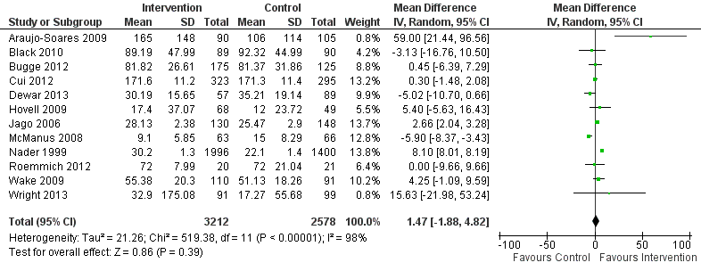
Moderate to Vigorous PA

Slide 15
Total PA

Slide 16
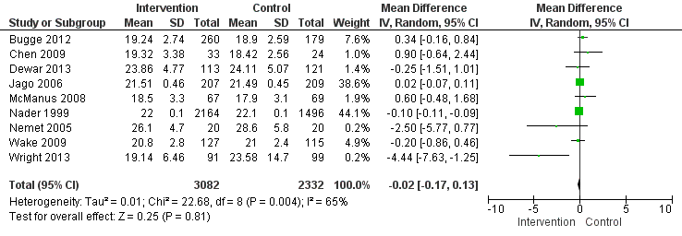
BMI

Slide 17
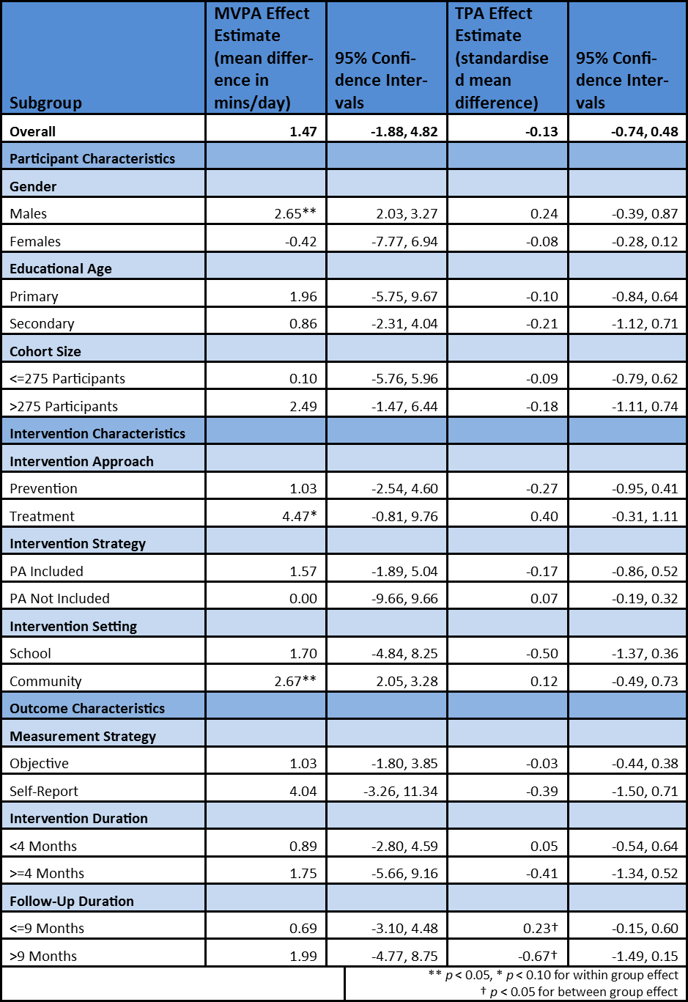

Slide 18
Meta-regression by continuous variables
TPA and MVPA by Baseline BMI
TPA and MVPA by Follow-Up Duration
r² = 0.285; p = 0.10
r² = ; p =
r² = -0.965; p = 0.99
r² = -4.61; p = 0.69

Slide 19
Meta-regression by continuous variables
TPA and MVPA by Intervention Duration
TPA and MVPA by Cohort Size
r² = 0.285; p = 0.10
r² = 0.285; p = 0.10
r² = 0.797; p = 0.5
r² = 0.; p = 0.10

Slide 20
Summary of primary findings
Statistically and clinically negligible change in MVPA, TPA and BMI at delayed post-intervention measurement compared to controls
Statistically significant intervention effect for males on MVPA
Approaching significance for treatment-based studies on MVPA
Statistically significant intervention effect for community interventions on MVPA
Statistically significant difference between studies with follow-up less than nine months compared to studies with follow-up greater than nine months

Slide 21
Potential Bias
Not possible to blind participants or delivery staff to intervention
Non-blinded researchers responsible for data gathering and analysis
More important when using self-report, less so objective
No between group difference note between measurement strategies
Risk of bias typically in favour of intervention group
Weighed against the already negligible findings is not encouraging for interventions but does reduce risk of false positives

Slide 22
Sub-group analyses
Significant sub-group difference between school and community interventions on MVPA
Removal of Jago et al (2006) reduces this distinction
Approaching significant difference for TPA on setting
Treatment was notably, but not significantly, favoured to prevention on MVPA
Both trends also clustered with smaller cohort sizes

Slide 23
Comparison with previous reviews
Consistent with Metcalf et al. (2012), Dobbins et al. (2013) & Kamath et al. (2008)
Small overlap between studies but largely independent data sources
Longer interventions do not convey added benefit
Plateau of effect after three months
Treatment more effective than prevention
Pre-existing low PA and/or high BMI demonstrate greater change
Gradual decline of TPA following longer-duration follow-up compared to control
Not present in MVPA

Slide 24
Limitations
Insufficient studies left the analyses somewhat underpowered
Particularly sub-group analyses and meta-regressions
Only possible to infer patterns, not associations
Overall quality contained a large amount of uncertainty
High levels of between-study heterogeneity (I² = 98%)

Slide 25
Conclusions
Lack of studies on childhood PA that
Comprehensively measure PA
Measure PA subsequent to intervention
Include (or report) sufficiently robust methodological protocols
Current studies show little or no sustained benefit subsequent to intervention in childhood
Potential cluster of ‘effectiveness’ surrounding smaller cohorts, treatment approaches and community settings

