Slide 1
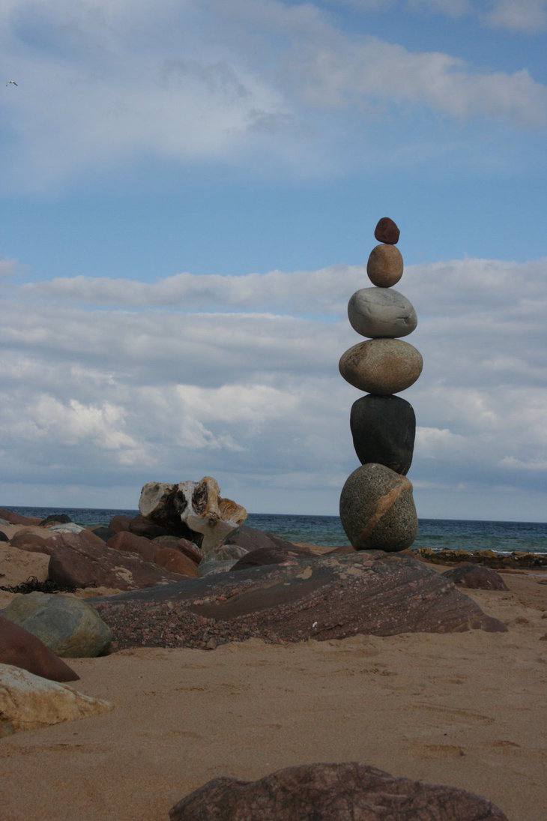
Doing dancing…Being in dance Undoing the Danced Body Feldenkrais and Awareness in Motion
Man’s life is a continuous process, and the improvement is needed in the quality of the process…The more clearly the fundamentals of the process are understood, the greater will be the achievements
(Moshe Feldenkrais)

Slide 4
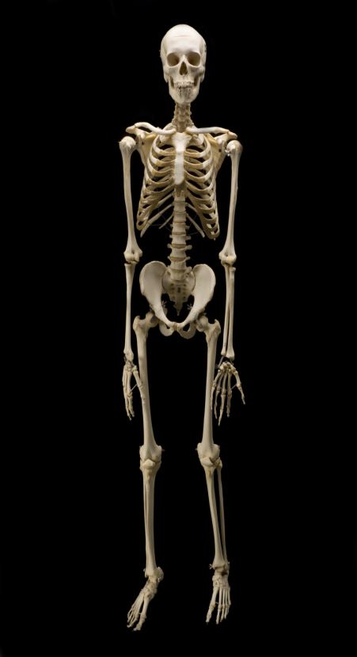
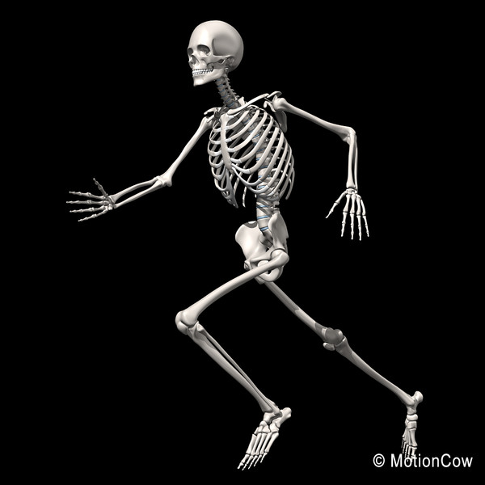

Slide 6
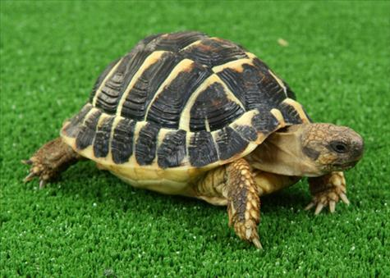
We called him tortoise because he taught us
(Lewis Carroll)

Slide 8
Notice your breathing…

Slide 10
Some student feedback
I understood something that changed my way of thinking/dancing completely
The lessons helped me to accept my body more, so I am not constantly concentrating on my inadequacies
Through this experience I don’t feel limited anymore because I know my body has infinite possibilities of moving…
All of a sudden I lost all of the anxious feelings I felt before and I felt like I had found myself
I feel more confident
The first time I felt myself
I have started to care a bit less about how I look
I feel like I can be myself without being judged for doing it wrong

Slide 11
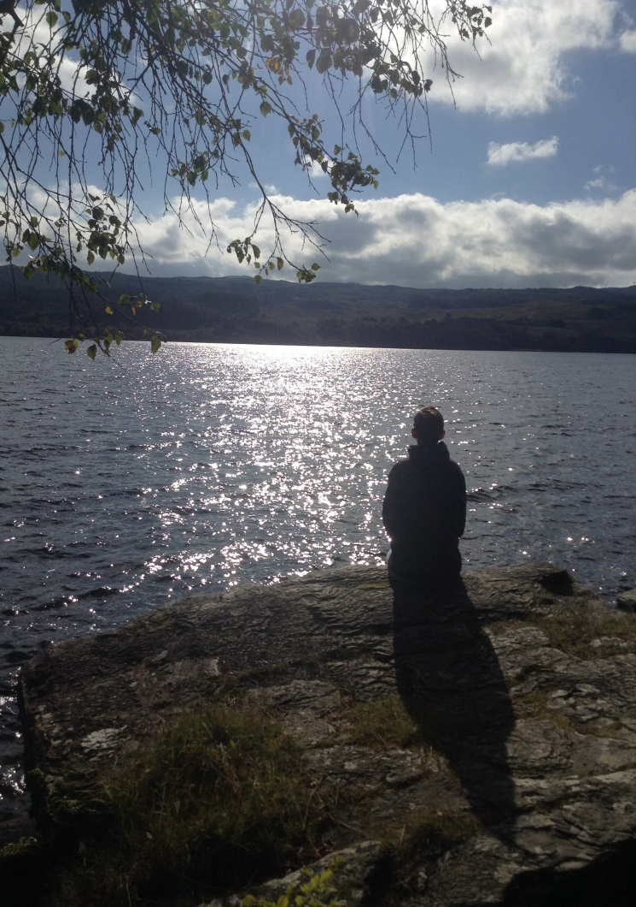
Listening to silence awakens the dimension of stillness within you
Stillness is where creativity and solutions to problems are found
(Tolle)

Slide 13
walls come down

Slide 17
Thankyou Any Questions

Slide 18
Bibliography
Books
Almaas, A.H. (2008) The Unfolding Now, Boston & London, Shambala Publications
Damasio, A. (2000) The Feeling of What Happens, London, Vintage Books
Doidge, N. (2015) The Brain’s Way of Healing, London, Penguin Publishers
Feldenkrais, M. (1990) Awareness Through Movement, New York, Harper Collins Publishers
Tolle, E. (2003) Stillness Speaks, Canada, Namaste Publishing and New World Library
Francis Dziuban, P. (2013) Simply Noticing, US, Balboa Press
Brown, M. (2010) The Presence Process, Canada, Namaste Publishing
Clarke, S & Beringer, E. (2011-2015) London Feldenkrais Training, London
Online references
Feldenkrais, M. http://the peacefulrunner.com (Accessed 20.8.15)
Images
spazzy-poptart-deviantart.com
interludeunscripted.com
pinterest.com
naptimetales.com
stock-clip.com
nsm.or.th
proprofs.com
Jeffhoffmeyer.com
walthamchase.wordpress.com
funcrestview.com
eagle-photography.deviantart.com
nasa.gov
companyofburninghearts.wordpress.com
themindunleashed.org
hcclivingletters.wordpress.com
tumblr.com
tobifairley.com
skeleton-walk-6.gif

Slide 19
‘Clear awareness is silent seeing’ (Dziuban)
Live Breathe Experience Discover

