Slide 1
‘A New Direction’: The Changing Face of English Early Childhood Education and Care Policy
Nikki Fairchild
BERA Conference
25th September 2014

Slide 2
Aims of this presentation
Research question – why this study is important;
My research journey;
Setting the Early Childhood Education and Care (ECEC) policy context;
Methodology;
Why Foucauldian discourse analysis?
Analysis;
What next?

Slide 3
My research journey
First year of my doctoral studies;
(Re)discovering critical inquiry and post-structuralism (Crotty, 1998);
Deconstructing and problematizing ECEC and Education policy;
Reflecting on the notion of discourse, power, control and social justice (Foucault).

Slide 4
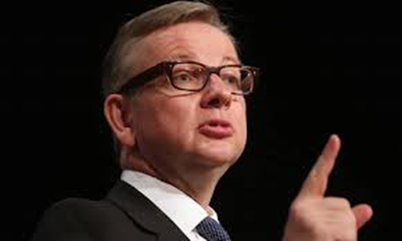
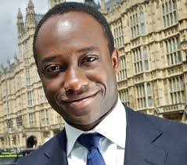
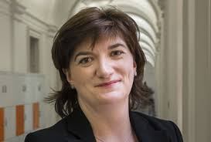
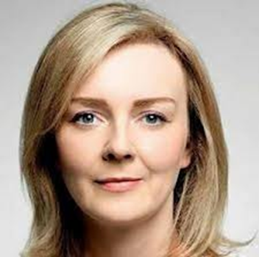
Research question
‘What is the current discursive landscape surrounding Early Years Professionals in respect of performativity and New Managerialism’
Why?.....

Slide 5
Setting the Early Childhood Education and Care (ECEC) policy context
Rise of neo-liberalism since 1970s and impact on education (Ball, 1990; Bowe and Ball, 1992; Tomlinson, 2005);
Promotion of the market model in ECEC (Lloyd and Penn, 2013);
Significant review of ECEC policy since 2010 (Tickell, 2011; DfE, 2012; Nutbrown, 2012).

Slide 6
Methodology and methods
Structured literature search using key words (6 documents sourced);
Qualitative paradigm – documents (based on policy made between 2010 and 2012) used as a data source;
Analysis of secondary data sources;
Applied Graham’s (2011) - describe, recognise and classify;
Discourse analysis on documents based on work of Foucault (1974, 1975, 1989);
Utilised notion of policy as discourse (Bowe and Ball, 1992; Ball, 2006).

Slide 7
Why Foucauldian Discourse Analysis?
Reflection on notion of ‘policy as discourse’ (Ball, 1990; Bowe and Ball, 1992);
Allows for problematizing and multiple readings of the circulation of power;
Reveal how texts define position and control readers/listeners;
Examine effects texts/discourses allow for construction of social subjectivities.
(Olssen, Codd & O’Neill, 2004)

Slide 8
Six documents selected
Statutory Framework for the Early Years Foundation Stage (DfE 2012).
‘The marketisation of early years education and childcare in England’ (Lloyd 2012)
Early Intervention: The Next Steps (Allen 2011).
Longitudinal Study of Early Years Professional Status: an exploration of progress, leadership and impact. Final Report (Hadfield et al 2012).
The report of Her Majesty’s Chief Inspector of Education, Childrens Services and Skills – Early Years (Ofsted 2012).
Foundations for Quality: The independent review of early education and childcare qualifications. Final Report (Nutbrown 2012).

Slide 9
Analysis and Findings (1)
Governmentality (O’Farrell, 2005)
Dominant discourses common sense notions;
Government policy intervention can be justified ‘through strongly mediated “public” dissatisfaction with educational institutions’ (Popkewitz and Brennan, 1997:208).

Slide 10
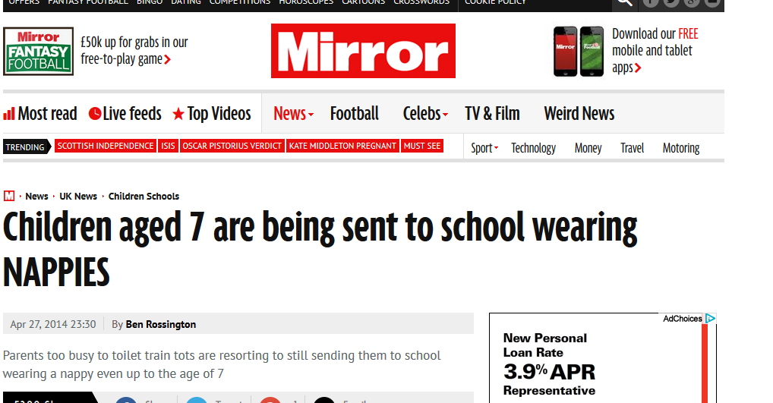
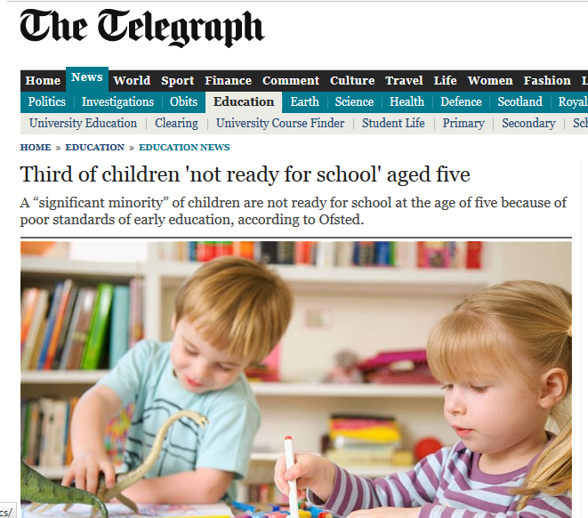

Slide 11
Analysis (2)
Regimes of Truth – Nutbrown Review
Early Years Teachers (QTS) with specialist 0 - 8 knowledge should lead practice (Nutbrown, 2012)
Resolve the deficit notions in the workforce;
Allow for progressions routes;
Attract more men into ECEC;
More understanding of term ‘teacher’ from general public and policy makers.
BUT……..

Slide 12
Analysis (2)
When problematised
Could suggest a reductionist view of ‘teaching’ – ECEC more than didactic transmission;
Teachers’ Standards (Early Years) (DfE 2013a) – greater focus on maths, phonics and group learning;
Discourse and counter discourse on role of play;
Does not consider the diversity of professional identities in ECEC (More Great Childcare (DfE 2013b) and Wilshaw letter, 2014);
Subsequent rebuttal by Professor Nutbrown.

Slide 13
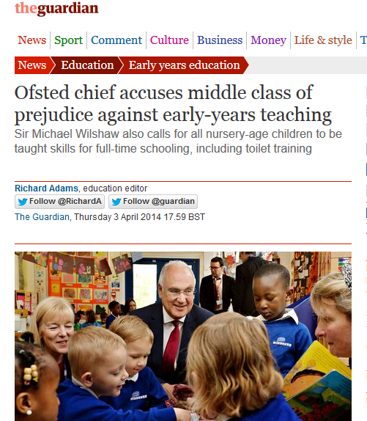
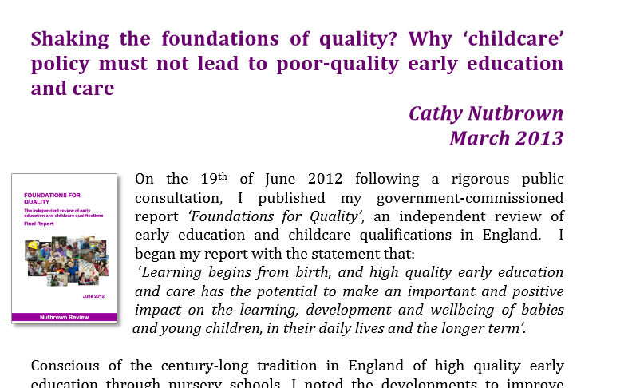

Slide 14
Analysis (3)
Power relations and quality
Quality environments need a quality workforce – ECEC policy has encouraged this and defined professional training routes.
But….
What does quality and professional identity look like in ECEC?
Do current conceptions privilege white, middle class children and families? (Canella 1997; Robertson and Días 2006);

Slide 15
What next?
(Re)imagining Early Years Teacher professional identity;
New ways to theorise and explore professionalism:-
Post-human (Osgood, 2014; Urban, 2014).
(Re)positioning myself.

Slide 16
Bibliography (1)
Allen, G. (2011) Early Intervention: The Next Steps. London: HM Government. Available from http://www.dwp.gov.uk/docs/early-intervention-next-steps.pdf (accessed 12 December 2012).
Ball, S. J. (1990) Politics and Policy making in Education – Explorations in policy sociology. London: Routledge.
Bowe, R. & Ball, S.J. (1992) Reforming Education & Changing Schools. London: Routledge.
Canella, G. S. (1997) Deconstructing Early Childhood Education: Social Justice and Revolution. New York: Peter Lang Publishing.
Crotty, M. (1998) The foundations of social research: meaning and perspective in the research process. London: Sage.
Department for Education (2012) Statutory Framework for the Early Years Foundation Stage: Setting the standards for learning, development and care for children from birth to five. Cheshire: Department for Education.
Department for Education (2013a) Teachers’ Standards (Early Years). Crown Copyright.
Department for Education (2013b) More Great Childcare. Raising quality and giving parents more choice. Crown Copyright
Foucault, M. (1974) The Order of Things. An Archaeology of the Human Sciences. London: Tavistock Publications.
Foucault, M. (1975) Discipline and Punishment: The Birth of Prisons. Harmondsworth: Penguin
Foucault, M. (1989) The Archaeology of Knowledge. London: Routledge.
Graham, L. (2011) The Product of text and ‘Other’ Statements: Discourse analysis and the critical use of Foucault. Educational Philosophy and Theory. 43 (6) pp. 663 – 674.
Hadfield, M., Jopling, M., Needham, M., Waller, T., Coleyshaw, L., Emira, M. & Royle, K. (2012) Longitudinal Study of Early Years Professional Status: an exploration of progress, leadership and impact. Final Report. Department for Education Research Report DFE-RR239c. CeDARE, University of Wolverhampton.

Slide 17
Bibliography (2)
Lloyd, E. (2012) ‘The marketisation of early years education and childcare in England’. In L. Miller and D. Hevey Policy Issues in the Early Years. London: Sage.
Lloyd, E. & Penn, H. (2013) Childcare markets - can they deliver an equitable service? Bristol: Policy Press.
Nutbrown, C. (2012) Foundations for Quality: The independent review of early education and childcare qualifications. Final Report. Department for Education.
O’Farrell, C. (2005) Michel Foucault. Sage: London.
Ofsted (2012b) The Report of Her Majesty’s Chief Inspector of Education, Children’s Services and skills – Early Years. Available from http://www.ofsted.gov.uk/resources/report-of-her-majestys-chief-inspector-of-education-childrens-services-and-skills-early-years (Accessed 9 December 2012).
Olssen, M., Codd, J. and O’Neill, A. (2004) Education Policy: Globalization, Citizenship & Democracy. London: Sage.
Osgood, J. (2014) ‘A time to reconfigure ‘quality’ in early childhood education’. Paper presented at University of Chichester, Chichester, 25 July.
Popkewitz, T.S and Brennan, M. (1997) ‘Restructuring of social and political theory in education: Foucault and a social epistemology of school practice’. Educational Theory. 47 (3) pp. 287 – 313.
Robertson, K. H. and Días, C. (2006) Diversity and Difference in Early Childhood Education: Issues for Theory and Practice. Maidenhead: Open University Press.
Tickell, C. (2011) The Early Years: Foundations for life, health and learning. London: Department for Education.
Tomlinson, S. (2005) Education in a post welfare society (2nd Ed). Maidenhead: Open University Press.
Urban, M. (2014) ‘How Preschool Saves the World (or how we came to believe it does and what we should do about it)’ Paper presented at University of Roehampton, London, 14 July.

Slide 18
Contact Details
Title, Nikki Fairchild
Early Years Initial Teacher Training Programme Coordinator
Department of Childhood, Social Work and Social Care,
University of Chichester,
College Lane,
Chichester,
West Sussex,
PO19 6PE.
Tel: 01243 816287
Email: n.fairchild@chi.ac.uk

