Slide 1
‘It was part of why I went for the course – specialisms feel like a no-brainer’ Four student viewpoints that challenge the UK Film Industry and Government assumptions
Marzenna Hiles

Slide 2
HE film production degrees – there are many voices clamouring for attention
BFI (2017) Future Film Skills: an action plan. Skills review of the UK film and screen industries
BIS (2009) Higher Ambitions; the future of universities in a knowledge economy
HEPI-HEA (2015) 2015 Student Academic Experience Survey report summary and recommendations

Slide 3
To represent student views
UK National Student Survey
TEF: Teaching Excellence and Student Outcomes Framework
Office for Students

Slide 4
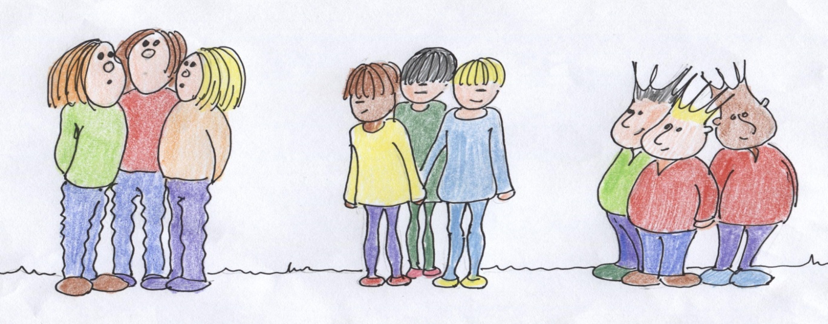
Generalist course: learn about all aspects of film making
Specialist course: in second or third year put into cohort specialisms
CINEMATOGRAPHY STUDENTS
EDITING STUDENTS
DIRECTING STUDENTS

Slide 5
William Stephenson Systematic analysis of qualitative data Seeks patterns of opinions on a topic Seeks participants’ subjective views Uses factor analysis to correlate multiple sets of data and identify participants with similar viewpoints
METHODOLOGY

Slide 6
The Q CONCOURSE data from three focus groups and two questionnaires from two UK film production degrees using cohort specialisms – six themes .
Inter cohort dynamics Intra cohort identity Pedagogy Views on specialising Collaboration Reflecting the industry

Slide 7
The Q Set 8 concourse statements were chosen to represent each of the 6 themes and these were made into cards giving 48 statements (cards) The Q SET

Slide 8
Examples of Q Set statements: It’s like the Hunger Games – support, compete, survive, win I would go to my tutors for advice Our films should stop being the director’s baby Specialisms get us ready for the industry Everything I have learnt has been mainly self-taught

Slide 9
The Q SORT
- 4 | -3 | -2 | -1 | 0 | +1 | +2 | +3 | +4
AGREE WITH LEAST
AGREE WITH MOST

Slide 10
The Participants Participants: 32 students from a film production course using cohort specialisms. Specialisms included directing, cinematography, editing, producing etc. The Q SET

Slide 11
PQMethod software, Q Sorts were correlated and factor analysed using Principal Component Analysis (PCA), followed by Varimax rotation. This compared Q Sorts and showed which students had sorted their Q sorts in similar ways. A four factor solution was deemed to best represent the data

Slide 12
Four viewpoints (factors) were identified: A: Collaborative Learners B: Alienated Generalists C: Industry Driven D: Specialism Enthusiasts

Slide 13
Collaborative Learners 6 male and 5 female students Collaborators – get along – no power issues – better friends outside specialism Storytellers Tutors matter – have most interaction Most satisfied with specialism choices Value formal learning and learning for its own sake – would study for an MA Value specialising Most realistic about future employment – would be runners

Slide 14
Alienated Generalists 3 male and 2 female students Anti-specialising, pro being generalists Specialising narrows job opportunities Collaboration needs to be taught more Students need to understand the other specialisms Power issues – some roles have too much Tutors have negative attitude to other specialisms Studying MA or starting as runners not seen as an option

Slide 15
Industry Driven 5 male and 1 female student Highly competitive See things in terms of the industry Better friends in same specialism Specialising gets you work Very little interest in learning about other specialisms Everything learned mainly self-taught Ambivalent towards tutors Will leave with proper skills Would not start out as runners

Slide 16
Specialism Enthusiasts 6 male and 1 female student Storytellers Very interested in specialising phenomenon; as means to tell stories and share their ideas Specialisms generate hierarchies Stated there are gender inequalities Critical of film industry culture Had the least interaction with tutors Want to make specialism choices again Further post-grad studies not an option

Slide 17
Points of consensus All factor viewpoints showed some consensus: Filmmaking is teamwork. Course does not need to be more specialised. Tutors did not force students to choose their specialisms. All expected, to different degrees, to start out higher up than just runners. Tutors have some sort of role in the specialisms.

Slide 18
Points of disagreement Specialism Enthusiasts felt strongly there were issues around gender imbalance, Alienated Generalists acknowledged this but did not feel it was a problem. Only Alienated Generalists and Specialism Enthusiasts believed strongly that Documentary is outcast specialism.

Slide 19
Points of disagreement Collaborative Learners valued formal teaching but Industry Driven stated being self-taught. Alienated Generalists said specialising narrows job opportunities and does not get you ready for the industry – rest disagreed. Alienated Generalists said the big problem is they don’t know enough about each other’s jobs – rest disagreed.

Slide 20
RESEARCH PROJECT OUTCOMES: four viewpoints
Alienated Generalists – want a broad, general Higher Education and are anti-specialising
Industry Driven – Pro-specialising and accept industry methods without question
Specialism Enthusiasts – Pro-specialising and aware of negative aspects of industry
Collaborative Learners – Pro-specialising but value education in its own right, would undertake post-graduate studies.

Slide 21
Specialist or Generalist
Within the UK, some universities are adopting broad, USA based Liberal Arts degrees, whilst others are offering even more specialised courses that promote industry based, high-level skills
In light of UK Government and BFI policies, calling for HEIs to teach specialist skills, can we ignore the needs of students more interested in a general Higher Education or those students who value learning for its own sake and are open to post-graduate studies?

Slide 22
Ashton, D. and Noonan, C., (2013) eds. Cultural work and Higher Education. London: Palgrave Macmillan.
Barnett, R., (2007). A will to learn, being a student in an age of uncertainty. England: Open University Press.
BFI (2017). Future Film Skills: an action plan. Skills review of the UK film and screen industries. Available at
http://www.bfi.org.uk/sites/bfi.org.uk/files/downloads/future-film-skills-an-action-plan-2017.pdf
BIS. Department for Business Innovation and Skills (2009) Higher ambitions; the future of universities in a knowledge economy. London: HMS. Available at http://webarchive.nationalarchives.gov.uk/20101012121855/http://www.bis.gov.uk/policies/higher-education/shape-and-structure/higher-ambitions
Blair, H., (2001). ‘You're only as good as your last job’: the labour process and labour market in the British film industry. Work Employment Society, 15, 149-169.
HEPI – HEA (2015). 2015 Student Academic Experience Survey Report Summary and Recommendations. Available at: http://www.hepi.ac.uk/wp-content/uploads/2015/06/AS-PRINTED-HEA_Student-Academic-Experiance-Survey-Report_PRINT3.pdf
Porter, S., R., (2010). Do college student surveys have any validity? Paper presented at Association for Institutional Research 2010. Chicago, IL. 2010.
Sabal, R., (2009b). The individual in collaborative media production. Journal of Film and Video. Spring 2009, 61 (1) 6-17.
Watts, S. And Stenner, P. (2012). Doing Q methodological research. Theory, method and interpretation. London: Sage Publications Ltd.

