Slide 1
Korcula's Fragments Walls Speak
https://archive.org/details/KorculasFragmentsWallsSpeakOutsoundPoetry

Slide 2
Problematising the concept of ‘voice’ in Early Childhood research
Rob Abbott, Nikki Fairchild, Sandra Lyndon and Eva Mikuska
University of Chichester

Slide 3
Overall aim
To explore different ways of conceptualising voice and its impact on practice, drawing upon a range of qualitative research methodologies within the Early Childhood Education and Care (ECEC) field of inquiry.
To complete a small scale research project to understand how others conceptualise voice (consent forms; information sheets to follow; and audio/video recording).
Notes:
Rob and Nikki to do this slide

Slide 4
Our research questions:
How can voice be explored which allows for multidimensional presentations?
How can the experience of others be presented without being dominated by the interpretation of the researcher?
How could arts based methods be used to explore understandings of voice?
Notes:
Sandra and Eva

Slide 5
Why arts based methods?
Building on the work of Byrne (2015) and her study about using poetry to present the different voices of students and their experience of education.
Byrnes (2015) argues that arts based methods enables:
Data to presented in different ways;
Enables different voices to be presented: participant; researcher; and respondent;
Helps to address issues of power between the researcher and participant.
Notes:
Sandra

Slide 6
The student voice - Rob
Research focussed around a year one Child Development module:
Problem-based learning
Formal lectures
Podcasts
“The PBL sessions for me were not useful as we constantly felt unaware of what needed to be done.”
“I felt like we needed more guidance throughout the PBL tasks, not always very clear.”
“The PBL groups took up too much time, there was no[t] enough time spent on theory or application of it.”
On-going and mid-term feedback from students largely positive.

Slide 7
Issues around the student voice - Rob
How should I react to the feedback I was given; how do I hear the voice that was spoken?
How do I ensure that my students have the language to speak, the knowledge to understand what they speak, and the power to feel they can say it?
How can we create an environment that allows for meaningful dialogue where both voices can be heard?

Slide 8
Narrative Imagination and Voice – Sandra
Andrews (2014, p.1) states that ‘narrative and imagination are integrally tied to one another’.
They bring into focus:
The ability to time travel, i.e. ‘moving backwards and forwards in our mind’s eye’ (p.3)
A link between the ‘real, the not-real, the not yet real’ (p.2)
A construction of the self and other
How does narrative imagination link to the construction of voice?
Notes:
I am going to consider voice in the light of narrative methodology and how imagination can be used to construct voice. Molly Andrews (2014) states that ‘narrative and imagination are integrally tied to one another’ (p.1)
They bring into focus:
The ability to time travel, i.e. ‘moving backwards and forwards in our mind’s eye’ (p.3)
Provide a link between the ‘real, the not-real, the not yet real’ (p.2)
Construction of the self and other – how one perceives and understands one’s own life is always connected to one’s view of others.
This last area is the one I want to focus on, and it’s this ability to construct the other and give voice to the other.
I’m going to illustrate through an example from my research which looks at early year practitioners’ understandings of child poverty.

Slide 9
Damp Clothes
‘One of my children came in and I needed to change their clothes and their bag had loads of nice clothes in but they were damp.. obviously I thought you know that could have just been they were rushed in the morning [….] and then it happened again and then there were just small things that would come so like … the shoes suddenly … a little bit too small…[…] it would be like ‘I think they’re saying their feet are hurting so they might need some …’ yer yer and it’s that look you know you just see that face that ‘oh god […] I can’t get them any more shoes.’
Key Worker for children under the age of 3
Notes:
This is an extract from an interview with a Key Worker who works in a Daycare setting with children under the age of 3. This story which I’ve called Damp Clothes, is in response to a question I asked her about when she first became aware of poverty. She tells a story about a child who comes in with Damp Clothes. READ STORY
SHE NARRATES the STORY in 1st person AND GIVES VOICE TO the different characters HERSELF AS AN EY P; the child; AND THE MOTHER. These are represented in different colours – black – the voice of the narrator; purple – the EYP giving voice to the child; green for the voice of the mother. Through the construction of the different voices you get a sense of the identity of the practitioner and the mother.
She uses her imagination to try and give an explanation of why the clothes might be damp (they were rushed in the morning) but then there are these little signs (it happened again/ the shoes were too small) suggesting that the mother might be finding things difficult.
As she recounts what she says to the mother she gives voice to the child ‘I think they’re saying their feet are hurting so they might need some…..’ The ‘I think’……….suggests this may or may not be something the child has said.
She goes onto give voice to the parent and it’s her interpretation of the parents’ facial expression – and through her imagination she gives voice to the parents’ inner thoughts ‘Oh God……..I can’t get them any more shoes’ – suggesting the panic the parent might be feeling about being found out – I can’t provide for my child.

Slide 10
What is ‘voice’? Eva
Problematising the meaning of voice that are historically grounded in positivism, interpretivism and critical theory ( Mazzei and Jackson, 2009).
The process of turning voice into text which is then deconstructed, that is exposing the instability of meaning which the text tries to cover up.
Can we become a source of voice rather than an effect of it, when ‘it’ can be culture, structuring principles etc.?
Can we occupy the position of ‘other’?
Voice is not monolithic – dominant meanings can be contested and alternative meanings affirmed (Weedon, 2009).
(we=researchers)

Slide 11
Example - Eva
Really
Notes:
Everybody

Slide 12
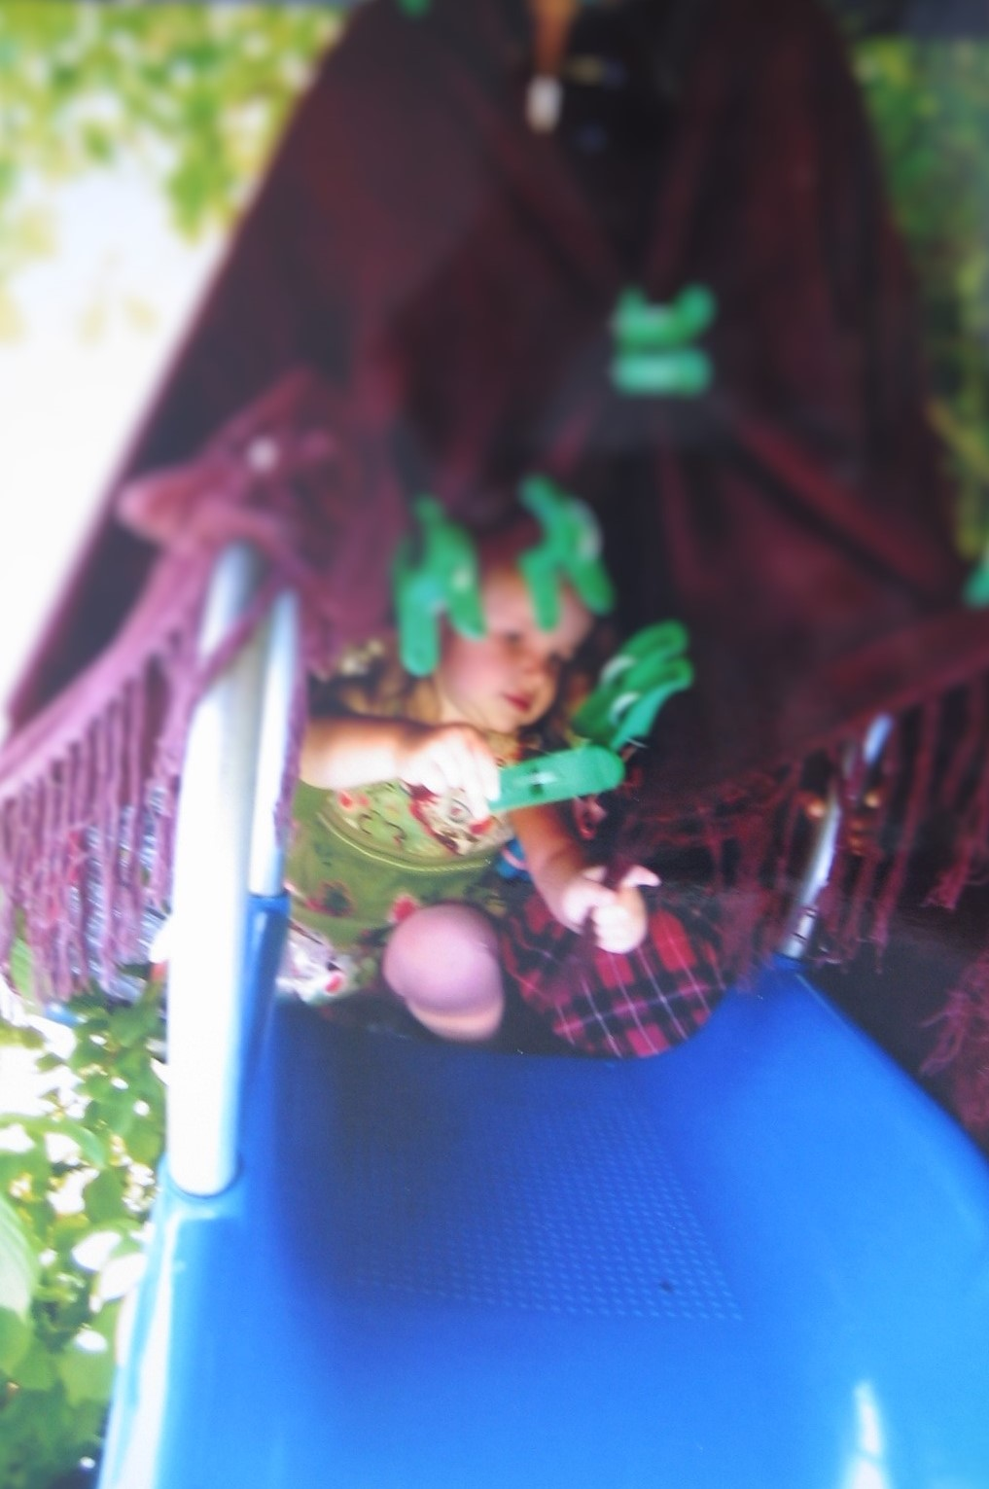
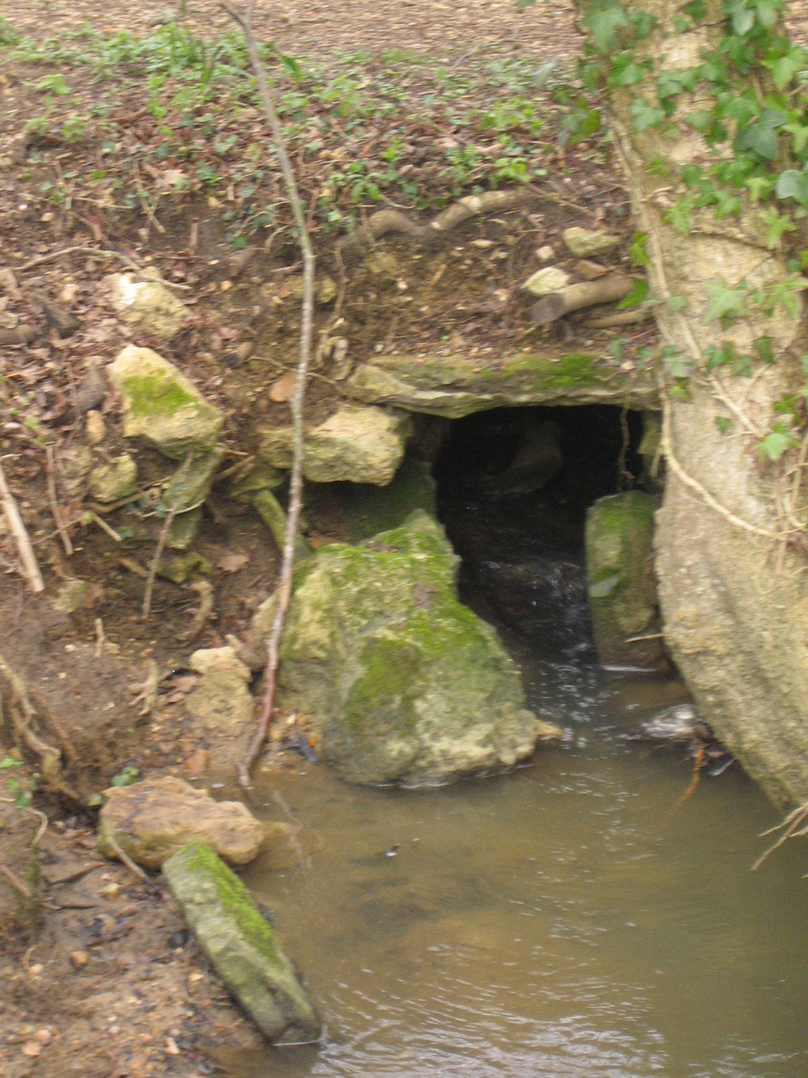
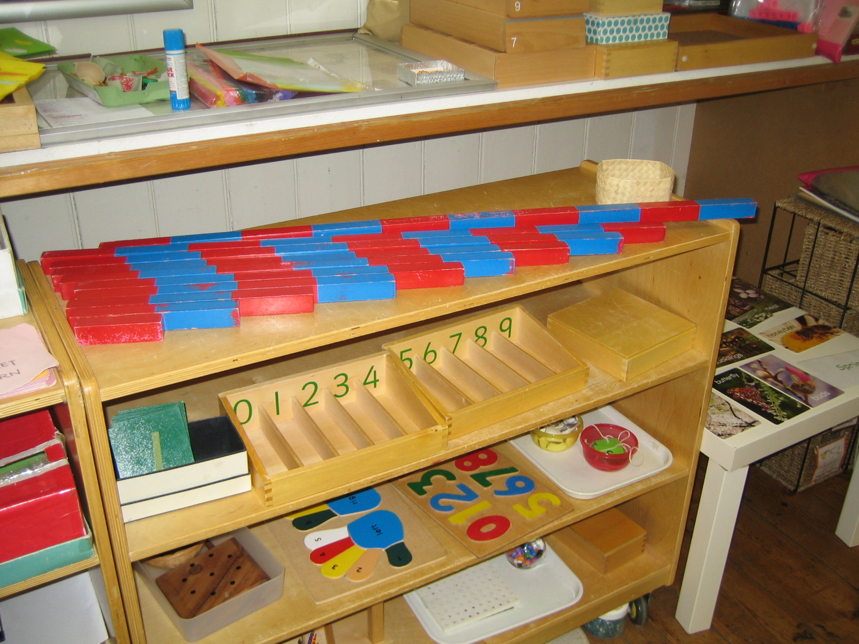
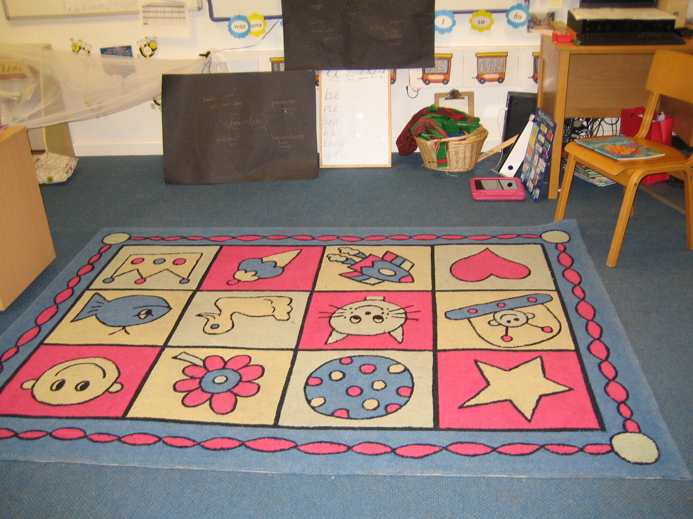
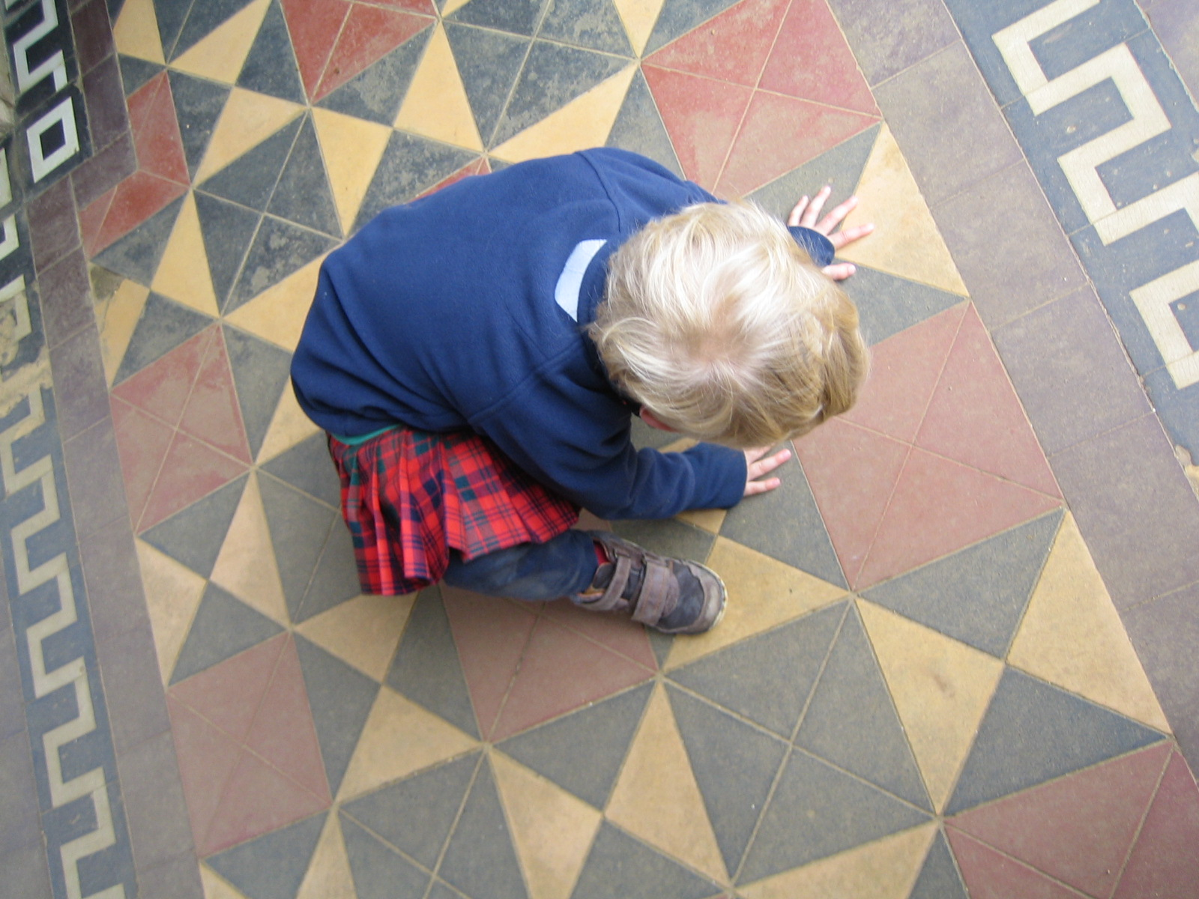
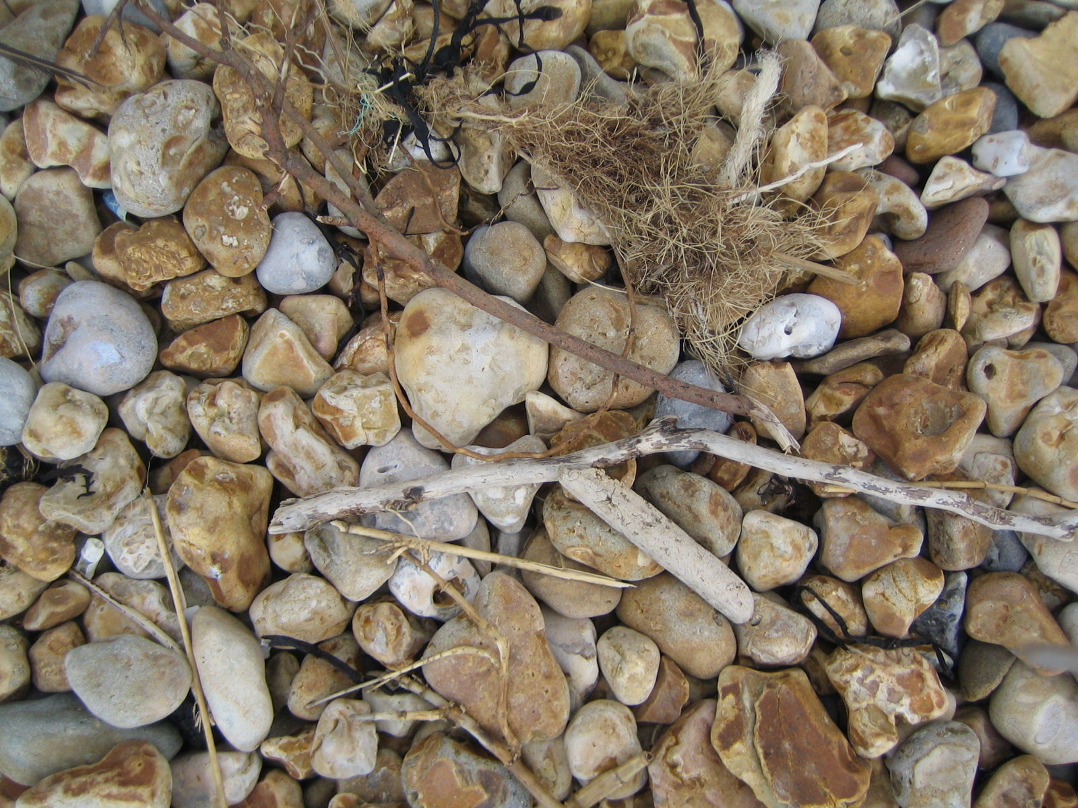
A more than human voice - Nikki

Slide 13
Activity
Think about a childhood memory and think about how to present this memory using the range of materials on offer (or not!)
You may wish to make, draw, build, record this. This could be on your own or in groups – the choice is yours.
You have15 minutes
Notes:
Nikki

Slide 14
Reflection
Why did you choose that particular medi(a)(um) to present your voice?
Please would you share one aspect about this session or the activity (presentation of the voice) with the wider group

Slide 15
Closing thoughts
How might you use what we have discussed today in your wider professional life (research or practice)...

Slide 16
References
Andrews, M. (2014) Narrative Imagination and Everyday Life. Oxford: Oxford University Press
Byrne, G. (2015) Narrative Enquiry and the Problem of Representation: ‘giving voice’, making meaning. International Journal of Research and Method in Education. 1-17
Bennett, L. (2016) ‘Thinking Like a Brick’ in C.A. Taylor and C. Hughes (eds.) Posthuman Research Practices in Education. London: Palgrave Macmillan.
Jackson, A. Y. and Mazzei, L. (2012) Thinking with Theory in qualitative Research. Viewing data across multiple perspectives. Abingdon: Routledge.
Lather, P. and St. Pierre, E. A. (2013) ‘Post-qualitative research’. International Journal of Qualitative Studies in Education. 26 (6): 629 – 633.
Mazzei, L. (2013) ‘A voice without organs: interviewing in posthumanist research’ International Journal of qualitative Studies in Education. 26(6), 732-740.
Mazzei, L. (2016) ‘Voice without a Subject’ Cultural Studies<>Critical Methodologies. 16(2), 151-161.
Taylor, C. A. and Hughes, C. (eds.) (2016) Posthuman Research Practices in Education. London: Palgrave Macmillan.
Weedon, C. (1997) Feminist Practice and Poststructuralist Theory. 2nd Edition. Oxford: Blackwell

Slide 17
Contact Details
Rob Abbott – r.abbot@chi.ac.uk,
Nikki Fairchild – n.fairchild@chi.ac.uk,
Sandra Lyndon – s.lyndon@chi.ac.uk,
Eva Mikuska – e.mikuska@chi.ac.uk
Senior Lecturers
Department of Childhood, Social Work and Social Care
University of Chichester,
College Lane,
Chichester,
West Sussex,
PO19 6PE.

