Slide 1
Motion – Perception – Motion: Dance & Mental States
Aska Sakuta
PhD in Dance Science

Slide 2
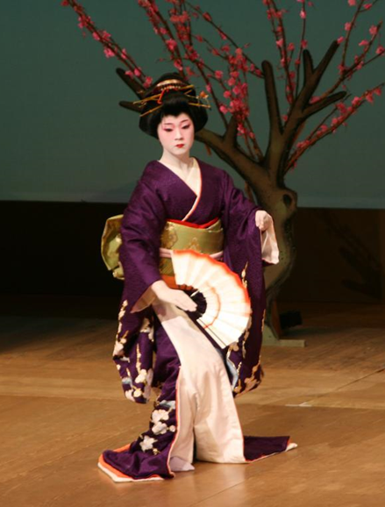
Japanese Training Philosophy
Japanese traditional performing arts
Training mind through body
Show “Hana”
Body motion
Mental growth
Presence…?

Slide 3
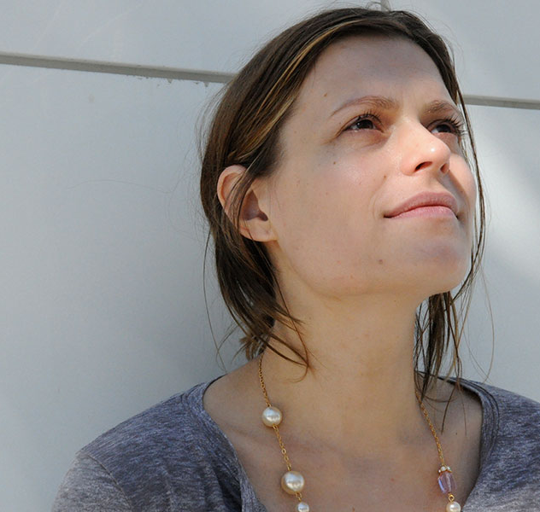
Embodied Cognition
“Be on top of
things”
“Head of organization”
“Facing the
future”
“Feeling down”

Slide 4
Eastern Meditation
Non-Judgmental self-awareness
‘Mindfulness’ & Meditation
High awareness to moment-to-moment experience
Extreme presence

Slide 5
‘Flow’ in Sports
‘Mindfulness’ = ‘Flow’ inducer in sport?
‘Flow’ = optimal skill performance & suppression of explicit system

Slide 6
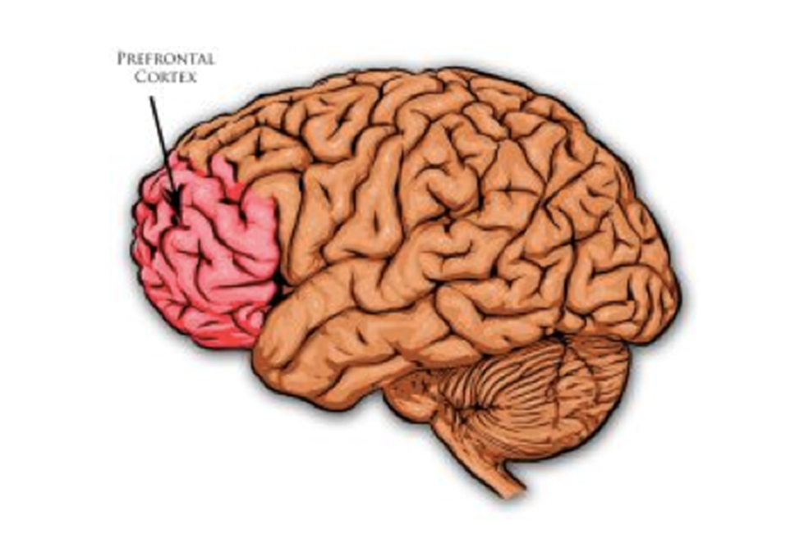
Neurology of ‘Self’
Feed-forward System in motor control
Mirror Neuron System
→ “Experiential-Self”
Prefrontal Cortex
“Narrative-Self”
Memory functions
→Short-term/procedural
→Declarative/semantic

Slide 7
Self-Less ‘Flow’
‘Mindful’ meditators enter loss of self- consciousness
“Self-Less” state
Foundation before “Experiential-Self”?
‘Flow’ = finer attunement to immediate present
Shut-down explicit mind
Suppression of Default Mode Network

Slide 8
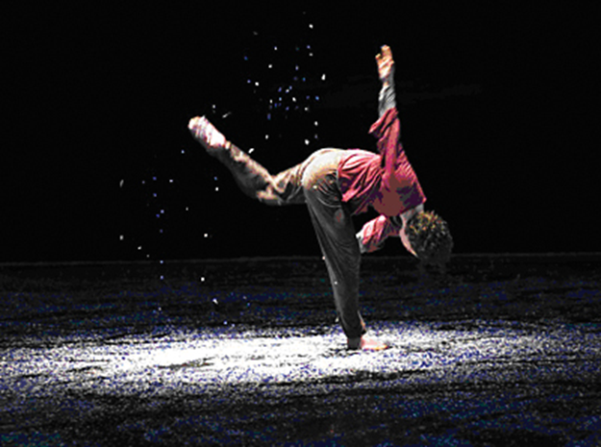
Further Questions & Research Plan
What is optimal skill performance in dance?
What is the science behind stage presence?
Can I measure “high-skill” in dance quantitatively?
Improvisation dance tasks
Digital motion tracking
Perception of stage-presence

Slide 9
List of References
Aherne, C., Moran, A., Lonsdale, C. (2011). The Effect of Mindfulness Training on Athletes’ Flow: An Initial Investigation. The Sport Psychologist, 25, 177-189.
Anderson, M. (2003). Embodied Cognition: A field Guide. Artificial Intelligence, 149, 91-130.
Carney, D., Cuddy, A., Yap, A., (2010). Power Posing: Brief Nonverbal Displays Affect Neuroendocrine Levels and Risk Tolerance. Psychological Science, 21(10), 1363-1368.
Christoff, K., Cosmelli, D., Legrand, D. Thompson, E. (2011). Specifying the Self for Cognitive Neuroscience. Trends in Cognitive Sciences, 15(3), 104-112.
Damasio, A., Carvalho, G. (2013). The Nature of Feelings: Evolutionary and Neurobiological Origins. Nature Reviews Neuroscience, 14, 143-152.
Dor-Ziderman, Y. Berkovich-Ohana, A., Glicksohn, J., Goldstein, A. (2013). Mindfulness-induced selflessness: a MEG Neurophenomenological Study. Frontiers in Human Neuroscience, 7, 1-17.
Farb, N., Segal, Z., Mayberg, H., Bean, J., McKeon, D., Fatima, Z., Anderson, A. (2007). Attending to the Present: Mindfulness Meditation Reveals Distinct Neural Modes of Self-reference. SCAN, 2, 313-322.
Iacoboni, M. (2009). Imitation, Empathy, and Mirror Neurons. Annual Review Psychology, 60, 653-670.
Knoblich, G., Flach, R. (2003). Action Identity: Evidence From Self-Recognition, Prediction, and Coordination. Consciousness and Cognition, 12, 620-632.
Mrazek, M., Smallwood, J., Schooler, J. (2012). Mindfulness and Mind-Wandering: Finding Convergence Through Opposing Constructs. Emotion (Online), 1, 1-7.
Murray, R., Debbane, M., Fox, P., Bzdok, D., Eickhoff, S. (2015). Functional Connectivity Mapping of Regions Associated with Self- and Other-Processing. Human Brain Mapping, 1, 1-21.
Punpeng, G. (2012). Meditation in Motion to Mindfulness in Performance: a Psychological Approach to Actor Training for Thai Undergraduate Drama Programmes (Unpublished doctoral dissertation). University of Exeter, Exeter.
Semple, R. (2010). Does Mindfulness Meditation Enhance Attention? A Randomized Controlled Trial. Mindfulness, 1, 121-130.
Spunt, R., Meyer, M., Lieberman, M. (2015). The Default Mode of Human Brain Function Primes the Intentional Stance. Journal of Cognitive Neuroscience, 27(6), 1116-1124.

